Slide 1


Road Construction Initiated Slides Awareness For Professionals
Notes:
In late 2014 CHAG and BCFSC noticed a trend of an increase in the number of landslides related to forestry road construction on the coast
Slides are costly to industry / environment/people.
There has been significant injuries / No fatalities
Operational and human/personal/environmental costs have been significant
Resulted in the formation of the Construction Initiated Slide Working Group (CISWG).

Slide 2
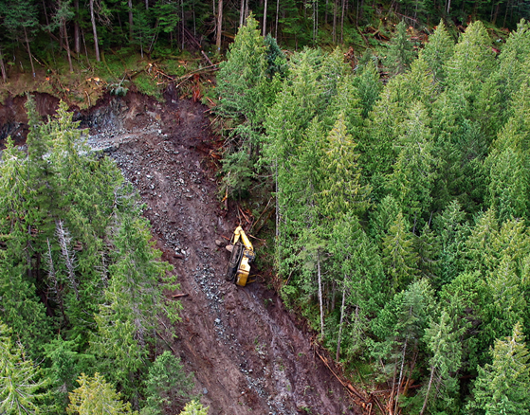
Introduction
Notes:
In late 2014 CHAG and BCFSC noticed a trend of an increase in the number of landslides related to forestry road construction on the coast
Slides are costly to industry / environment/people.
There has been significant injuries / No fatalities
Operational and human/personal/environmental costs have been significant
Resulted in the formation of the Construction Initiated Slide Working Group (CISWG).

Slide 3
Construction Initiated Slides Working Group
(CISWG)
Group Purpose:
Formed in 2015 to develop initiatives that support the elimination of landslide incidents during road construction activities on the coast.
Collection of professionals, industry and government representatives and road builders who are focused on improving coastal road construction.
Have developed short to medium term strategies to address quick wins. These include awareness sessions with road construction crews and professionals
Notes:
-Sponsored by CHAG
-Supported by BCFSC
-Focused group with support from Worksafe BC
-this presentation is one of several initiatives of the CISWG (operator awareness session, etc)

Slide 4
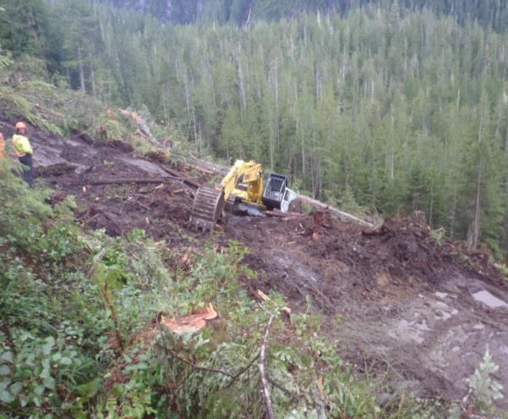
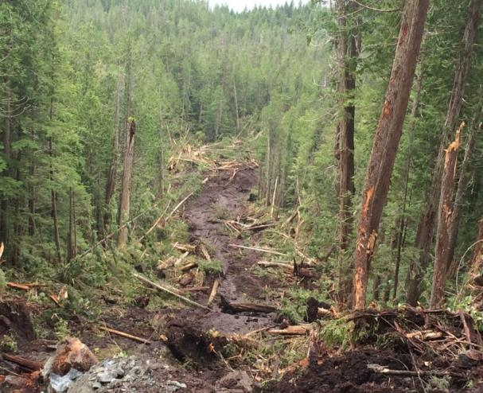
CIS Background
36 slides from 2012-2015
Many of these involved excavators sliding down slope
considerable human, environmental and operational costs
Notes:
Data was solicited from CHAG companies and associates to quantify the issue
Data set was solicited from CHAG members for the initial three year period, and is re-solicited and updated annually. Slide reports and professional post-slide assessments are used to determine the causes and group them into categories
No fatalities to date but significant injury to operators.
Operational costs can be substantial 200-500 K without any serious injuries, fatalities or critical environmental damage.
Add the potential costs of these other factors and overall costs could easily bankrupt a contractor.

Slide 5
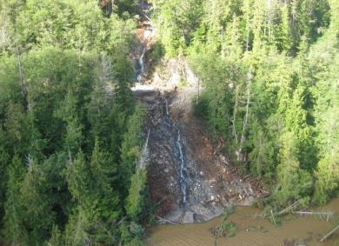
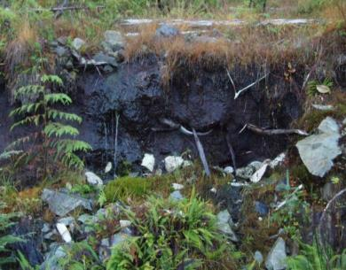
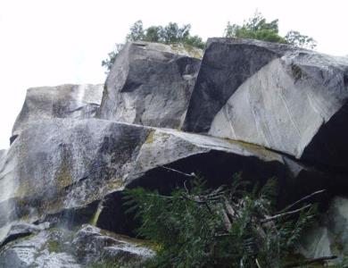
CIS Contributing Factors
  Water
  Soils
  Bedrock
  Planning
  Unknown conditions
  Production Pressure
  Weather
  Operator Competency
Notes:
Slides are occurring on Vancouver Island, South Coast, Haida Gwaii and central coast with a regularity that is unacceptable.
Factors that effect the risk of initiated slide event can range from environmental to operational.
There are many different factors to consider.
The goal is to try and understand them, recognize indicators and eliminate the events from occurring, thus eliminating fatalities, injuries, and damage, and promoting more effective business.
Finding: Operator experience plays a factor, young operators typically lack knowledge and seasoned operators can become complacent.
Finding: Unknowns/unidentified conditions relating to rock, soils, drainage are one of the largest factors until excavation begins.
Next we will review a few case studies as examples

Slide 6

Presentation Outline
Intro to Construction Initiated Slides Working Group (CISWG)
Contributing Factors to Construction Initiated Slides (CIS)
Review 2 Case Studies of landslides
General Safety
Regulations
Communications
The Plan
Final Design and Road Plan
Road Construction
Road Deactivation/Maintenance/Reactivation
Road Inspections
Technology
Conclusion

Slide 7
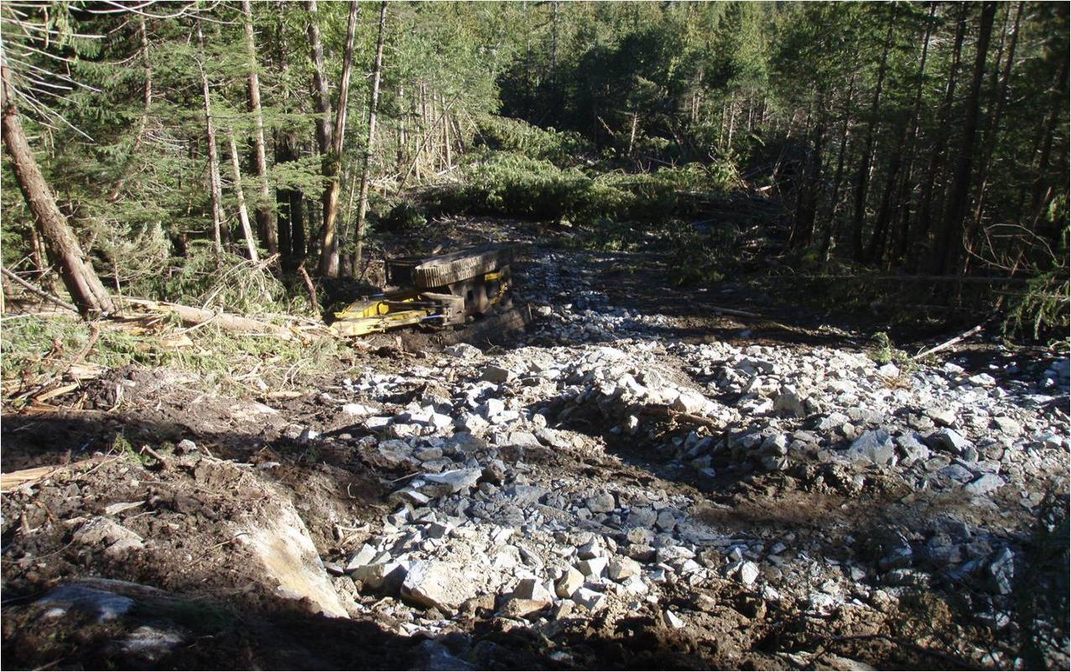
Case Study: Yeo Island
Excavator
Top of Landslide
Road Construction in Central Coast; dry summer conditions
Notes:
Operator was entering endhaul transition zone in moderately steep ground
Encountered a pocket of subsurface water and deep, wet organics that were not identified on plan
Excavator and operator moved out onto wet organics over bedrock rather than removing organics down to competent bedrock.
Operator did not stop and seek clarity or advice on the plan or the changed conditions
Key Factor: Hoe not on stable footing through Transition Zone.

Slide 8
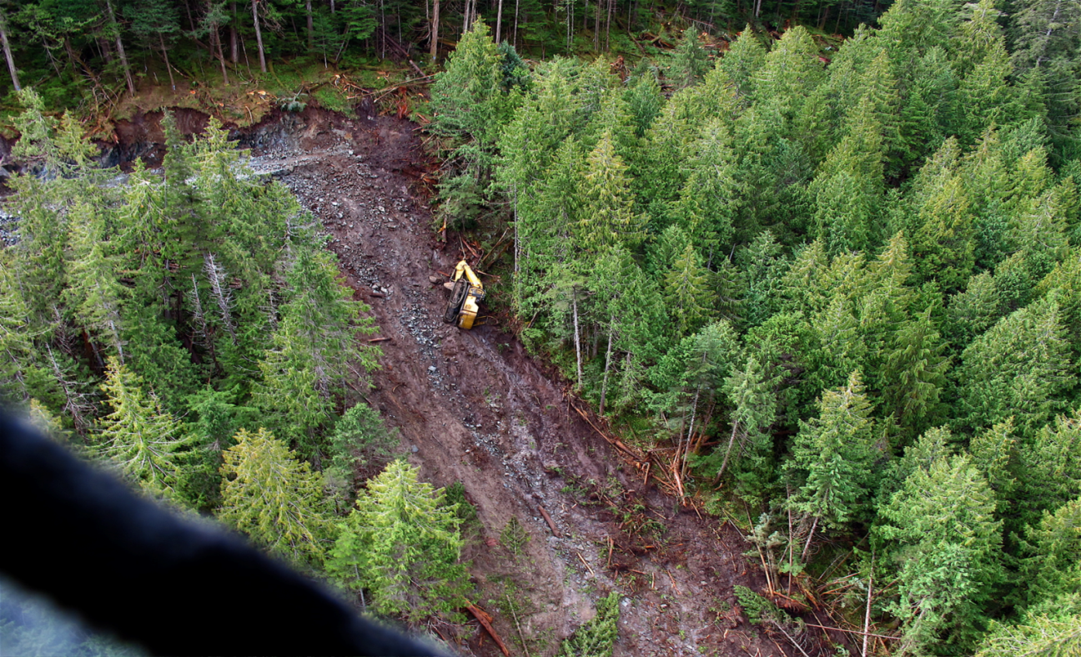
Yeo Island
Result: Expensive, dangerous and potentially avoidable landslide.
Notes:
Construction was shut down for 6 days.
Professional Geoscientists, WorkSafeBC investigators and company reps were flown in and out to inspect and develop a plan.
A tote road was needed to recover the machine.

Slide 9
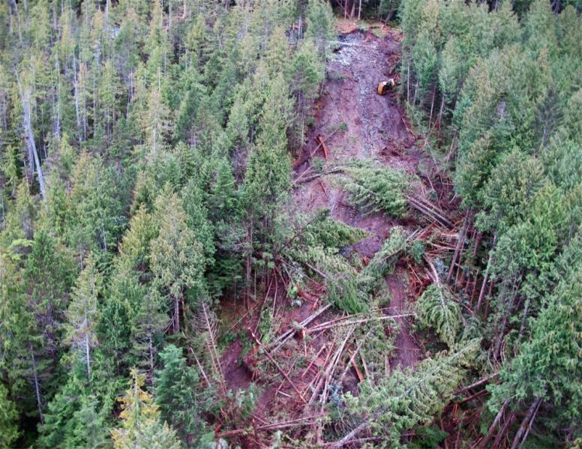
Yeo Island
Monetary costs:
$27,000 to repair excavator
$48,000 in lost production (6 day shutdown x $8,000/day)
$32,000 in transportation costs (crew, investigators, professionals)
$16,500 in other professional and administrative costs
$26,000 to build tote road to recover excavator
Lost harvest opportunity – gross value $400,000
Total direct cost of this landslide: $549,500 plus human/ environmental impact
Notes:
The operator was not physically injured, but was unable to continue operating an excavator for some time.
No charges or penalties were issued, but the contractor’s reputation may have been negatively impacted.

Slide 10
Yeo Island
Possible Key Factor: Hoe not on stable footing through Transition Zone
List of CIS contributing factors:
  Water
  Soils
  Bedrock
  Planning
  Unknowns
  Production
  Weather
  Operator Experience
Notes:
Group to discuss which of the contributing factors likely played a role
Main message: there can be many different contributing factors. Not always one factor

Slide 11
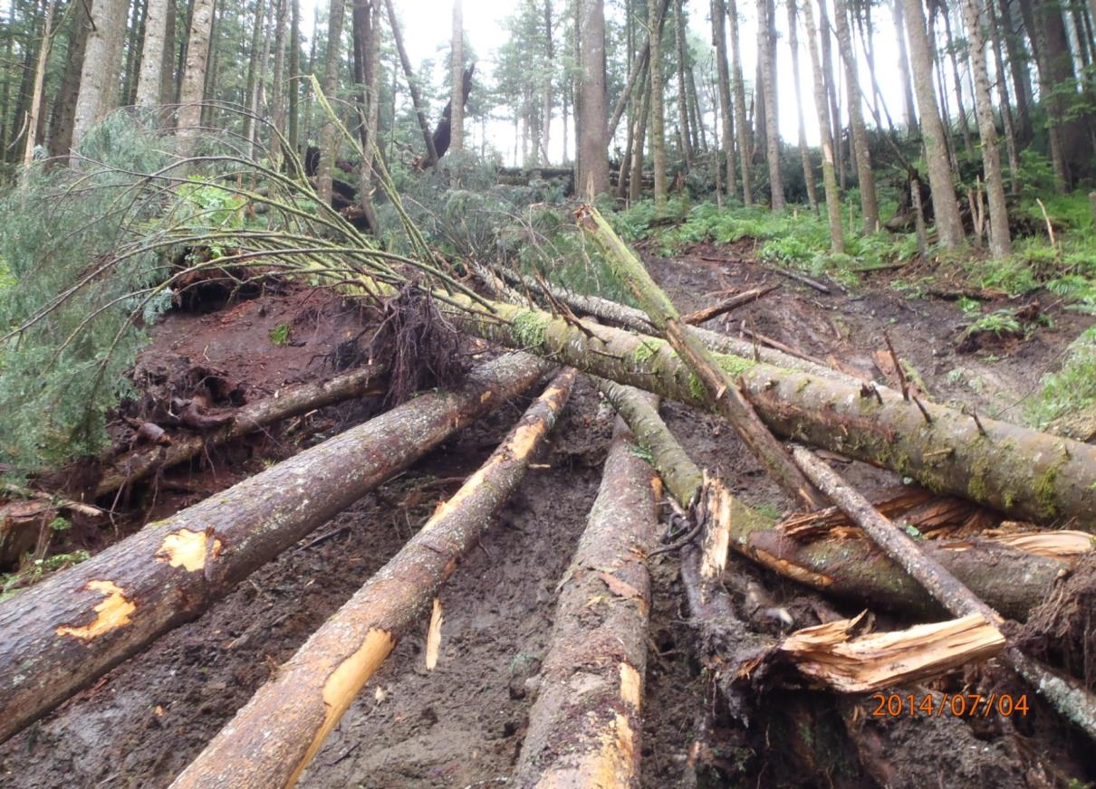
Case Study: Holberg
Road construction project: Vancouver Island during July (dry conditions).
Notes:
Operator was working in “conventional construction” section, transitioning out of endhaul.
Slopes were 50-55%.
Operator noticed deepening, wet organics in the transition section.
Operator paused and asked for a reassessment of the plan for this section.
On the operator’s advice, the centerline was moved into the bank and additional endhaul was approved, even at increased cost.

Slide 12
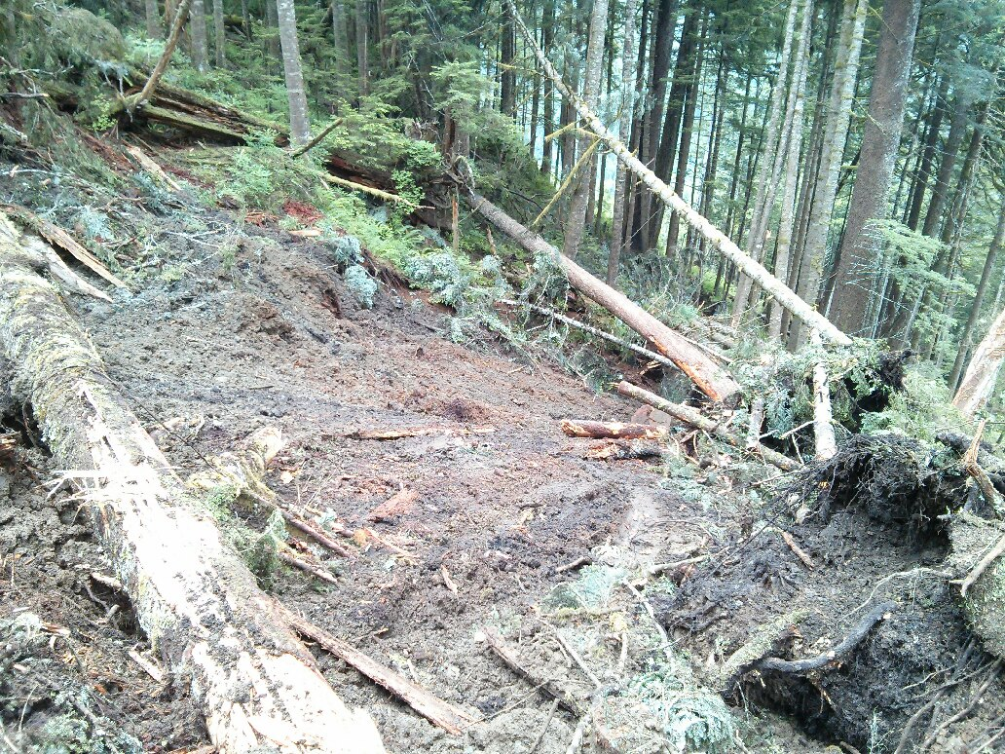
Holberg
Slide still occurred despite dry conditions.
Notes:
It was much less significant than what could have occurred if the centerline was not moved and additional endhaul was not prescribed and approved.
No equipment or personnel were involved in the slide, likely because of the proactive approach taken by the operator.
Environmental damage and loss of timber was minimized, as the slide was medium in size (estimated .25 hectares in size).
Cleanup and reassessment was minimal due to the medium size of the slide.
The contractor was able to return to work quickly, reducing lost $$.
NO ONE WAS INJURED!
Key Factor. Stop and seek supervisory or professional input.

Slide 13
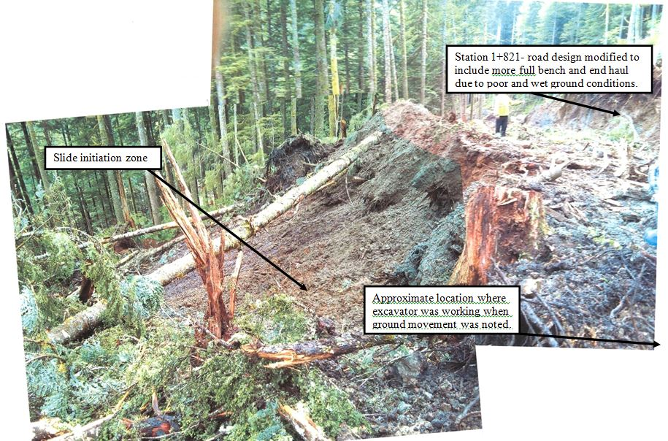
Holberg
Notes:
This slide shows the initiation zone in relation to where the excavator was working. Demonstrates how close the operator came to taking a ride downhill.

Slide 14
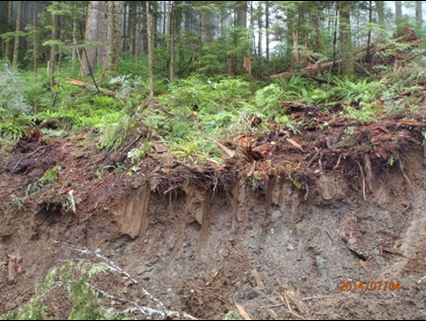
Holberg
Notes:
This picture demonstrates that although there had been some recent rainfall, the post-slide assessment concluded that it was not associated with recent rainfall; this site was likely always wet. Adjacent ground soils were dry.
Discuss rainfall interpretation/collection. When to dump the rain gage? What decisions did the crew make?

Slide 15
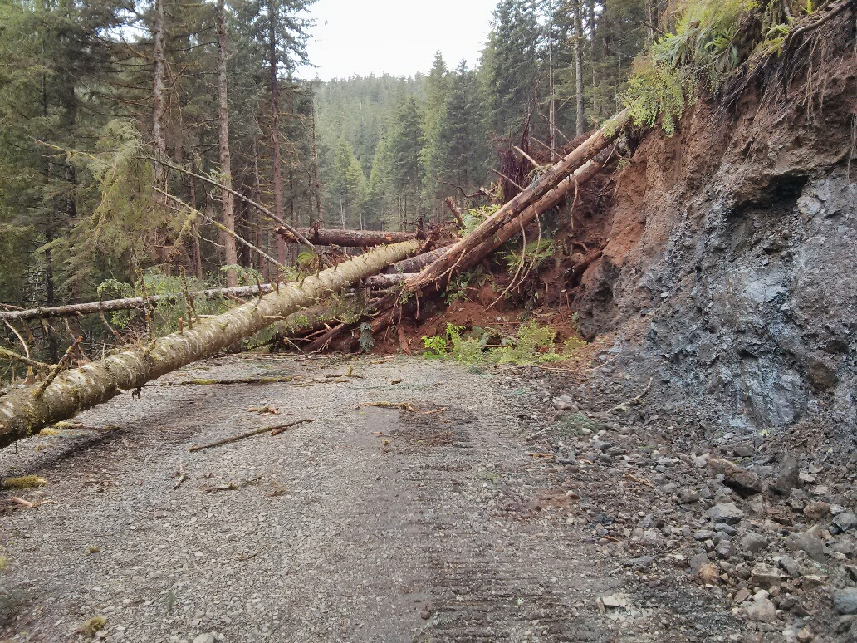
Holberg
Notes:
This slide demonstrates other consequences and risks. Crews were travelling on this road each day to access the road construction project
The crew was temporarily stuck behind this debris. Digging themselves out could have created other stability issues
Remember to consider this in planning stage.

Slide 16
Case Study Review
Has your organization had similar incidents ?
What could have been done to prevent them?
What is your professional role?
Notes:
-As professionals, we need to take ownership of our decisions and sometimes challenge the status quo, always driving towards a safer environment for all workers
-Safety is a business process- discuss this (help Tom J)
-

Slide 17

General Safety
Recognize the risk
Assess the situation – stop to think
Develop a safe solution
Act safely to fix the problem
Report and record the upset condition
Heads up and have a plan
Notes:
Safety of all personnel is paramount. Everyone can be a positive or negative influence on the safety culture, what you say is important, but how you say it is more of the communication, don’t say it unless you mean it. If you mean it, you may not even need to say it, people will know---just ask yourself do I want anyone to get hurt, do I want the project to suffer unnecessary delay. Think about the influence you have on the crew and the overall team.
If your focus tells everyone what is important , make sure your focused on the right stuff so your not the hazard.
Make sure everyone on the team knows how important it is to not create hazards for others, over blast, debris cast, of or decks of wood perched on steep slopes create hazards for others, don’t be the cause of someone elses hazard!
Heads up and use your radar and your team
Interruption to construction activities is always a difficult call, but if conditions look questionable for any reason it is imperative that appropriate action is taken.
This may include reassigning of personnel/equipment/activities or work stoppage.
The cost of not making the right call can be substantial and potentially catastrophic.
There is no road that is worth having workers seriously injured or worse.

Slide 18
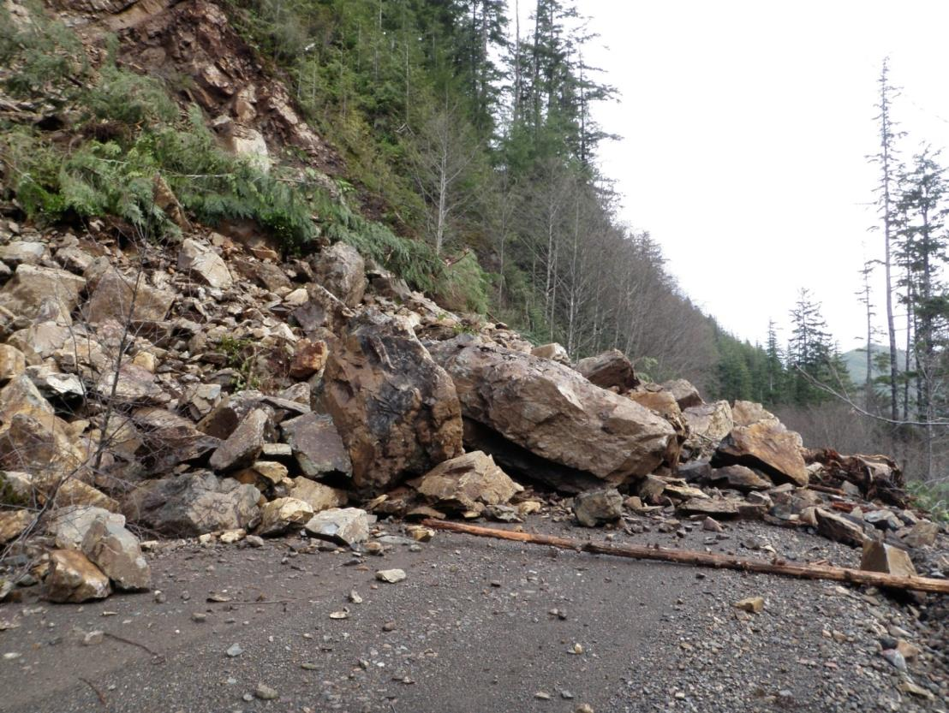
General Safety
Rock Slide onto Mainline
Consider your safety and that of others
Notes:
-Be very aware of other phases of harvesting , what hazards you may be creating for others.

Slide 19
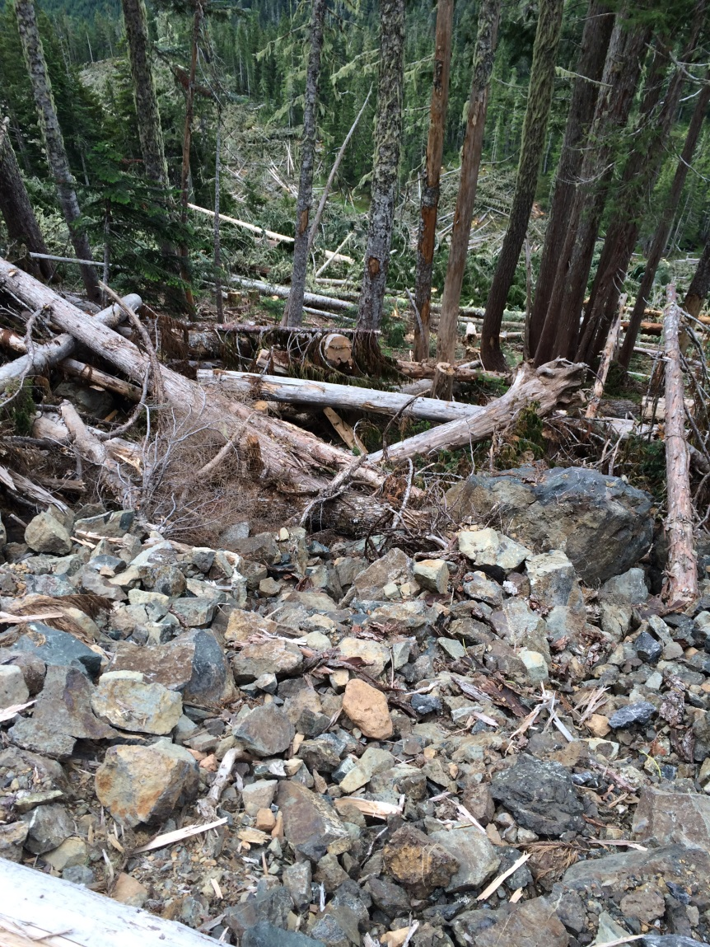
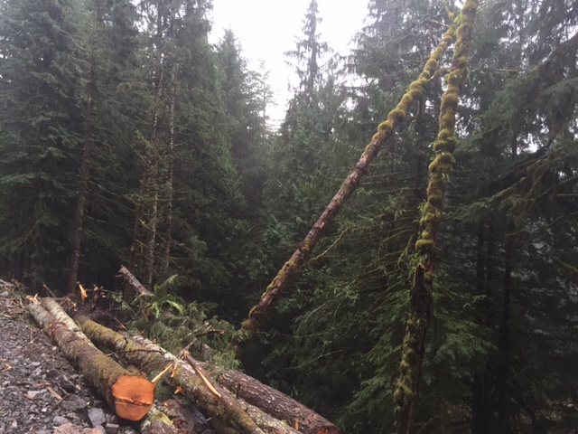
General Safety
Don’t create hazards for others
Notes:
Communication is critical, but it can be what is said and not said.
Report hazards, have you created an atmosphere where it is ok to do this
Pass all information and knowledge on to other members of the crew, particularly between shifts and phases.
Very important to consider the other phases of harvesting, and how a landsilde can create hazards for other workers immediately and in the future

Slide 20

General Safety
Notes:
The Swiss cheese model illustrates that, although many layers of defense lie between hazards and accidents, there are flaws in each layer that, if aligned, can allow the accident to occur.
How would this relate to road construction and landslides? (equip failure, unknown ground types, poor safety briefing, operator inexperience, etc. All are addressed as business processes, but all have potential holes. If the holes align, losses can occur.)

Slide 21
General Safety
Key Discussion Points
How well does your organization address
personal safety issues ?
How could this be improved ?
What is your role as a professional ?
Notes:
Good time for engagement of room
Who knows someone who has died in the forest industry? Make it personal; challenge the room at this point to take the lead; be the change , not the status quo.

Slide 22
Regulations and Responsibilities
WSBC Act Division 3 General Duties of Employer, Workers and Others
  Employers/Workers/Supervisors/Multiple Employers/Owner etc.
WSBC OHS Regulations Excavations (20.78-20.101)
WSBC OHS Regulations Planning and conducting a forestry operation (26.2)
WSBC OHS Guidelines (G26.18) for Regulation Part 26 (26.18) Acceptable standards for landslide risk assessments
WSBC OHS Regulation Part 26 (26.80) Creating additional hazards
Notes:
Employer must ensure health and safety of all workers all the workplace
This is done through building a team to complete assessments, work plans and hiring qualified construction crews.
Guidelines are established for professionals completing the assessments and plans to protect worker safety and establish expected due diligence through construction.
26.80 - Road or skid trail construction, including any blasting activity, must be carried out in a manner that prevents hang-ups, hanging broken tops or limbs, leaners, sidebind of pushed trees, or similar hazards which could endanger fallers or other workers.

Slide 23


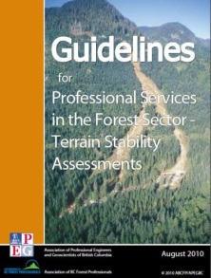

Regulations and Responsibilities
  Professional Practice (ABCFP/APEGBC JPB Guidelines)
  Management of Terrain Stability in the Forest Sector
  Professional Services in the Forest Sector – Forest Roads
  Professional Services in the Forest Sector – Crossings
  Professional Services in the Forest Sector – Terrain Stability Assessments.
Notes:
Employer must ensure health and safety of all workers all the workplace
This is done through building a team to completing assessments, work plans and hiring qualified construction crews.
Guidelines are established for professionals completing the assessments and plans to protect worker safety and establish expected due diligence through construction.
Professional responsibility. Show leadership-find solutions. The alternative: fatality or injury. Is this acceptable to you??
Think of safety as a business process.

Slide 24

Communication

Slide 25
What is communication?
Two-way process of reaching mutual understanding
exchange of information, news, ideas and feelings
An organization cannot operate without communication between levels, departments, and employees.
Notes:
-key in on “two-way”. Discussed more later in this section (active listening).
-”cannot operate” is critical. Speaks to business process and safety. Poor communication can result in losses, including monetary, human, environmental, etc.

Slide 26
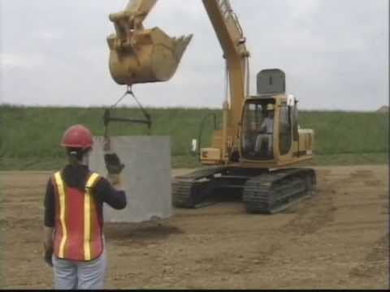
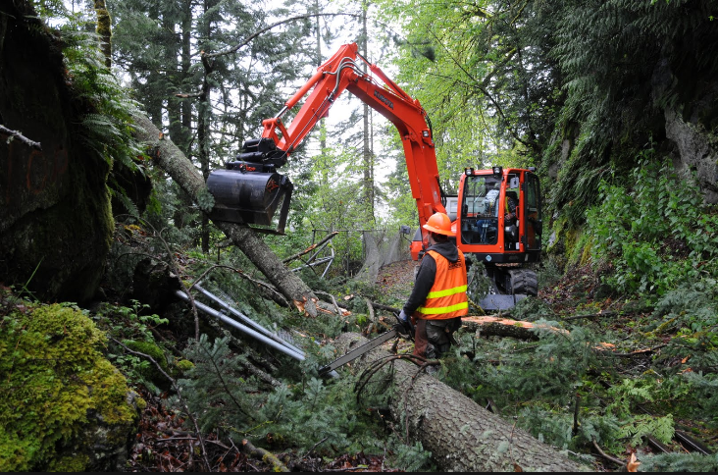
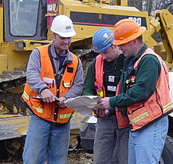
Communication
Pre-work meetings
Daily safety briefings
Planning meetings
During and after operations
All day, every day
Notes:
Communication has many forms, including:
Verbal
Written
Visual (like this presentation)
Individual
Group
Example: Hand signals- used alot between excavators and ground crews; know and understand them before works starts.
for challenging projects or sections, perhaps you might consider an extra field visit to verify the plan and confirm the messaging that will be given at the pre-work

Slide 27

Communication
Must be :
Effective and timely
Inclusive
Open and honest
Respectful
Listen, understand and contribute
Notes:
-treat all workers as professionals with valuable input and feedback.
-be an active listener.
-Be open to providing and receiving information, and treating all feedback with due professional respect.

Slide 28
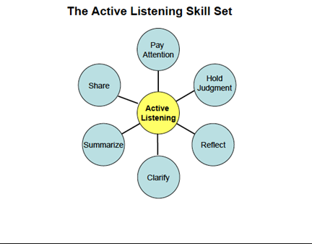
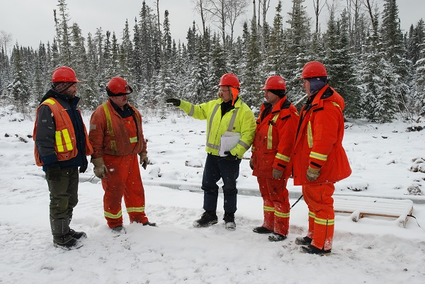
Communication
Show leadership! Foster a culture of open and honest communication.
Ask for opinions
Listen to everyone
Adjust accordingly
Don’t minimise concerns
Notes:
Allow everyone the opportunity to communicate in different ways. Some people might not speak up in a group, but may be more apt to raise concerns, questions or ideas one on one.
Allow many opportunities for everyone to communicate throughout all phases of the project, and every day.

Slide 29
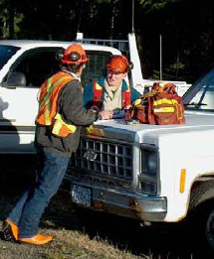
Communication
Do some follow up:
What went well?
What went poorly?
How could it be better next time?
Close the loop between the project planner/designer and the project implementers, and all phases in between.
Learn from the feedback and adjust going forward.
Notes:
Use this knowledge to improve performance and results.
Ensure that professionally, we are closing the loop and providing feedback.
If you are a professional that receives feedback from any one at any level, never disregard it.

Slide 30
Communication
Effective communication is a professional obligation, per APEG and ABCFP guidelines
Effective and timely communication among all team members is important in order to meet the objectives of the project.
Notes:
This includes:
informing the owner of the operation of the steps required in order for a member to be responsible for the constructed works;
maintaining communication with the owner of the operation and among other team members.
coordinating specific tasks including field layout, specialist assessments, surveys and design.
Receiving feedback and adjusting accordingly (continuous inprovement)

Slide 31

Communication
During a road project, when do you ask for help or advice?
Do you understand your professional “scope”?
Do things look very different from the plan?
  Is there water where it wasn’t expected?
  Does the ground type differ greatly from what is in the prescription?
  Are you seeing instability indicators?
Does something just not seem right?
Notes:
Interactive slide if it fits the room. Ask the group to speak to the questions.
Don’t wait until its too late to ask for help. If you are unsure, it’s probably a good indicator that you should be asking for help.
If you are asked to provide clarity, do so in a respectful manner, and be thankful that someone took the time to stop and ask for help. It’s not always easy to ask for help. It can be humiliating, and its up to all of us to foster a culture that promotes open communications up and down and doesn’t make people feel humiliated or minimized.
If the plan needs to be changed ,ensure the correct professionals are consulted

Slide 32
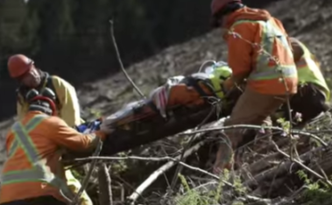
Communication
Don’t put yourself in a position where you “wish you would have asked, or spoken up…”
Think of how you would feel if an incident or injury occurred that may have been avoidable if there was better communication.
Notes:
-you have to go home each night and live with your decisions. Make sure you can do that. No regrets.

Slide 33
Communication Summary
Communications is the two way transfer and understanding of information
Communications occur in many forms and frequencies
Effective Communication is a professional obligation
Must me timely, inclusive, respectful and honest
Show leadership in fostering a culture of open, respectful communication
Be an active listener
Communicate your feedback and close the loop (Continuous Improvement)
If things don’t seem right, communicate! Saying or doing nothing is not an option.
Notes:
-you have to go home each night and live with your decisions. Make sure you can do that. No regrets.

Slide 34
The Plan!

Slide 35
The Plan!
Typical Process
Road Planning
Field Review; Engineering and Geotechnical Surveys
Final Road Plan and Design
Road Construction Pre-work
Road Construction Phases
Road Construction As Built Review
Notes:
There is typically a very comprehensive process involved with road planning and development.
The planning process is to ensure the construction meets the objectives of the overall timber development plan and that road design and safety is maintained throughout the process.
Integral to the planning and development process are key individuals and organizations.
These include the licensee staff, government agencies, contractors, and professionals/specialists (i.e. PGeo, PEng, RPF, RFT etc.).
All these individuals are part of a team who are responsible to ensure the development work goes according to plan and is done in a safe and effective manner.
Contractors/Operators are typically very knowledgeable and have developed skill sets regarding road construction.
This knowledge and skill is critical in terms of both team participation and slide prevention.
Applies to reactivation and deactivation as well.

Slide 36
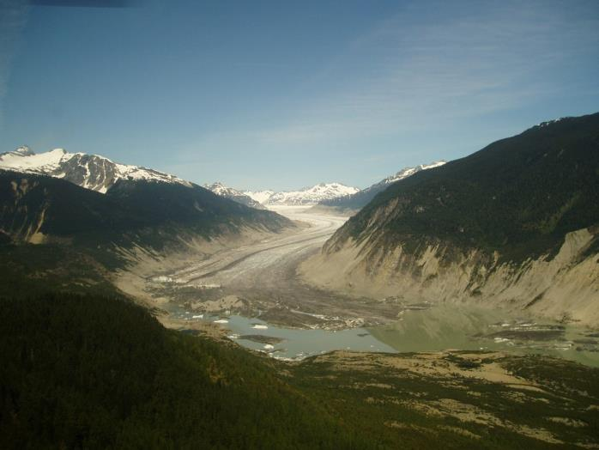
The Plan!
Pre Field Planning
Determine Objectives
  Mainline/long term road versus spurs/short term
  Other users (e.g. First Nation’s, Hydro, Tourism…)
  Timing of activities (season, markets, contractors)
Notes:
Ensure road location addresses present and future plans and operational requirements.
If areas are noted that cause concern look at identifying optional routes for future field verification.
Depending on the circumstances alternative harvesting methods may have to be considered at the planning stage if road location, operational constraints and safety requirements do meet development objectives.

Slide 37
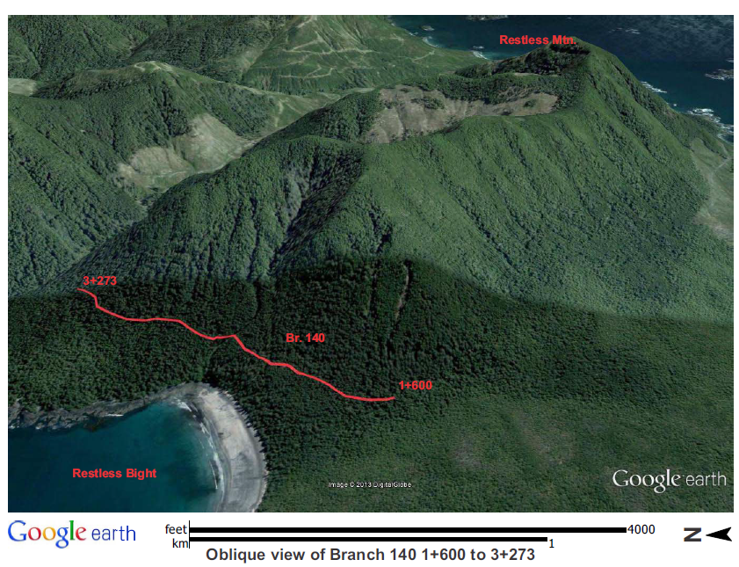
The Plan!
Pre Field Planning
Review existing information including adjacent terrain
  Reports and Assessments
  Maps, Google EarthTM, Lidar, air photos, ortho imagery
  Previous Development
Notes:
Existing Higher Level Plans, Watershed Assessments, Terrain Classification, Biodiversity, Fish Habitat
Largely done by Planning Department; Coordinating Member (CM) or Coordinating Registered Professional (CRP)

Slide 38
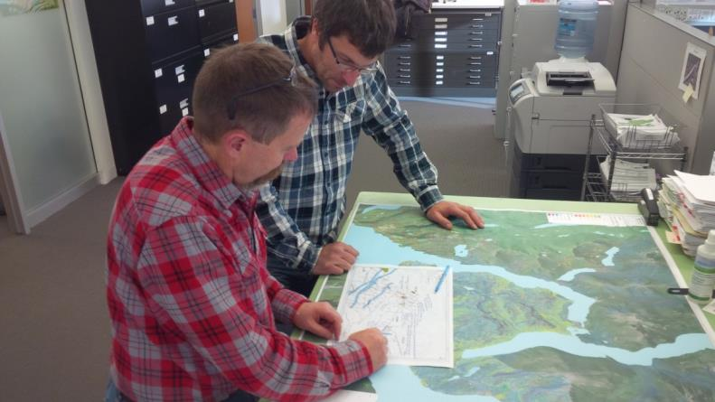
The Plan!
Pre Field Planning
Utilize local knowledge and get information on:
  Slope instabilities
  Rock hardness and formations
  Past issues with construction
  Weather as it relates to construction and drainage
  Post Harvest concerns
Notes:
Coordinating Member (CM) or Coordinating Registered Professional (CRP)

Slide 39
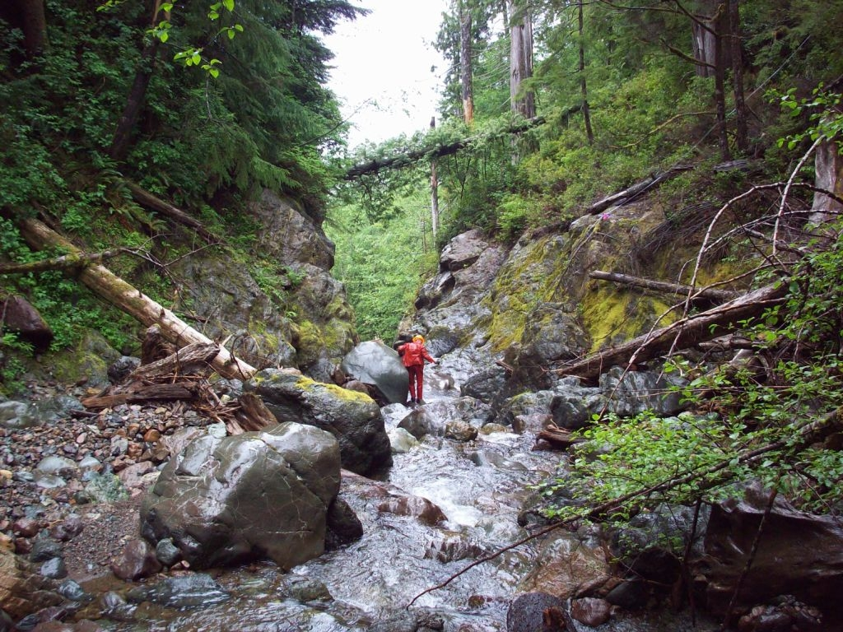
The Plan!
Field Recce/Layout and Options
Notes:
Directed by Coordinating Member (CM) or Coordinating Registered Professional (CRP)….but maybe not …i.e. BCTS

Slide 40
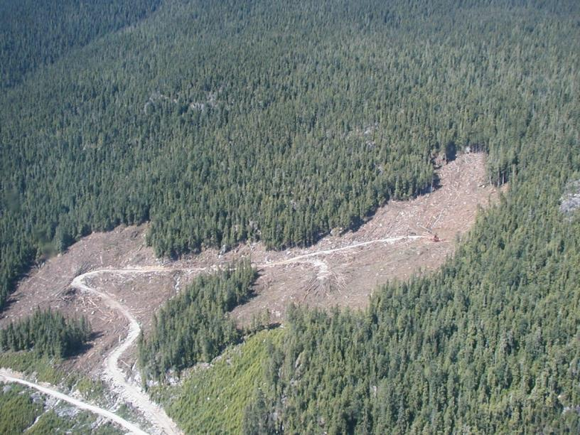
The Plan!
Field Recce/Layout and Options
(New construction, Reconstruction, Maintenance and Deactivation)
Reconnaissance work is critical
  Don’t find a quick route and assume it is the best option
  Find all the critical control points
  Remember rock is stable and is usually a benefit
Notes:
Options for road dictated by control points. Know where the control points are and why.
Were areas of concern noted and investigated.
Was the grade line run/know the grade.
Is the proposed road location in the right spot to align itself with critical areas.
What options exist and do they meet the goal of safe, efficient and effective development.
Are pre-layout surveys required? (i.e. terrain, riparian)

Slide 41
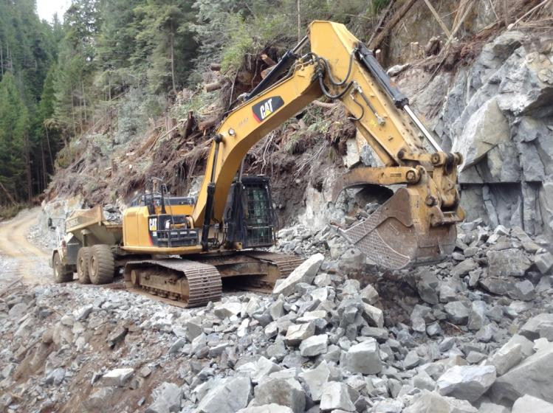
The Plan!
Field Recce/Layout and Options
While in the field be observant and take notes
  Identify terrain hazards as well as other safety concerns
  Determine (quantify) impacts and consequences
  Communicate mitigation options
Gather the details to ensure a safe and efficient construction plan
Notes:
Options for road dictated by control points. Know where the control points are and why.
Were areas of concern noted and investigated? direct terrain professionals to these areas
Was the grade line run/know the grade.
Is the proposed road location in the right spot to align itself with critical areas.
What options exist and do they meet the goal of safe, efficient and effective development. Do they meet or exceed Worksafe standards?
Layout crews and Terrain Specialists reporting to Coordinating Member (CM) or Coordinating Registered Professional (CRP)

Slide 42
PLANNING
– KEY MESSAGES
Road locations address present & future plans, operational and legislated requirements
Road plans examine all options
Field observations and data collection includes ground conditions and potential hazards and risks

Slide 43
Soils and Terrain

Slide 44
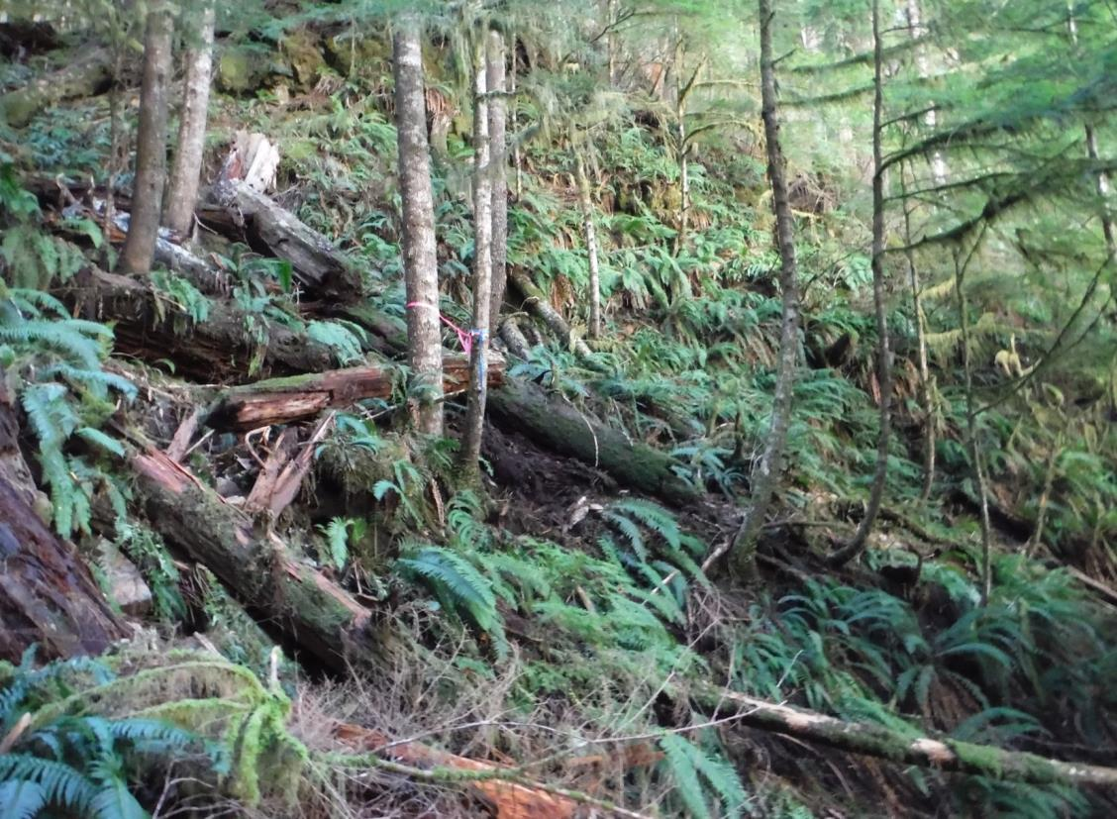
Soils and Terrain
Note pistol-butted trees,
deer fern & soil parting
Be aware of areas that hold moisture!
Notes:
Areas of subsurface and overland seepage often contain organic soils and excess water, which promote unstable slopes.
This can determine appropriate construction methods and the level of drainage control measures required.
Excessive water, heavy fern cover, devil’s club, salmon berry or swayed, pistol-butted or jack-strawed trees etc.
Sometimes these areas are more visible after R/W felling and the field team does not always catch them during the field work.
Given this operators are a second set of eyes and are very important in this process. Let them know this.

Slide 45
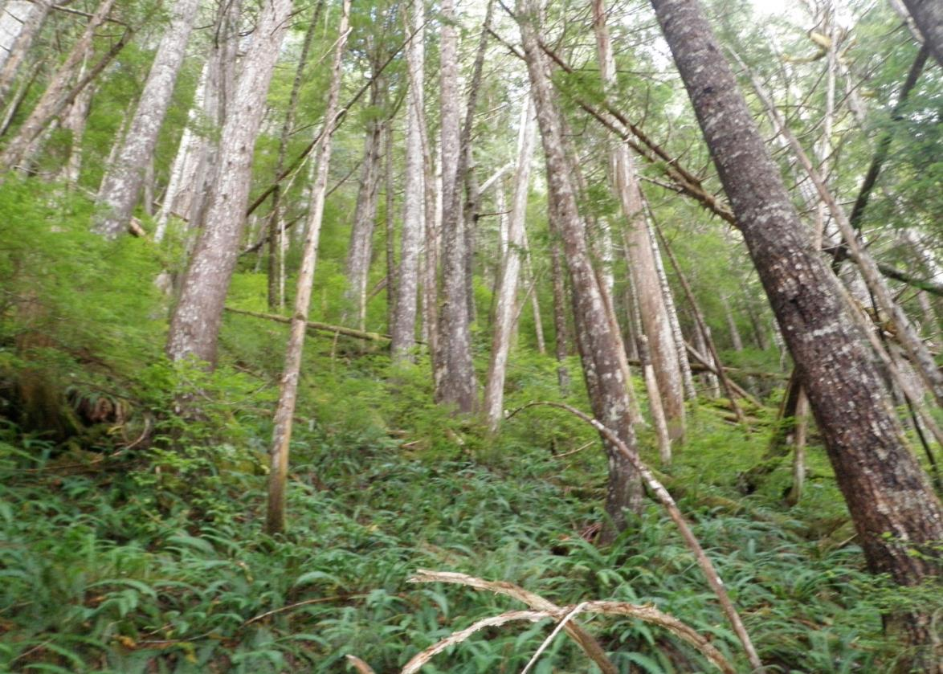
Soils and Terrain
Seepage/wet soils/ deformed trees
Notes:
Leaning, jack-strawed & pistol-butted trees often indicate potential soil instability which can also be associated with subsurface and overland water flow
Especially when in combination with wet site indicators such as:
Heavy fern cover, skunk cabbage, salmon berry, devil’s club, etc.

Slide 46
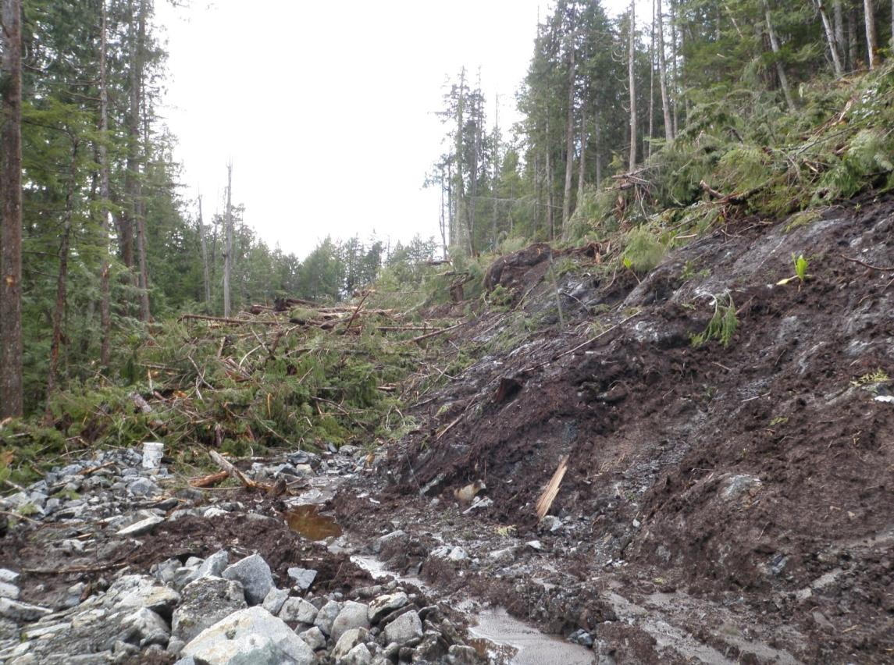
Soils and Terrain
Organics over bedrock; ponded water
Notes:
Combine water with organic soils or compact soils and steep slopes and we have a high hazard.
This a prime location (likely transitioning from steep terrain to a bench) for the potential to sneak ahead which can result in triggering slide events.
All organics and saturated soils must be stripped down to bedrock or competent mineral soil from the top of the cutslope to the toe of the fillslope, prior to placement of structural fills (load bearing).

Slide 47
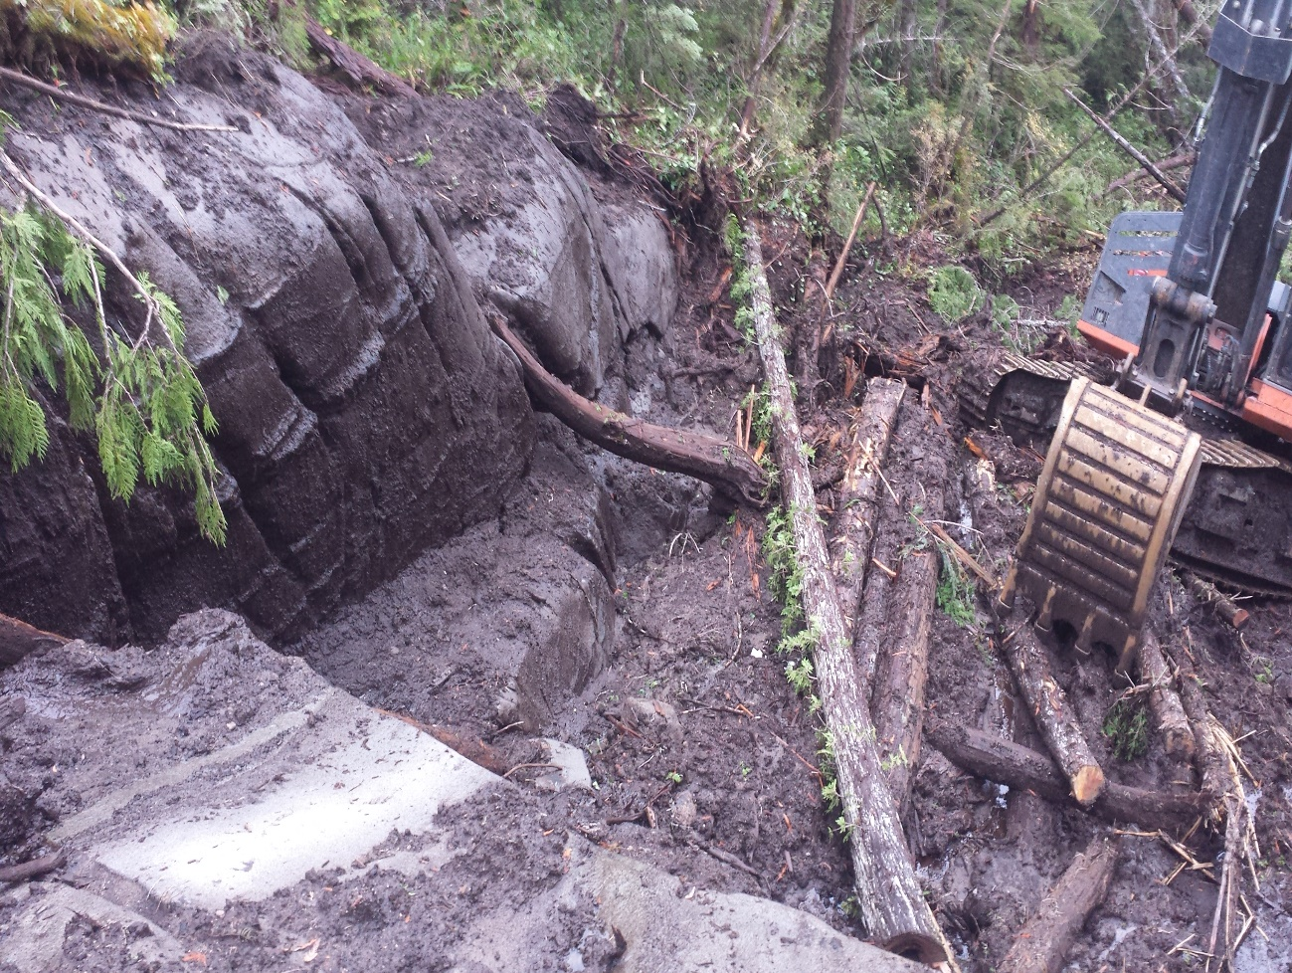
Sediment layers and organic accumulations are commonly greater in draw features and may store significant amounts of water:
Soils and Terrain
Remember:
1 bucket of mud
mixed with 5 buckets
of gravel or sand
= 6 buckets of mud
Notes:
Attention to DRAINAGE and appropriate GRUBBING, STRIPPING and SPOIL PLACEMENT is critical.
Operators must Ensure machine is on stable ground.
Plans may have assumed more rock than exists at the site –
Therefore more end haul may be required. Stop and reassess.

Slide 48
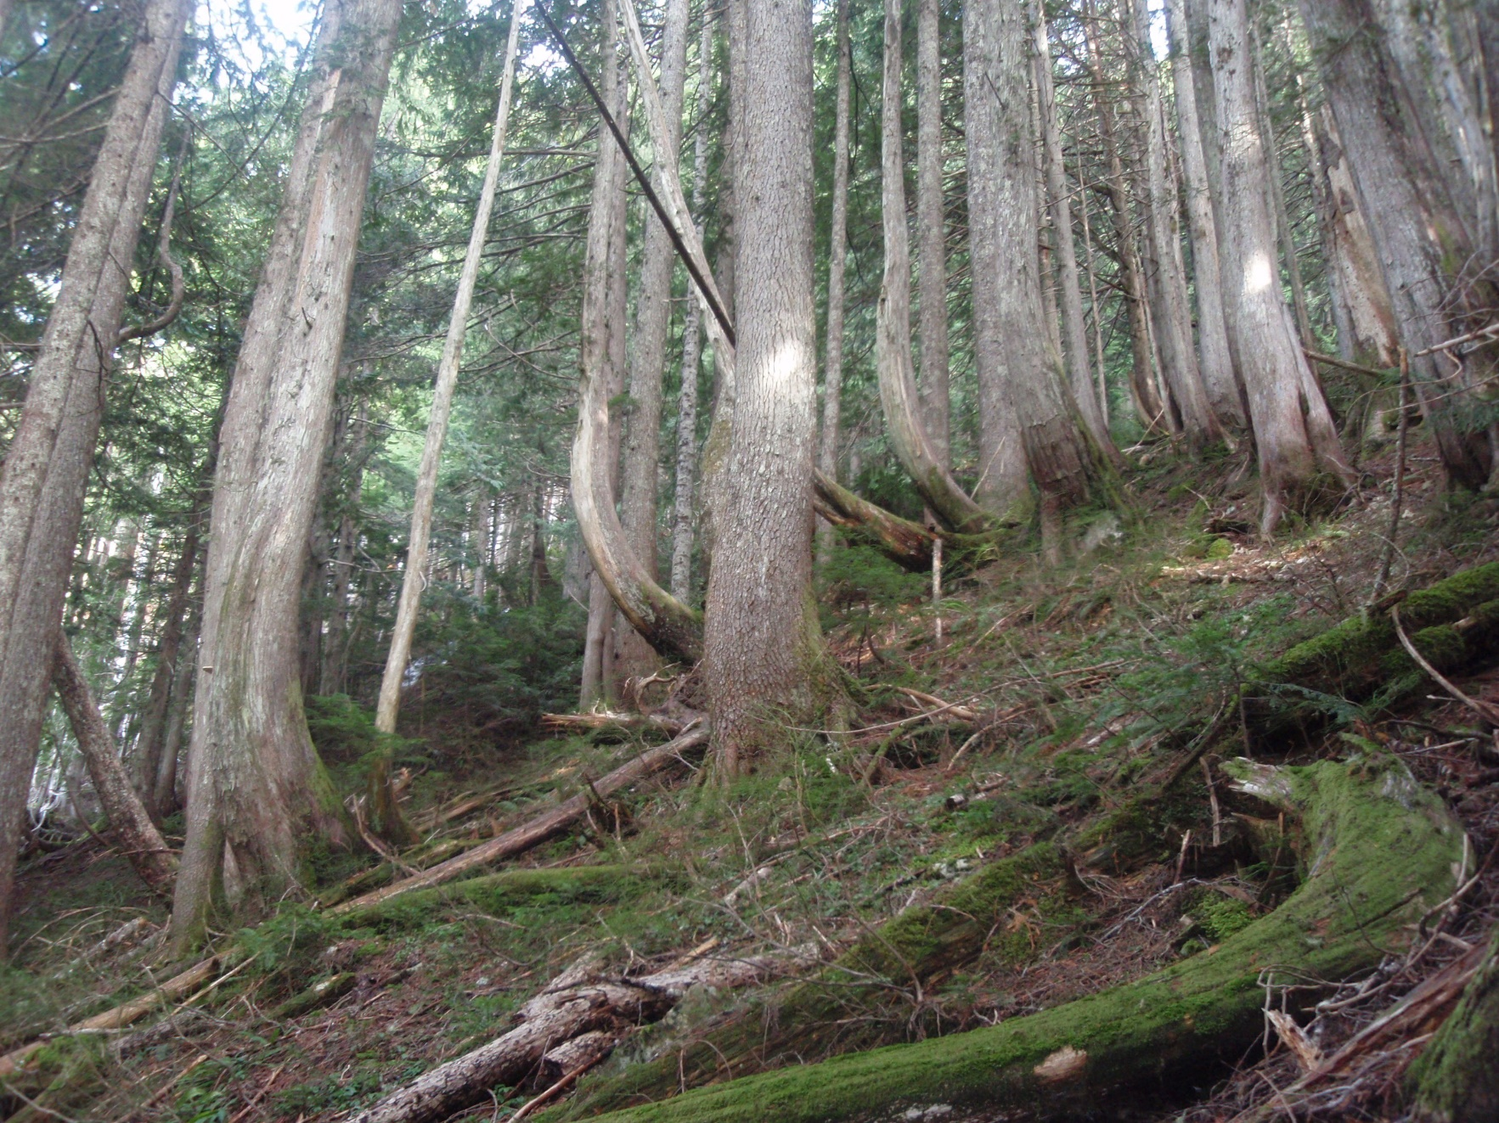
Soils and Terrain
Pistol-Butted trees and soil movement indicating slope instability
Notes:
Areas which show soil movement/creep should be avoided where possible.
These have likely been assessed by a geotech with a construction prescription for the site.
If construction through these areas is required, the plan and construction methods should reflect the potential for and mitigate slope instability.
If signs of instability that are not indicated on the Plan are noted, work should be stopped until clarification is reached.

Slide 49
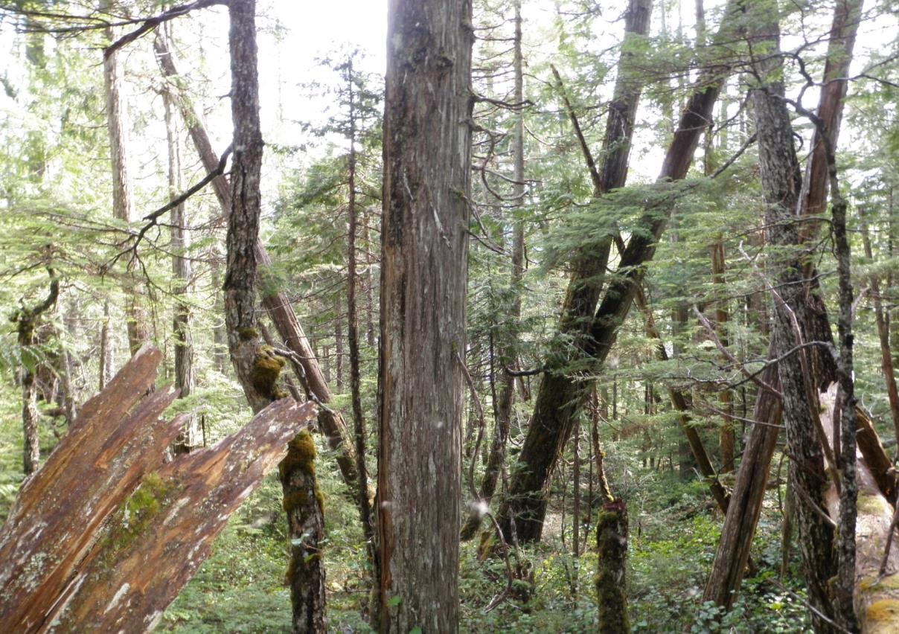
Soils and Terrain
Jack-strawed trees indicating slope instability
Notes:
Jack-strawed trees are a fairly common occurrence on inherently unstable terrain.

Slide 50
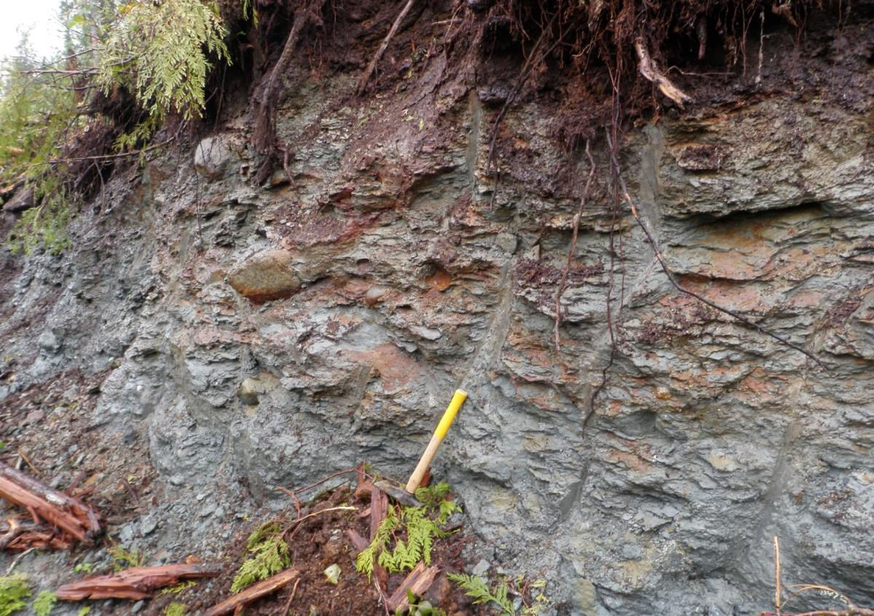
Soils and Terrain
Hardpan soils acting as a water barrier
Notes:
Beware of higher water tables, creating slippery working surface and potential instability.
This was a slide initiation area/cut slope, where a 400 m long slide initiated in fill slope below due to full bench not being carried out.
Jack-strawed trees were numerous in the seepage draw below road, see previous slide.

Slide 51
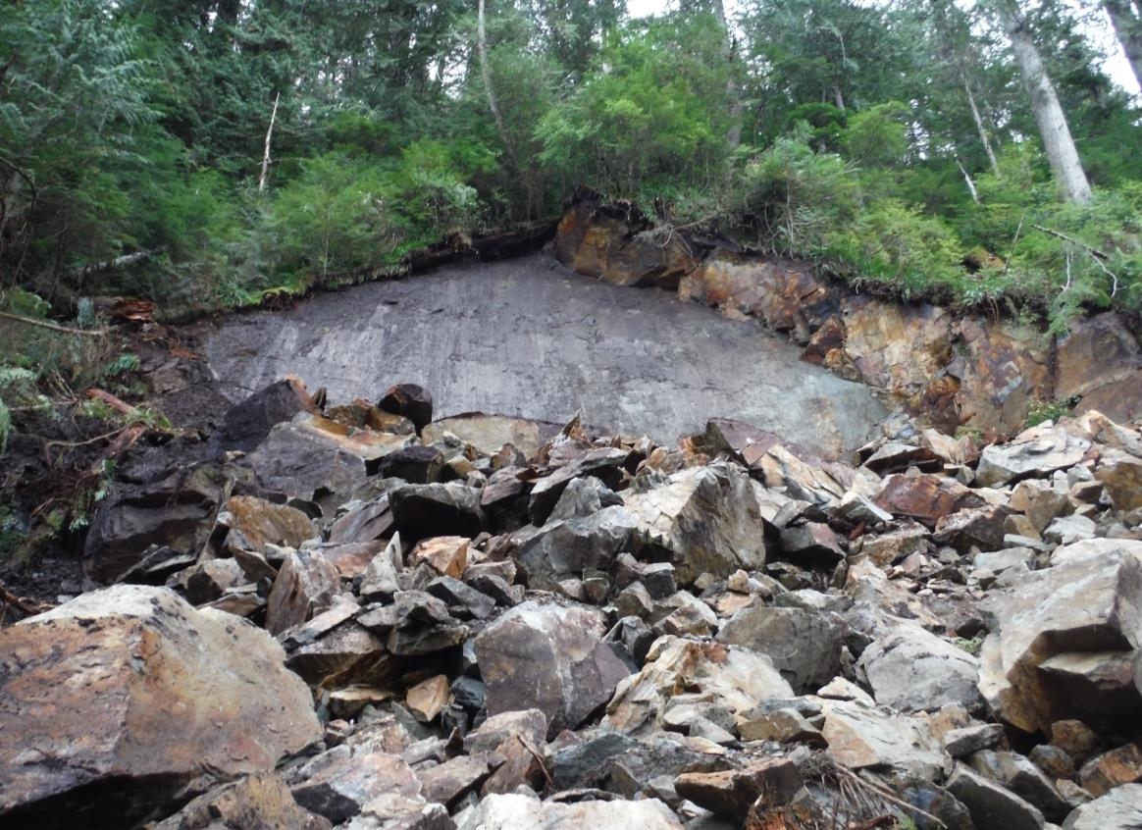
Soils and Terrain
Slip plane with unstable
masses remaining on top
Rock instability
Notes:
High Rock cuts can be High hazard during construction
May also be designated as “No Stopping” zones after construction for hauling and harvesting operations.
Above photo shows steep fracture plane in rock paralleling road, which is a common cause of rock fall.
This road was abandoned due to large volumes of unstable rock along road location.
Not observed in the PLAN…
Resulted in loss of conventional harvest opportunity.
Unforeseen conditions, stop, reassess and make suggestions.

Slide 52
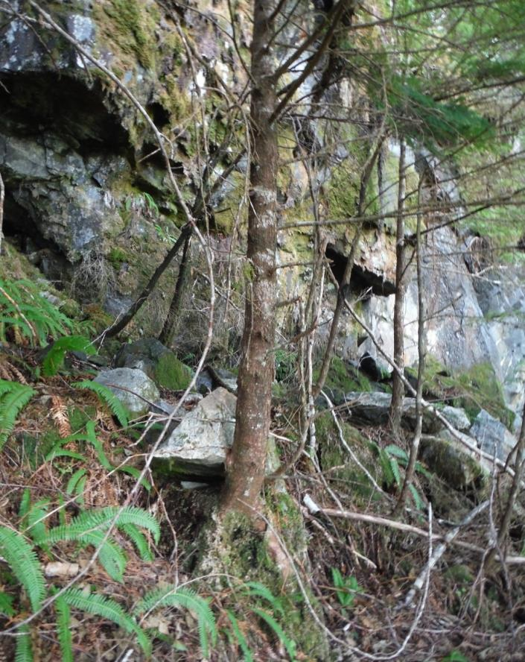
Soils and Terrain
Fractured bedrock with evidence of instability
Notes:
Cutslope failures adjacent to this site shortly after road construction.
Bluff with overhangs, loose rocks below bluff indicating rock fall.
Also pistol butted trees on slope below bluff immediately above road.
Road heading was stopped after contract supervisor brought in geotech.
The whole slope below the bluff slid a few weeks later.
Road was continued below toe of slide and there was no loss of harvest area.

Slide 53
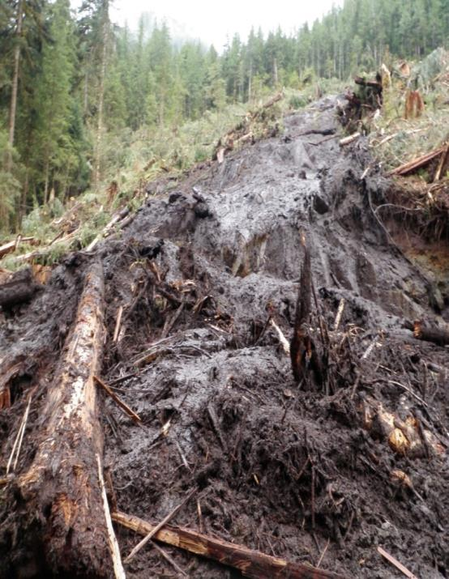
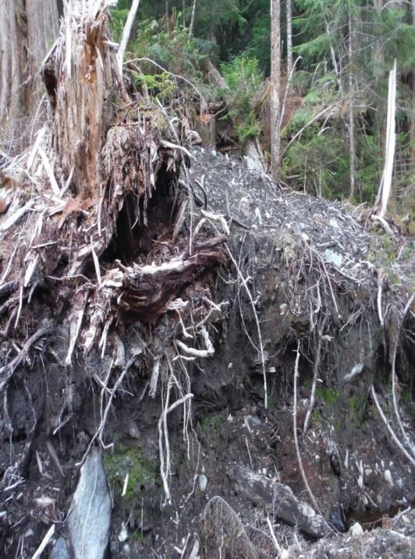
Soils and Terrain
Slides above road depositing organic material within new road prism
Notes:
Slide deposits off upper slopes can result in an unstable mass of organics + mud deposition within the road prism area.
These can be due to disturbance related to new road construction.
On the left, yarding down organic-rich (skunk cabbage pockets) on 40-60% slopes resulted in landslide.
On the right old landslide debris cut by main road.
Important to be aware of your surroundings especially old slide activity and any evidence of inherent slope instability both up and below road prism.

Slide 54
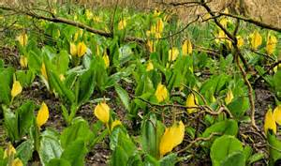
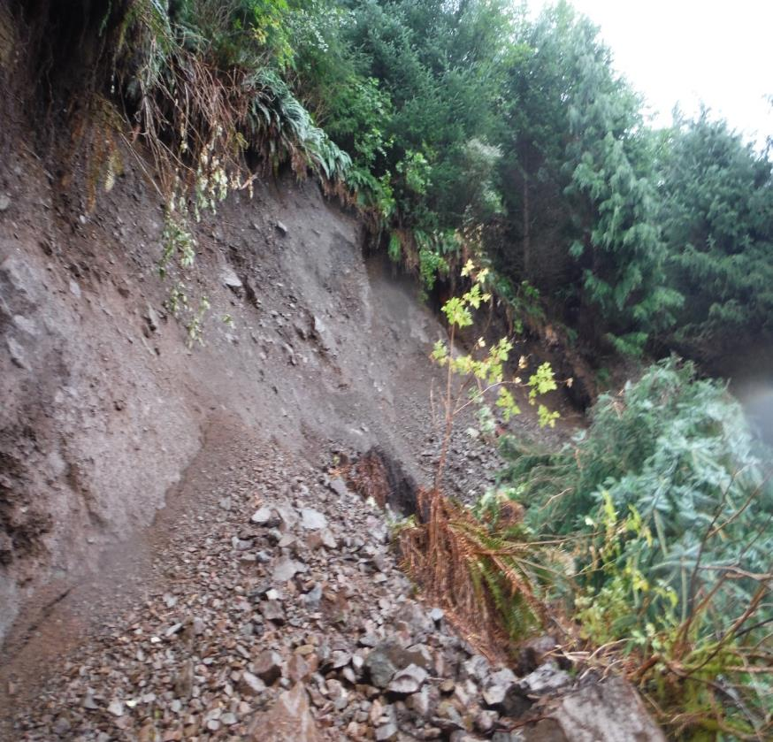
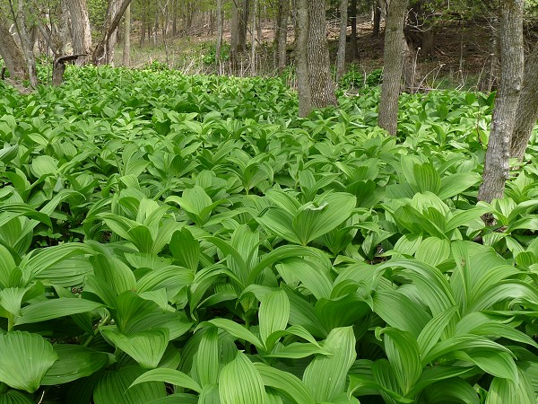

Soils and Terrain
Clockwise from top right: Skunk Cabbage; False Hellebore; Devils Club; cutslope failure with salmon berry & deer fern; All associated with seepage or imperfect drainage
Notes:
Common indicators of subsurface and overland water flow.
Typically associated with organic-rich soils, but also in pockets of thick soils. Fern in open draws indicate water retention/accumulation areas.
These areas contain significant water/seepage and potential for slope instability.

Slide 55
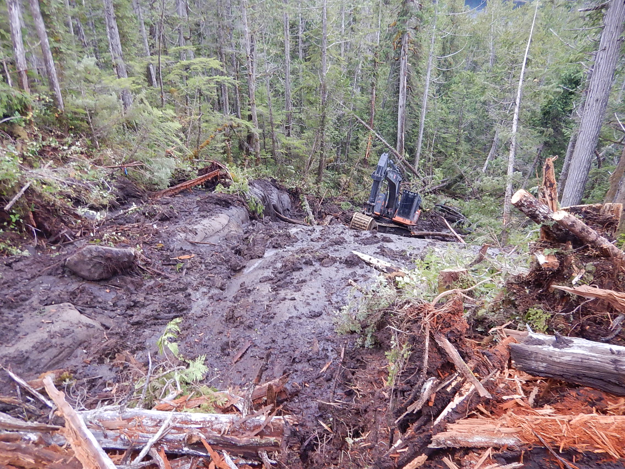
Wet sediment pockets and/or organic accumulations are common in draw features, but also on open slopes. These may store significant amounts of water for long periods of time.
Soils and Terrain
Notes:
Attention to planning appropriate stripping, spoil placement and drainage infrastructure is critical.

Slide 56
SOILS & TERRAIN
– KEY MESSAGES
Know or seek to learn indicators of slope stability
Assess and report on ground conditions:
Organic soils, sediment types, bedrock characteristics, drainage

Slide 57
Final Design and Road Plan

Slide 58
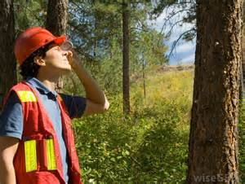
Final Design and Road Plan
Should address all alignment concerns – vertical & horizontal
Should address all drainage concerns
Should address all terrain prescriptions/recommendations
Plan maps should be an effective visual presentation
Prescriptions should be on plan map and on profiles,
with cross-sections representing prescriptions and
what is seen on the ground with respect to slopes and materials
Notes:
Traverse notes and resulting cross-sections should have multi-sideshots, particularly in steep terrain.
Ensure road building techniques are clearly defined in plan. i.e. specific definition of conventional, overland and other construction techniques.

Slide 59
Plan Elements – Map
Final Design and Road Plan
Main document used by the crews
Required by all EMS and FMS systems – all workers
Must match geometric designs and instructions
Consistency between ground markings and plan documents
Notes:
Plan/prework map is key communication document used with construction crews
Field markings (alpha numerics or station distance) must be represented on maps and designs/cross sections/profiles for operator and supervisor reference - Especially critical in steep sections

Slide 60
Plan Elements – Map
Final Design and Road Plan
Critical Map Elements
Construction techniques
Known hazards and other safety requirements
All roads, stations and field markings
All drainage structures (stationing and sizes)
Endhaul, special construction, reactivation sections, spoil sites
Sensitive terrain and other local information
Block boundaries / other reference points
Legend describing all map features including location (Lat/Long/UTM coordinates)
Notes:
Location i.e. UTM/Lat/Long

Slide 61
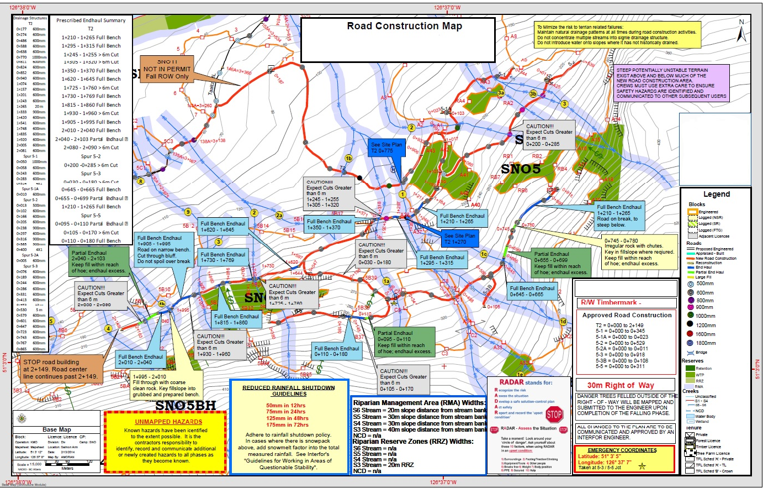
Final Design and Road Plan
The plan can be complicated
Notes:
Construction on moderately steep to steep slopes can be complicated. Comprehensive review and subsequent discussion regarding the plan is critical for all those involved with planning, supervision and construction. This process will ensure knowledge transfer and provide an opportunity to raise awareness and spur discussion regarding areas requiring special attention during the construction phase. If workers do not have a clear understanding of the plan, then work must be stopped until clarification is resolved.

Slide 62
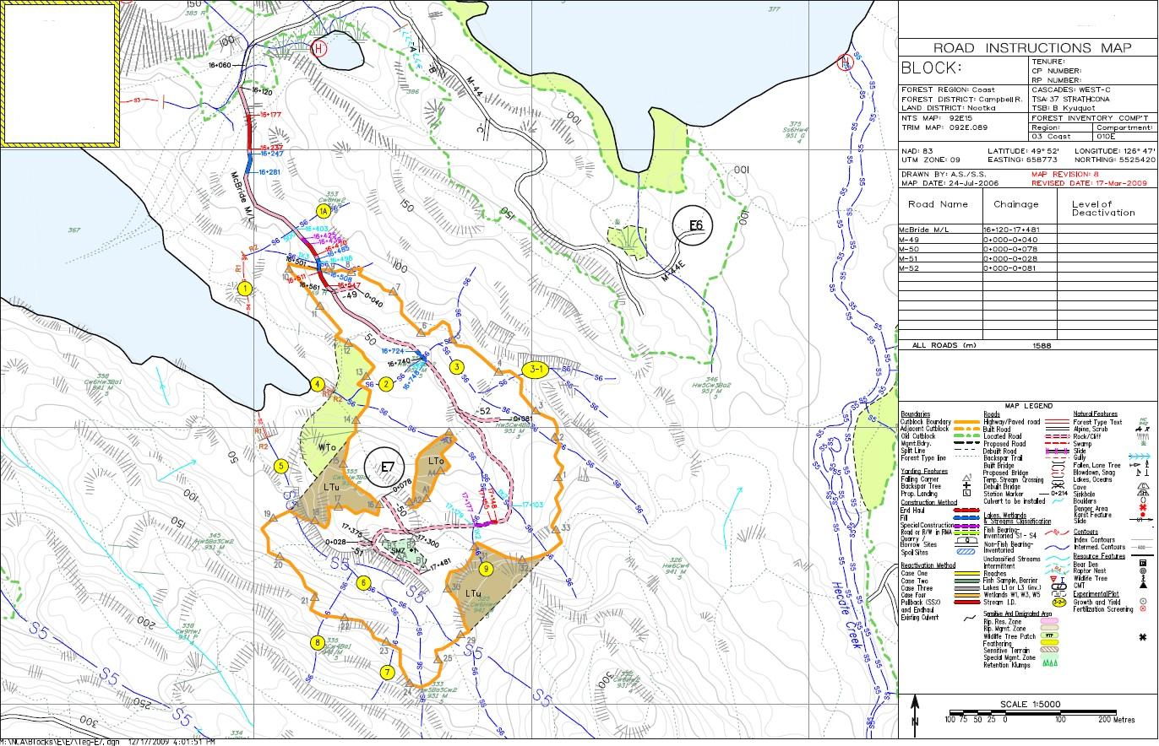
Final Design and Road Plan

Slide 63
Final Design and Road Plan
Design needs to:
Accurately reflect ground conditions
Be easy to read and understand
Highlight road construction prescriptions
Highlight potential worker safety hazards
Be a useful tool for road construction crews and supervisors
Needs to be followed to be effective
Notes:
Georeferenced plan maps
Unforeseen conditions are common causes of CI slides.
Plans should reflect actual ground conditions and highlight appropriate construction requirements.
One of the most common complaints form road crews is the complicated nature of the plans.
Plans should be clear, concise and easy to understand.
Areas requiring special attention or where risks are present need to be highlighted and made clear to the road crews and supervisors.
The intent is to provide a plan that is a useful and easy to follow for road construction personnel. This is key in ensuring development objectives are achieved.

Slide 64
Plan Elements – Road Design
Final Design and Road Plan
Geometric (Roadeng) road design incorporates:
    Design specifications
    Identified ground conditions – bedrock, soils, organics
    Special limitations – ground conditions
    Specialist recommendations
    All other required information
Geometric road design is critical to allow successful construction of road without issues!

Slide 65
Final Design and Road Plan
Notes:
1/2 Bench / Balanced Cut & Fill: An approximate 1/2 of the road subgrade is supported by B.C.
Once road width has been cleared, grubbed and stripped, removing overburden and organic soils, the road subgrade can be
constructed using in-situ material, preferrably coarse mixed with fines. Sidecasting is permitted as is puncheon in the subgrade,
but no organics.
TSAs should spell out the meaning of road construction prescriptions
Clearing: Site preparation clearing the way for road construction
Grubbing: Site preparation reducing the amount of woody debris mixed in with the suitable fill or subgrade.
Stripping: Site preparation eliminating the layer of litter, brush and debris in the fill or subgrade material.
Puncheon: Woody debris (usually logs) used to support subgrade fill.
Sidecast: Material not placed, but tossed onto the slope outside the road prism.

Slide 66
Notes:
3/4 Bench (+/- Key-in Rock): An approximate 3/4 of the road subgrade is supported by B.C.
This method is used when a limited amount of material can be securely placed as fill. Once road width has been cleared, grubbed
and stripped, removing overburden and organic soils, the road subgrade can be constructed using in-situ material, preferrably
coarse mixed with fines. Sidecasting is not permitted and the toe of the fill is placed. Puncheon in the subgrade is not permitted .
A version of this method, called “Key-in”Rock” utilizes shot rock, angular boulders or rubble to construct an interlocking matrix,
'keyed in' to an excavated microbench, providing a stable subgrade with oversteepened slopes.
Sidecasting of fine soil material and organics or use of organics or puncheon in subgrade construction is not permitted
(remnants are acceptable). Spoil material is to be endhauled to designated spoil areas.

Slide 67
Notes:
Full Bench: All of the road prism is supported by B.C. This method of approximate full bench cut requires no side casting of cut material.
Once road width has been cleared, grubbed and stripped, removing overburden and organic soils, the road subgrade can be constructed
using in-situ material, preferably coarse mixed with fines. Any material used for subgrade construction should be keyed into the slope,
and be supported by benches within the road prism. Appropriate material such as gravel and rubble size shot rock should be used for subgrade
construction, or backcasted for use elsewhere. Use of fine textured, silty soil or organic material or use of puncheon in subgrade construction
is not permitted (remnants are acceptable). This material is to be endhauled to designated spoil areas.
Often these Full Bench sections are on gentle outer benches abover steep slopes, in which case some of the spoil can be placed on the outer benches,
thus ending up with a low volume of end haul material.

Slide 68
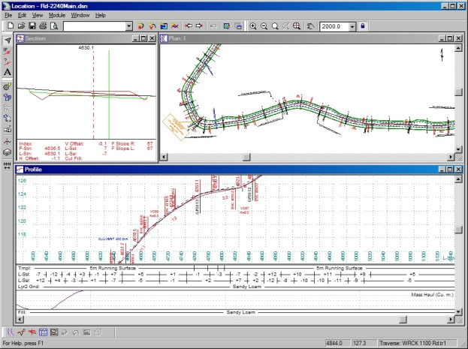
Plan Elements – Road Design
Final Design and Road Plan
Critical Profile Elements
  Grades
  Culverts
  Ground types
  Stationing including Endhaul
  or Special Construction
  Design specifications
  Scale and grid for reference
Notes:
Greater than 18% for 150m need to be risk assessed
High cuts 6m+
Road suitable for intended purpose

Slide 69

Final Design and Road Plan
Typical road design plans and profiles
Notes:
Need to understand and follow the plan.
The plan map, profiles and cross-sections are the guts of the plan.
Important to understand them. Know guidelines for cut-and-fill angles for different material types. This is often missed by road designer…needs input from terrain survey

Slide 70

Plan Elements – Road Design
Final Design and Road Plan
Critical X-section Elements
  Station (distinguish P line vs L line)
  Field marking
  Elevation
  H and V offsets
  Side slope information
  Grades (Next and Last)
  Sufficient cross sections to accurately reflect intended design
Notes:
Sufficient x-sections in steep sections are critical

Slide 71


Final Design and Road Plan
Full bench road design cross section
Notes:
Minor changes to road location in the field may result due to slight offsets in ribbon locations when compared to the road centerline on the plan. This is typically not an issue but if consistent should be discussed as to related issues, impacts and solutions
Relocating the center line can have significant effects at control points, bridge crossings, switchbacks etc. Again, understanding is critical , stop and get clarification when and where required
Very important for critical sections to have multiple side shots and field reference points
Any offsets to the design should be discussed with road crew during preworks

Slide 72
Plan elements – Instructions
Final Design and Road Plan
Critical elements/sections
Safety – link to Workplace Safety Plan
Summary of roads and instruction for each section
Drainage structures, including all stream info
Instructions for all Endhaul, special construction sections,
spoil sites etc.
Instructions on dealing with all other resources
Operational component (ribbon colors, etc.)

Slide 73


Plan Elements – Instructions
Final Design and Road Plan
Instructions should be on back of Road Map
Notes:
This is the main document that ties everything together
References all the required back up info from the pre-work release package.
Professionals have the opportunity at preworks to train or reinforce crews on plans, and reading designs

Slide 74
Essential Plan Elements
Final Design and Road Plan
Sufficient information to allow construction to the plan (function of risk and complexity)
Must have a link to standards (government, professional, corporate)
Sufficient documentation and rationale
Signed and sealed by the appropriate qualified registered professional
Team concept – professionals, specialists, road crew

Slide 75
Plan Elements – Road Design
Final Design and Road Plan
Road crew must have all the information they need to be successful
Link to safety required within all portions of the design
Geometric design ties it all together:
    Drainage structures
    Specialist requirements
    Design specifications
    Other special limitations
Notes:
Professionals and Construction Managers/Supervisors need to make time to train or refresh crew knowledge…maps, profiles, cross-sections

Slide 76
FINAL DESIGN & ROAD PLAN
– KEY MESSAGES
Addresses safety, alignment, drainage & terrain
Produces effective & representative plan maps, profiles and cross-sections
Includes all information required by supervisors and crews
Is understood by supervisors & crews
Feedback is encouraged
Notes:
Feedback from road crew to CRP, Terrain Specialist, etc.

Slide 77
Road Construction

Slide 78
Road Builder Selection
Many factors in selection.
Has the contractor completed similar projects?
Similar size?
Similar terrain?
Similar challenges?
Is the road builder suitable for the project?
Does the builder have the capacity to complete the work on time? If not, they may end up rushing, cutting corners, and increasing the risk of a slide.
Contactor safety performance?
Notes:
Tools to aid in the process:
Contract request for expression of Interest
Contractor qualifications list/requirements
Contractor references
WSBC contactor history/track record

Slide 79
Road Construction - Supervision
Road Construction
(New construction, reactivation, maintenance and deactivation)
Notes:
Coordinating Member - Member of ABCFP and/or APEGBC who has lead and coordinating responsibility for professional work
Road Personnel - Persons who supervise or carry out construction, maintenance, or deactivation of forest roads. These individuals typically include road supervisors and machine operators
Specialist - An individual that has specialized training and experience in a particular occupation, practice or branch of learning

Slide 80


Road Construction
Annual review of: Environmental Management system (EMS), Forest Management System (FMS), Standard Operating Procedures (SOPs), Job Safety Breakdowns (JSBs), Emergency Response Procedures (ERPs)
All workers participate
Contractor orientation – expectations clear
Good opportunity to review both general and project specific requirements
Pre-work requirements, training/awareness opportunities
Notes:
Environmental, forest management systems
Standard operating procedures
Job Safety Breakdowns
Emergency Response procedures

Slide 81

Road Construction – Pre-works
Road Construction
Coordinating Member/ releases plans
Supervisor takes responsibility
All workers receive pre-work
All critical elements explained
Do crews fully understand?
Notes:
How do we make this happen?
Supervisors could be on-site supervisors; construction manager, construction owner, construction foreman, lead hoe operator etc.
If there is a change in circumstance that is not indicated on design or in preworks, STOP and ASK
Cannot afford to be unsafe…as this also relates directly to production

Slide 82

Road Construction – Preworks
Road Construction
Get everyone on the same page
Give opportunity for all to ask questions
Cut and fill vs Endhaul
Drainage concerns discussed
Critical definitions covered
Safety
Notes:
Opportunity to train operators on reading and understanding the design such as vertical and horizontal offsets
Safety hazard identification

Slide 83


Road Construction - Supervision
Team concept critical for:
    Successful implementation
    Sufficient information
    Changed circumstances
Supervision must be effective, timely and on site
Qualified supervisors critical to success
Effective supervision = correct plan implementation
Notes:
May be several levels or forms i.e. direct road construction vs general project oversite
Supervisors and CRPs should be proactive, forward planning and foresee challenges to road construction ahead; establish realistic production and expectations based on preowrks documentation
Before any activities begin, supervisors should coordinate the safest, most effective approach for falling the right-of-way (ROW), building the road, and removing logs
• Requires open communication between all groups
• Ideally bull bucker, road building supervisor and contract supervisor walk the proposed centerline together
• Requires more timely approvals to facilitate better planning/coordination

Slide 84
Road Construction – Follow the Plan!
Critical message from professionals and supervisors:
STOP if you don’t understand the plan
STOP if you encounter unforeseen conditions
Don’t cut corners
Production vs safety relationship – send the right message
Notes:
Important to ensure the project work is understood by all involved
Production cannot come at the cost of safety, plan well , allow appropriate timelines and modify these if required.
Providing leadership is key
Safety adds to production

Slide 85

Road Construction – Follow the Plan!
Professionals/Supervisor’s role during construction:
Appropriate CRP
Rainfall shutdown
Changed circumstances/plan
Field review requirements – terrain stability professional
Worker safety/hazards
Notes:
Ensure proper handoff between Coordinating Registered Professionals if required.
Much like as-built reviews, terrain specialists are being required on-site for difficult road construction sections

Slide 86
Road Construction – Phase Interaction
Before
    Fallers play a critical role
    High stump for temp fill
    Stations left or referenced to allow road crew to know where they are
    Proper bucking to allow for Right of Way wood removal
    Proper clearing widths to allow for higher cutfaces, quarries etc.
    Danger trees
After
    Road construction to meet intended purpose and provide safe access for next phases
    Landings, pullouts and turn arounds as required for logging
    Grades and widths to allow for safe hauling
    Appropriate drainage, ditching and road surfacing
    Man-made hazards must be eliminated (hung up root wads, rocks, R/W wood); hazards to setting fallers and logging crews

Slide 87


Road Construction – Phase Interaction
Notes:
Important to do checks and monitoring of operations
Address roadside debris; encourage clean-up

Slide 88
Road Construction – Interaction
Road crews need to know where they are
    Stations identifiable
    Reference to plan
Changing conditions
    Weather/rain
    Terrain/ground
    drainage
Notes:
If field identification is difficult or conditions change significantly, crews need to STOP & consult with road supervisor/CRP and resolve.

Slide 89
Road Construction – Transition Zones
Planners play a critical role:
Ensure maps/instructions/design are correct and match each other
Give terrain specialists the time required to complete field review during construction of difficult sections
Consider operational changes when prescribing short term options (Endhaul vs Temporary fills)
Field and map information must be sufficient:
    Ribbon and station location
    Reference points
    Drainage
    Hazards
Notes:
Design information is critical
TSA’s / Road Designs need to consider and address endhauls and transition zones

Slide 90

Road Construction – Transition Zones
The operator becomes more relaxed and sees that better time can be made as the terrain begins to flatten out to what may look like “easy going” – often coming out of rock into thick seds/organics
Notes:
Transition zones are often critical zones with regards to slide activity. Too late getting in to full bench and too early getting out.
START EARLY….END LATE

Slide 91

Road Construction – Transition Zones
Road Design Map Indicating Transition Zone Locations
Notes:
Transition zones are a common area of slide initiation,
Particularly at the start and end of the end haul sections.
Start your transition so that you are on full bench by the start of the transition.
start early / end late.

Slide 92

Water tends to concentrate in draw features between steeper bedrock sections (Transition Zones)
Road Construction – Transition Zones
Failure Scarp
Notes:
This is an Area of unstable soils within a gentle draw.
Indicators of overland and /or subsurface seepage is evident; plants (devil’s club in this case), organic soils, open stand, exposed mineral soils.
Raveling or slumping within excavation or below excavation can indicate slope instability.
Be aware of active ravelling or slumping.

Slide 93

Road Construction – Transition Zones
Failure Scarp
Many of the road construction-related slides on the coast have been in areas where the road stripping and subgrade construction is coming out of a full bench and end haul section with lots of rock

Slide 94

Road Construction – Transition Zones
Danger can increase in these locations
Notes:
Transition zones can more hazardous than prescribed full bench areas.
Thicker soils and wetter ground.
Generally still above steep slopes, even though on bench.
Water tends to concentrate in draw features between steeper bedrock sections.

Slide 95

Road Construction – Transition Zones
Always be AWARE of your surroundings
Notes:
Watching for areas of seepage , organics, unstable material is critical.
Once noted appropriate action should be taken to ensure potential instability is mitigated.
Slow down, evaluate, stop, ask if required and if appropriate make suggestions.
Pioneering ahead in these circumstances is not an option.
Transition zones will vary in length depending on site conditions.

Slide 96

Road Construction – Transition Zones
Transition Zone Slide
Notes:
Wet unstable material within transition zone.
Machine was transitioning out from area of bedrock.
These areas can be/appear dry on top and be wet underneath.

Slide 97

Road Construction – Transition Zones
Clear road of stumps debris and organics
Notes:
In this case, the trees above cut slope show signs of slope instability.
Machine needs to be sitting on stable material at all times.
Grubbing, stripping, and clearing of unsuitable material is critical. (particularly organics)
Puncheon should not be used in transition zones even if on bench.
Puncheon should not be used in steep terrain.

Slide 98

Road Construction – Transition Zones
    Make sure that your Machine is on stable footing
Notes:
Remember, if the ground slopes away from the edge of the excavation at an angle >33%: You need to be on a stable footing.
If you create a slide, costs can be substantial and results potentially catastrophic.
If the bedrock is smooth, it must be blasted to create an irregular surface/platform from which to work. DO NOT WORK ON SMOOTH BEDROCK SURFACES!
Piloting/Pioneering ahead with the excavator is not safe where sideslopes are greater than 30%.
No decking of Right-of-Way wood on >30% slopes where organics over smooth bedrock.

Slide 99
Road Construction – Adverse Grades
Planning requirements
Consideration of additional drainage structures may be required
Pre-work requirements
Operators must be made aware of potentially dangerous areas
Soil conditions at critical road sections
Supervisory requirements
Critical element with changed circumstances / other
Construction requirements
Know where you are at all times – discuss planner’s role in achieving this
Don’t cut corners
Hoe on fill + water + steep ground = potential disaster
Notes:
Keep water away from excavation site; x-ditches
Always work on stable base/excavator
Plan for reduced production

Slide 100

Road Construction – Adverse Grades
Why is this so critical:
Adding water to the heading where it’s never been before can have disastrous results

Slide 101

Road Construction – Spoil Sites
SPOIL PLACEMENT:
Away from natural drainages or wet ground
Outside Riparian Management Areas (RMAs)
On slopes <30% (unless organics over smooth bedrock);
Away from outer bench crests above steep ground (unless in plan)
Utilize old quarries and pits where practicable
In general, not over 3m in height (<5m if spoiling rock)
Areas of low terrain hazard as defined in Timber Supply Areas(TSAs)

Slide 102

Road Construction
Notes:
Monitoring
Note steep fracture set in cutslope on left.
If excavation is >6m (20ft.) high and has no written instructions; Contractors are advised to STOP work and reassess site prior to continuing
Excavations are subject to vibrations, both drilling and blasting
Could add to build-up in hydrostatic pressures resulting in ground movement below road heading
Hazardous to workers

Slide 103


Road Construction
Overloading Outside Edges of Road
Link to BCFS website and video: www.bcforestsafe.org/node/2897
Notes:
Monitoring
Avoid decking right-of-way logs on outside edge of road above steep slopes
Avoid piling blast rock or on outside edge of road above steep slopes
Engineers, fallers, road builders, loader operators must recognize their role in managing roadside debris
Supervisors must ensure their workers are minimizing these hazards
Supervisors must be on site enough to evaluate their workers, and provide continual feedback to crews, plan designers and professionals

Slide 104


Road Construction
Owners, employers, supervisors and designated prime contractors have an obligation (under the Occupational Health and Safety Regulation) to prevent and remove roadside hazards
Notes:
Monitoring
Perched debris piles and rock (anthropogenic spoil) can be extremely hazardous to following operations (falling, bucking, silviculture, engineers and geos….etc.)
Rock scarring/ chip embedment of ROW and block harvest trees presents machine and safety problems in mills
Road builders should be provided with standards for road construction that include roadside debris management
Work completion checklists and safe work procedures should include roadside debris management
Contract supervisor should check for excessive roadside debris hazards when signing-off on the as-built road
Hold back “as-built certification of road” where works have not been completed to contract standard due to hazardous roadside debris

Slide 105
Other things to consider:
Road Construction
Poor horizontal or vertical alignment
Inadequate right-of-way falling
Smooth bedrock
Working in poor light conditions
Decking of Right-of-Way logs
Carry knowledge to re-construction of old roads
Carry knowledge to road deactivation
Notes:
Monitoring
Smooth bedrock should be blasted to create an irregular surface/platform to work on
Visibility may be impaired during times of poor light conditions
This can affect the ability to recognize indicators of potential slope instability
Decking of right of way logs in areas of steep slopes and/or poor drainage increase the risk of slope failure
Reconstruction of old roads can have increased risk given old cat construction and fill slope instability
Terrain specialists have a key role in developing prescriptions that address specific site conditions

Slide 106

Road Construction
    Drilling & Blasting operations should be focused towards “controlling the blast”, particularly when road works are above steep slopes. Drill holes should be directional and stemming should be with adequate materials to control the blast.
Notes:
Monitoring
Drill and blast control is critical to minimize over blast and fly rocks.
Utilize powder suppliers as a resource for determining best approach/options for challenging ground.
For example: Seamy holes need to be loaded differently.
Flyrock can be reduced by: Borehole alignment and appropriate use of explosives; proper use of stemming; site safety and management; training
Additional training may be required to offset limited practical field experience; several technical courses available through ISEE (International Society of Explosive Engineers)

Slide 107

Road Construction – Rock Instability
Professional’s role:
Identify beforehand
Relay information in Pre-work
Field review / monitoring requirements – terrain specialists
Notes:
For difficult construction = field review/monitoring by professional

Slide 108


Road Construction
Drainage Control
Ditch Block
Too High??
Road Surface run-off
Resulting in Erosion of Fill
Maintaining natural drainage is critical.
Notes:
Maintaining proper drainage is critical in ensuring the road prism does not become saturated which can result in failure and construction initiated slide events.
This is particularly important on roads with adverse grades draining water to active excavation sites without proper cross-ditching.
Use your experience, knowledge and skills in concert with the PLAN to ensure drainage patterns are maintained and drainage control is appropriate for the circumstances.
Additional drainage structures should be installed where there is significant surface runoff and/or subsurface flow encountered or where natural drainage flow was not identified on the road design.

Slide 109

Road Construction
Drainage Control
Notes:
Road surface runoff eroding highly erodible sandy soils
Culvert intake sump could use more rock armouring

Slide 110


Drainage Control
Road Construction
Drainage Control
Fillslope failure on left; Fillslope erosion on right
Notes:
Woody debris in the subgrade…in steep terrain in the left photo; don’t use
This is a no-no in steep terrain

Slide 111


Road Construction
Drainage Control
Blocky material or boulders can be used for drainage as well as bank stability
Notes:
Maintaining proper drainage is critical in ensuring the road prism does not become saturated which can result in failure and construction initiated slide events.
Left photo shows effective armouring of culvert outlet.
Right photo shows rock blanketing of unstable cut slopes and ditch line armouring.
Both photos in highly erosive sandy sediments.

Slide 112

Road Construction
Drainage Control
Ensure that drainage works. Ditches, culverts, cross-ditches and waterbars must be fully functional at all times.
Notes:
Includes grade control on road surface
Methods such as in sloping road surface, crowning, rolling grades, proper culvert or cross-ditch placement, ditch blocks, intake sumps, armouring.
Lack of drainage control can lead to landslide events during and after construction activities.
Particularly during periods of high rainfall or rain-on-snow events.

Slide 113
Road Construction – Changed Circumstances
Planning requirements
Who is qualified / allowed to change the plan
Consider large licensee vs small licensee
Documented protocols, standards and guidelines
Everyone’s roles:
    Planners / professionals
    Operators
    Supervisors
    Contract/licensee owners
Notes:
Examples include: subsurface waters or seepages exposed during construction, when none on plan
Bedrock is not competent or has unstable layers, not identified on plan
Cutslopes do not hold up at indicated design slopes
Rock is needed for keying-in the fillslope, but there is no rock large enough

Slide 114

Road Construction – Changed Circumstances
The coordinating member responsible for road construction should establish a communication protocol with road personnel that provides for the coordinating member to be notified as soon as road personnel become aware of conditions different than expected in the road plan, so that appropriate action can be taken.
Notes:
There may be more than one coordinating members depending on project management structure.

Slide 115


Road Construction
Changing the Plan
Unidentified Conditions:
All changes to be discussed with the road construction team
Notes:
Plans and planning is often not perfect. Unforeseen circumstances and/or conditions may occur which is why communication with the team is critical. If changing conditions stop work and reassess.

Slide 116




Road Construction
Changing the Plan
All those involved with road planning, engineering and construction
play a critical role in ensuring safe and successful operations. It is the
expertise and experience of the team and how they interact which
determines the outcome.
Notes:
All those involved in the planning and construction process have expertise in their areas of responsibility.
It is this combined expertise and good communication that can make the difference between having a problematic or successful project.
Contractors/operators have unique skills and knowledge that are critical in ensuring the job gets done efficiently and safely.

Slide 117
ROAD CONSTRUCTION
– KEY MESSAGES
Know experience, training and safety performance of construction company
Effective and understood preworks
STOP if questions arise, unforeseen or changed conditions; Report to Supervisors, Coordinating Member
Proceed with CAUTION through Transition Zones, Adverse Grades, High Cutslopes, Bedrock cuts, Organic-rich soils
DRAINAGE control of utmost importance
Management of Roadside Debris
Changed Circumstances / Changing the Plan

Slide 118
Reactivation, Maintenance and Deactivation

Slide 119



Slides can happen during maintenance, reactivation and deactivation works.
Impacts can be significant and similar to CIS.
Effective plan required
Timing is important
Supervision is critical
Plan/process is required to ensure deactivation is not missed
Notes:
Field reviews and a professional plan is needed for road reactivation and deactivation works in potentially unstable or unstable terrain.
Old roads tend to have over steepened fills, old wood culverts ready to collapse and buried woody debris on potentially unstable ground.
Water management is key.

Slide 120
Road Reactivation – Requires Same Diligence
Professional’s role with reactivation:
May require geometric design
Increased risk due to unknowns and hidden hazards
Terrain specialist field reviews often required, often forgotten
Often requires higher level of supervision and field reviews during construction

Slide 121

Road Reactivation – Requires Same Diligence

Slide 122


Road Reactivation – Investigating old road fills and culverts are critical
Old wood box culvert collapsed under tractor drive wheels leading trailer wheels into gully.
Notes:
Inspecting old structures and fill slope stability prior to reactivation works is critical.
Road reactivation plans should reflect any work needed to protect worker safety.

Slide 123

Buried culvert
Three arcuate
Slide scarps
Road Reconstruction Landslide: old plugged culvert; with water diverted onto old fillslope
Notes:
Followed a period of heavy rains over a short period; road not cross-ditched at stream in foreground
Existing fill had high organic debris component
Initiated on upper old road, crossed road mid-slope then ended up on lower road on valley floor
Slide length = 700m; then 200m of fines into fish resources

Slide 124
ROAD REACTIVATION – KEY MESSAGES
Old roads will have hidden hazards. Look and assess roads for:
  Old culverts that may collapse.
  Cut/Fill slopes for stability concerns.
  Natural drainage features and associated structures.
Conduct professional assessments and develop a reconstruction plan.
Communicate plan with operators.
STOP if questions arise, unforeseen or changed conditions; Report to Supervisors, Coordinating Member
Changed Circumstances / Changing the Plan

Slide 125

Road Maintenance, and Deactivation

Slide 126

Maintenance works along older roads may have unknown hazards to operators
Excavator roll over when working near fill slope on an old road while placing a cross ditch. Road fill slope failed under the outside track.
Notes:
Excavator roll over when working near fill slope on an old road while placing a cross ditch. Road fill slope failed under the outside track.

Slide 127


Maintenance works along older roads may have unknown hazards to operators
Fill slope stability were not known during reactivation and maintenance activities until the following winter when the slide occurred.

Slide 128


Deactivation works may be hazardous and slide may occur within or adjacent to the work site.
When working in terrain that is potentially unstable or unstable, a detailed prescription with map and work description completed by a qualified professional may be warranted.
Specific work guidelines may be required such as amended rain fall shutdown criteria.

Slide 129
ROAD MAINTENANCE AND DEACTIVATION
– KEY MESSAGES
Develop deactivation prescriptions and with appropriately qualified professionals.
Conformance statements may need to be signed off by professional after works are completed. See professional guidelines by APEGBC/ABCFP.
Conduct professional assessments and develop a maintenance and deactivation plan when works are outside established standard operating procedures and terrain hazards may pose a risk to operators and the environment.
STOP if questions arise, unforeseen or changed conditions; Report to Supervisors, Coordinating Member
Changed Circumstances / Changing the Plan

Slide 130
Road Inspections

Slide 131

Inspections and Follow-up
Road Inspections
Most EMS Systems require final road inspection
Describes required checks for:
    Safety
    R/W and road prism
    Subgrade
    Drainage structures
    Road surface

Slide 132
Inspections and Follow-up
Road Inspections
Road conformance required by Guidelines for Professional Services in the Forest Sector – Forest Roads (ABCFP/APEGBC, June, 2010)
Duty of professional to inspect for conformance to plan (field reviews)
MUST describe and approve variances to any element of the plan PRIOR TO INTENDED USE
Statement required to confirm road is safe for intended use

Slide 133
Road Inspections
Closing the loop:
Inspections and conformance tie it all together so things don’t go sideways
Qualified Registered Professional is responsible for conformance
Organizational structure
    Must allow for timely completion by professionals
    Generally a weak area within many organizations
    Must have the right people in place to complete correctly
Notes:
Under the APEGBC “Guidelines for Professional Services in the Forest Sector - Forest Roads”, a Professional is responsible for approving any modifications to the road plan and signing off on a Construction Conformance Statement that confirms the road was built to the plan or the modified plan
Non registered professionals can participate in conformance activities/works

Slide 134

Road Inspections
When things go sideways:
Remember it’s the guidelines standards and regulations against which you’ll be judged.
Are you comfortable that all the required elements are in place?

Slide 135
Technology

Slide 136


Technology
Various technologies can be used to help improve planning, safety and communication
Lidar and photogrammetry - aerial and mobile
UAV
In-cab visual display
Tablets
Crew and outside communications
Notes:
Can improve efficiencies and reduce costs.

Slide 137


Technology
FPDat
http://fpsuite.ca/l_en/fpdat.html
Safety
  Can be used for geozone warning
  Works with shapefiles
Navigation
  The integrated navigation system /machine’s position in real-time
  Custom map display
  the machine’s position with respect to:
    planned interventions,
    areas of concerns
    and other nearby machines.

Slide 138
Technology
A few useful applications
PDF Maps by Avenza ($) – maps within the app and from the BC Government: http://geobc.gov.bc.ca/basemapping/imagery/topographic.html
Theodolite ($) – Similar to a clinometer
Google Earth

Slide 139
Technology
Communication in remote locations
Cellular phone
  Poor reception at times
Satellite phone
  More reliable reception than cell phone
  Not 100 % coverage due to shifting satellites and canopy cover
FindMeSpot and inReach
  Provides a level of safety
  Can be used for checking in
  Has a SOS feature
  Relies on satellite
Company radio

Slide 140
Conclusion
Notes:
CIS type events continue to plague the industry.
Unless appropriate action is taken it will continue.
This will take a unified and comprehensive approach by all parties i.e. licensees, planners, professionals and contractors/operators.
However, based on your expertise and exposure, those most able to make immediate changes in this trend is “you” the construction contractor.

Slide 141
Conclusion
CIS type events continue to plague the industry.
Unless appropriate action is taken it will continue.
This will take a unified and comprehensive approach by all parties i.e. licensees, planners, professionals and contractors.
Based on your expertise and exposure, “you” and your team can impart immediate and lasting positive change……..

Slide 142

To avoid situations . . .

Slide 143

Which none of us want to witness

