Slide 1
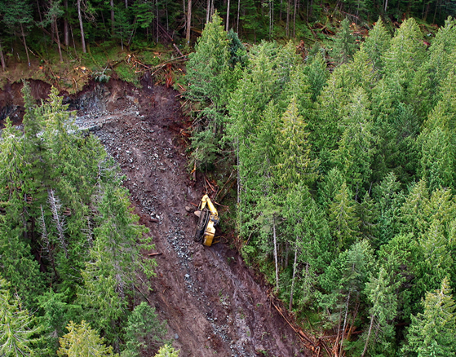
Road Construction Initiated Slides Awareness
Notes:
Slides are costly to industry and people.
There has been significant injuries / No fatalities
Operational and human/personal costs have been significant.
Information prepared with the objective of aiding in the prevention of construction initiated slides and avoid operational, environmental and human costs associated with slide events.
Information based on review of slide events occurring on the coast over the last several years.
Material is designed to create awareness and provide information to road construction crews and related personnel.

Slide 2
Presentation Outline
Construction Initiated Slides Working Group (CISWG)
CISWG Actions
Contributing Factors to Construction Initiated Slides (CIS)
Personal Safety
The Plan
Soils & Terrain
Drainage Control
Construction
Changing the Plan
The Cost
Conclusion

Slide 3
Construction Initiated Slides Working Group
(CISWG)
Group Purpose:
To develop initiatives that support the elimination of slide type incidents during road construction activities on the coast.
Collection of professionals, road builders and provincial agencies who are focused on improving coastal road construction.
Have developed short to medium term strategies to address quick wins
Longer term strategies to sustain improvement

Slide 4
Actions:
The working group is focusing on:
Data Collection and Analysis
Raising Awareness within the Industry
Training Methods and Resources for Road Crews and Professionals
New Ways to Identify Sensitive Zones and Build Road
Options for monitoring and enforcement of road construction standards and
Road Crew feedback
Notes:
Outcomes will be shared and used across the industry to create a more uniformed application of improved road construction methods and processes.

Slide 5
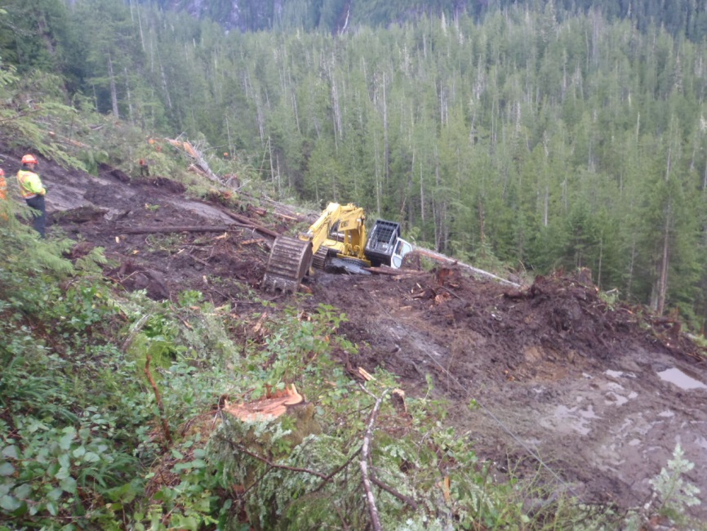
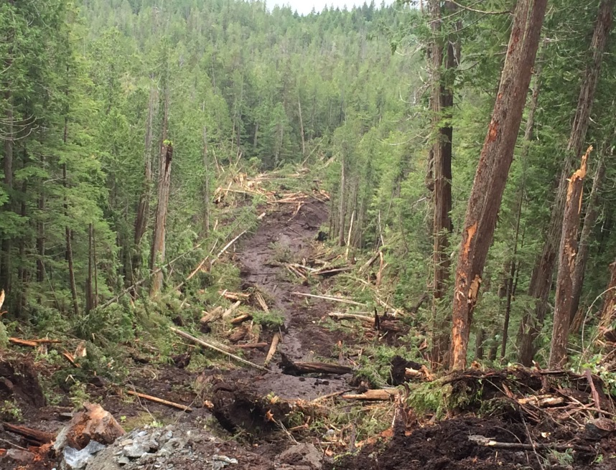
CIS Background
29 slides in the last 3 years
9 of these involved excavators sliding down slope
considerable human, environmental and operational costs
Notes:
No fatalities to date but significant injury to operators.
Operational costs can be substantial 200-500 K without any serious injuries, fatalities or critical environmental damage.
Add the potential costs of these other factors and overall costs could bankrupt a contractor.

Slide 6
The following are examples of
Construction Initiated Slides
on the Coast of BC

Slide 7
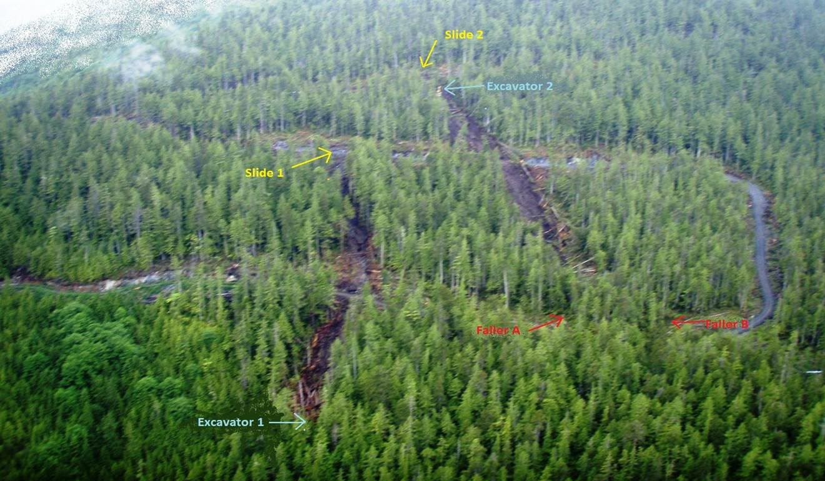
Huaskin Lake
Notes:
Jennis Bay 2011: 2 road construction landslides – 1st in April, 2nd in July – both were several hundred metres in length

Slide 8
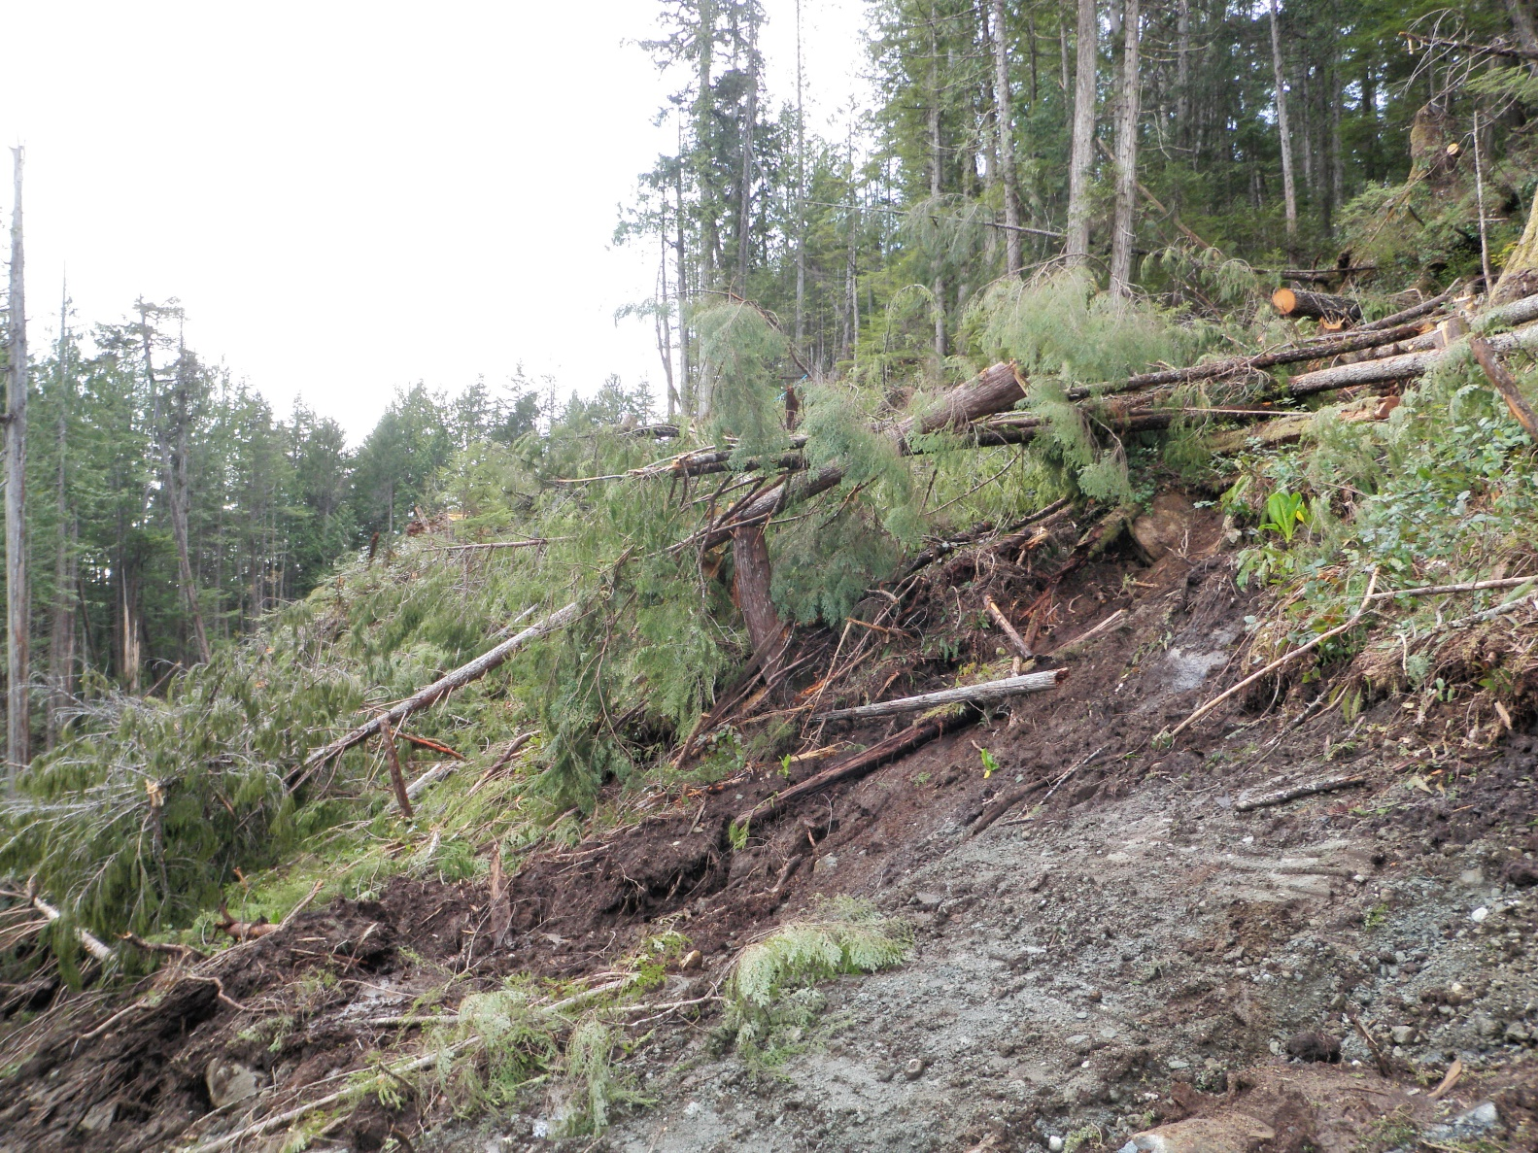
Huaskin Lake
Note Skunk Cabbage
Notes:
Landslide 1 (April): excavation on moderate 35-45% slopes; balanced cut-and-fill.
Road was transitioning out of bedrock-dominated cuts and had just begun excavation into a thick pocket of wet, organic-rich soils over compact grey sandy-clay soils.
Slopes above landslide showed wet-site indicators of skunk cabbage and Indian hellebore.

Slide 9
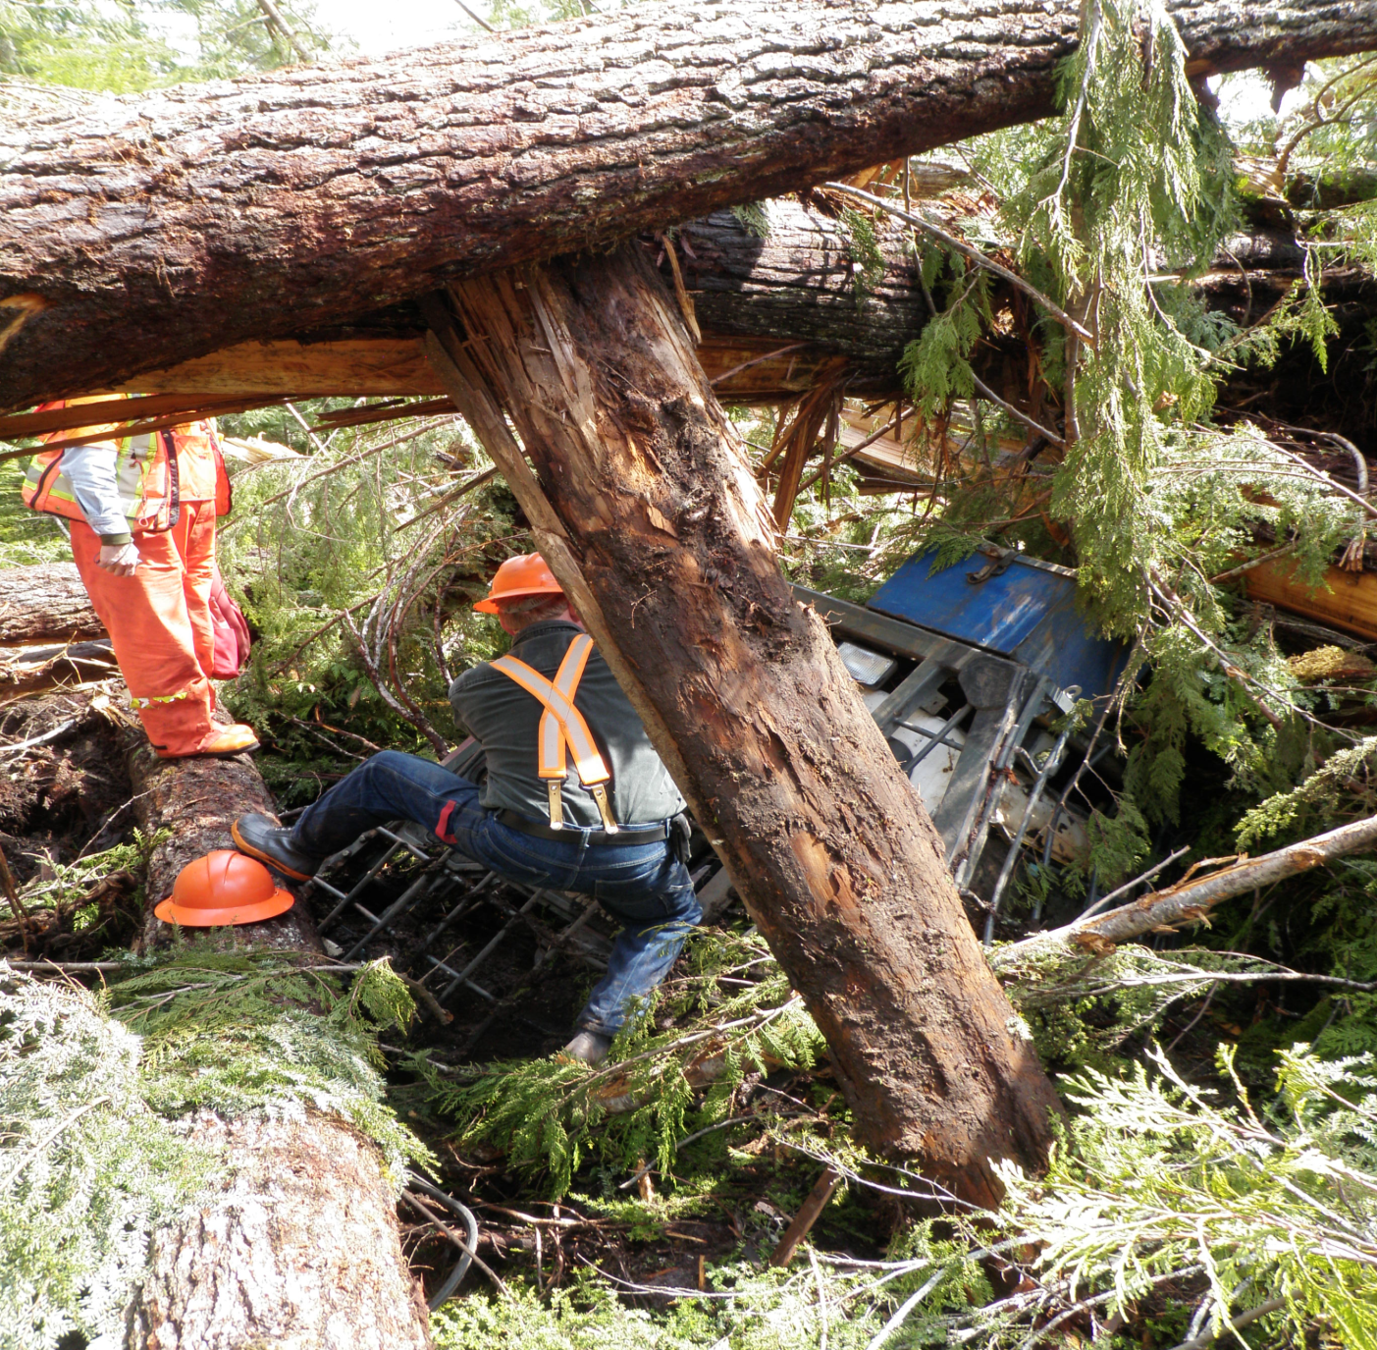
Huaskin Lake
Notes:
Landslide 1: excavator slid several hundred metres on moderate slopes down to old road below,
Then was bulldozed again by landslide debris a further 100m before coming to rest on a bench, partially submerged in mud and large trees.
Tote road had to be constructed to retrieve excavator.
Involved Worksafe and geotechnical investigations.
Road was moved into bedrock dominated-terrain and several full bench prescriptions were added to wet seepage areas.

Slide 10
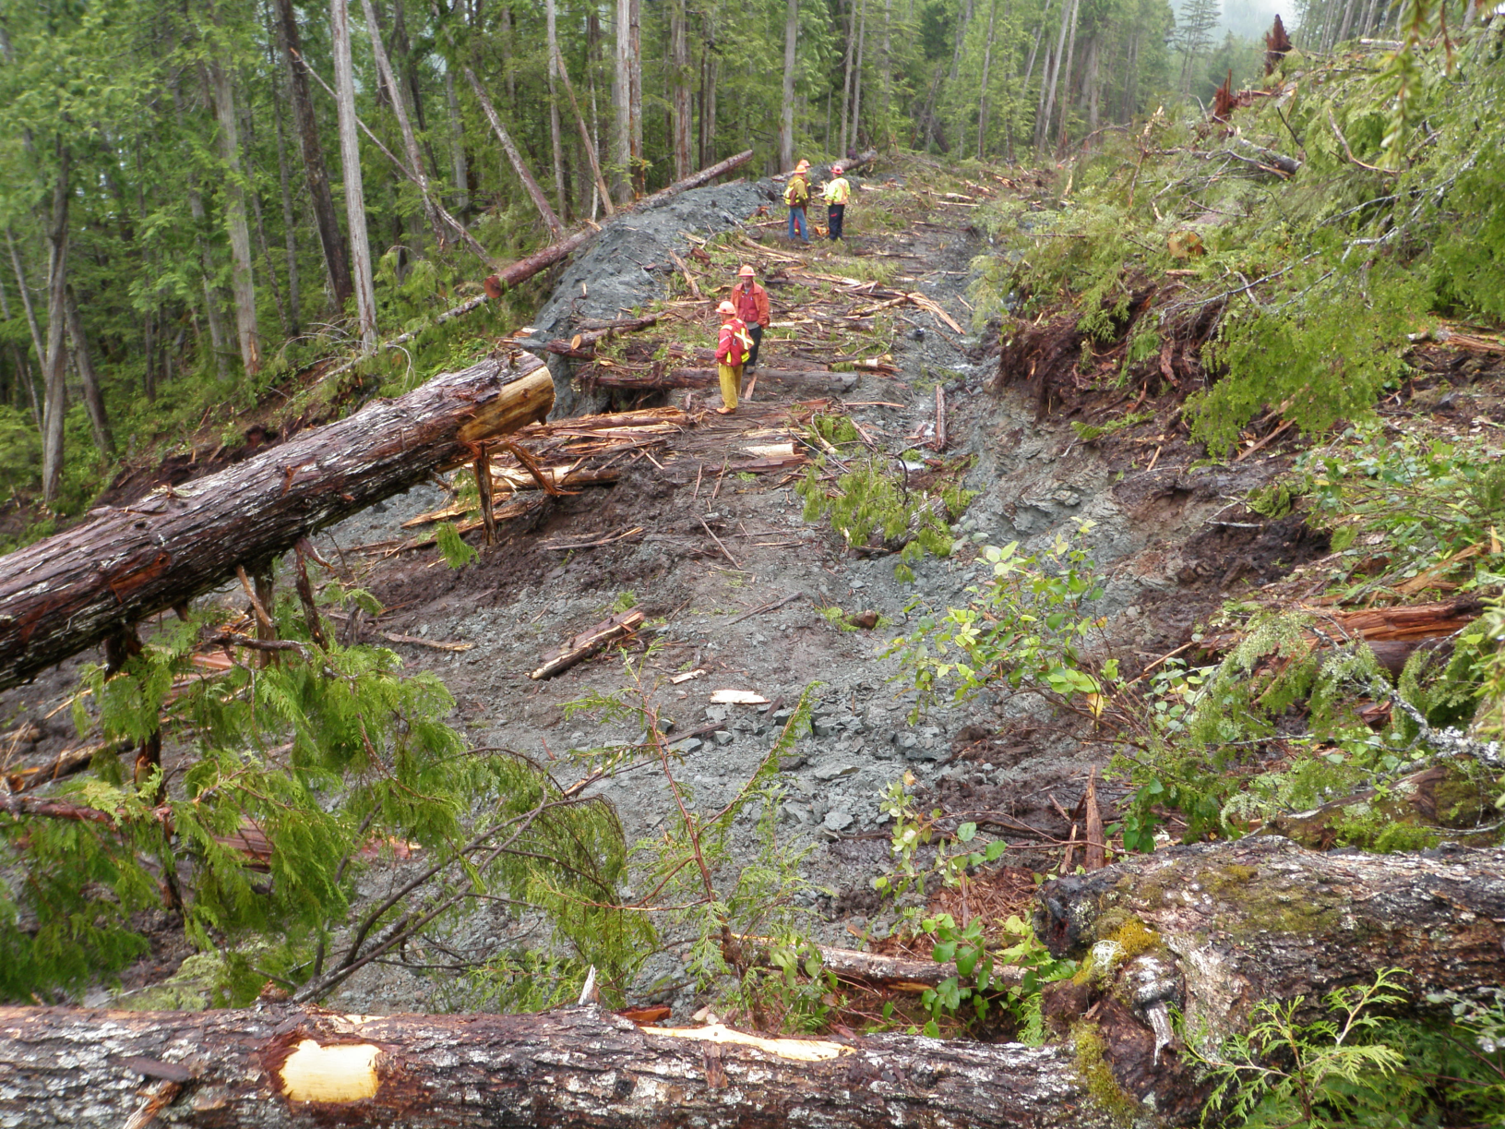
Huaskin Lake
Excavator Slid Here
Notes:
Landslide 2 (July): road construction on moderate to moderately steep slopes (50-60%) through a wet draw.
Prescription was for Full Bench-End Haul construction.
Instead, hoe was not on a full bench and was working on puncheon on wet organics over compact grey sand-clay soils.

Slide 11
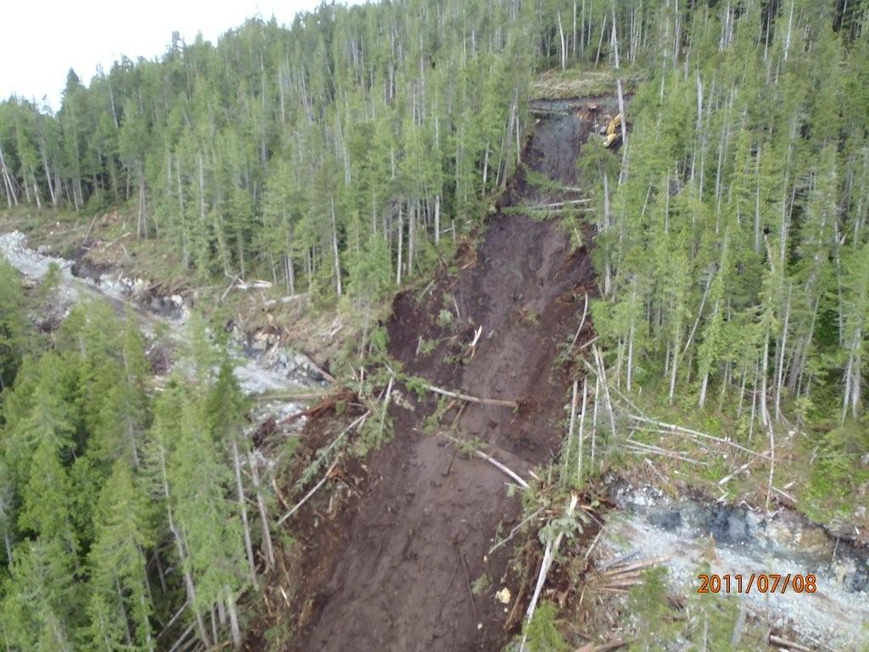
Huaskin Lake
Excavator
Notes:
Landslide 2: similar to landslide 1, operator heard/saw water flowing out of the ground downslope of the excavation.
Ground gave way 15 to 20m below road and excavator slid 15-20m downslope before his bucket found a secure hold.
Landslide continued as a mass of mud and debris for 150m across the lower road, before terminating another 250m down to lower benches, where fallers were active.
Near incident for Fallers.
Machine was winched back upslope.
Again Worksafe and geotechnical assessment.
Road was terminated at this point due to very high risks involved.
Loss of conventional harvest opportunity

Slide 12
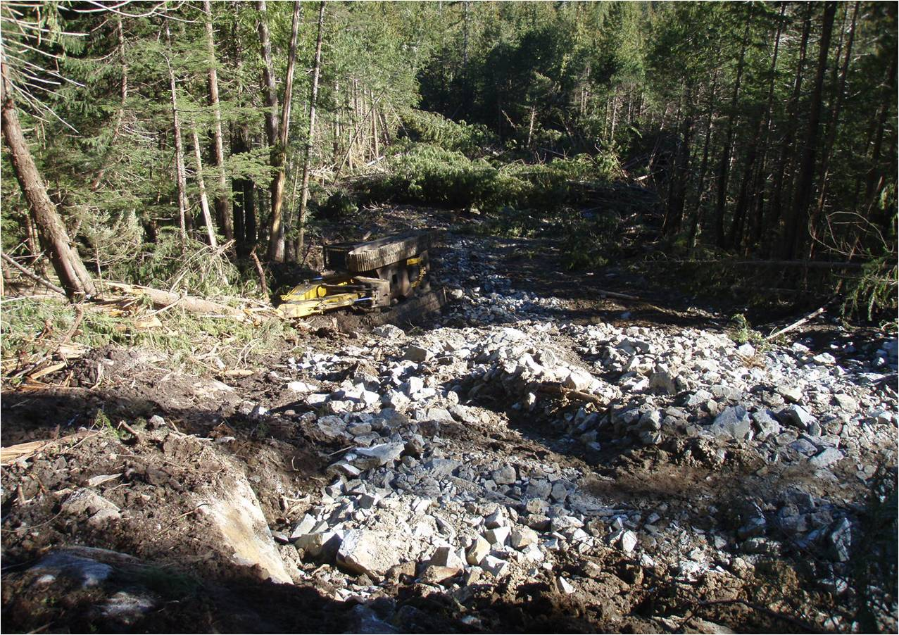
Yeo Island
Excavator
Top of Landslide
Road Construction in Central Coast; very dry summer conditions
Notes:
Operator was entering endhaul transition zone in moderately steep ground
Encountered a pocket of subsurface water and deep, wet organics that were not identified on plan
Excavator and operator moved out onto wet organics over bedrock rather than removing organics down to competent bedrock.
Operator did not stop and seek clarity or advice on the plan or the changed conditions

Slide 13
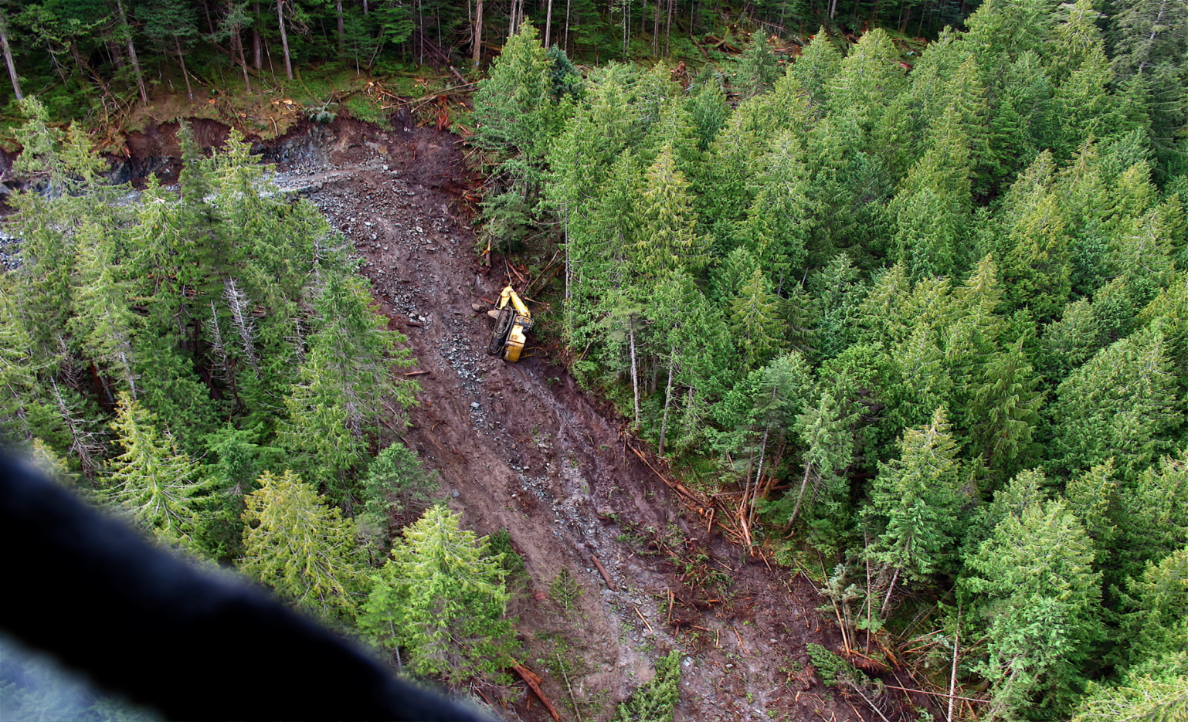
Yeo Island
Result: Expensive, dangerous and potentially avoidable landslide.
Notes:
Construction was shut down for 6 days.
Professional Geoscientists, WorksafeBC investigators and company reps were flown in and out to inspect and develop a plan.
A tote road was needed to recover the machine.

Slide 14
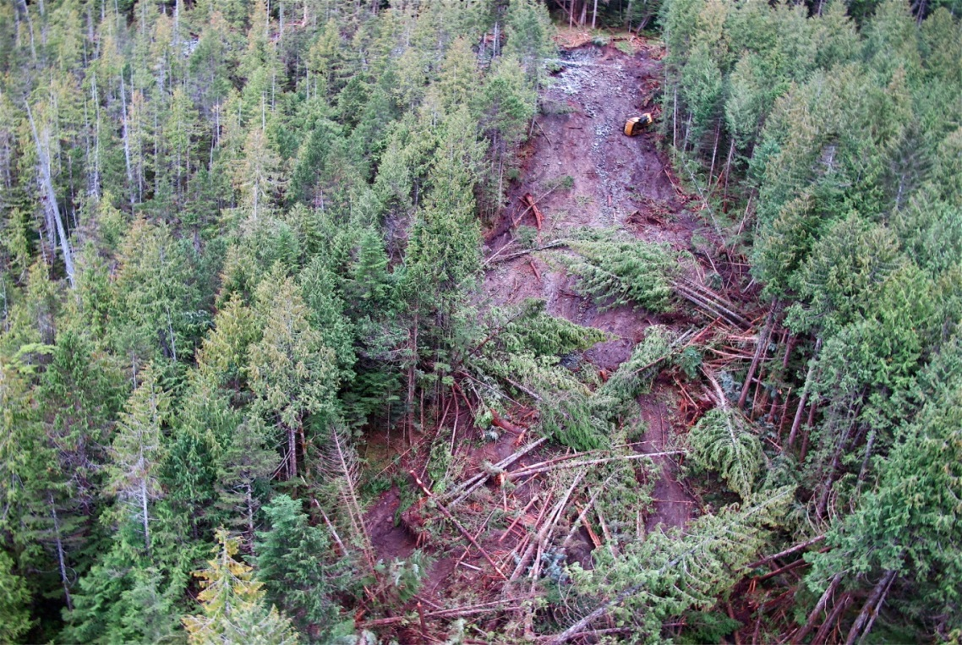
Yeo Island
Monetary costs:
$27,000 to repair excavator
$48,000 in lost production (6 day shutdown x $8,000/day)
$32,000 in transportation costs (crew, investigators, professionals)
$16,500 in other professional and administrative costs
$26,000 to build tote road to recover excavator
Lost harvest opportunity – gross value $400,000
Total direct cost of this landslide: $549,500 plus human impact
Notes:
The operator was not physically injured, but was unable to continue operating an excavator for some time.
No charges or penalties were issued, but the contractor’s reputation may have been negatively impacted.

Slide 15
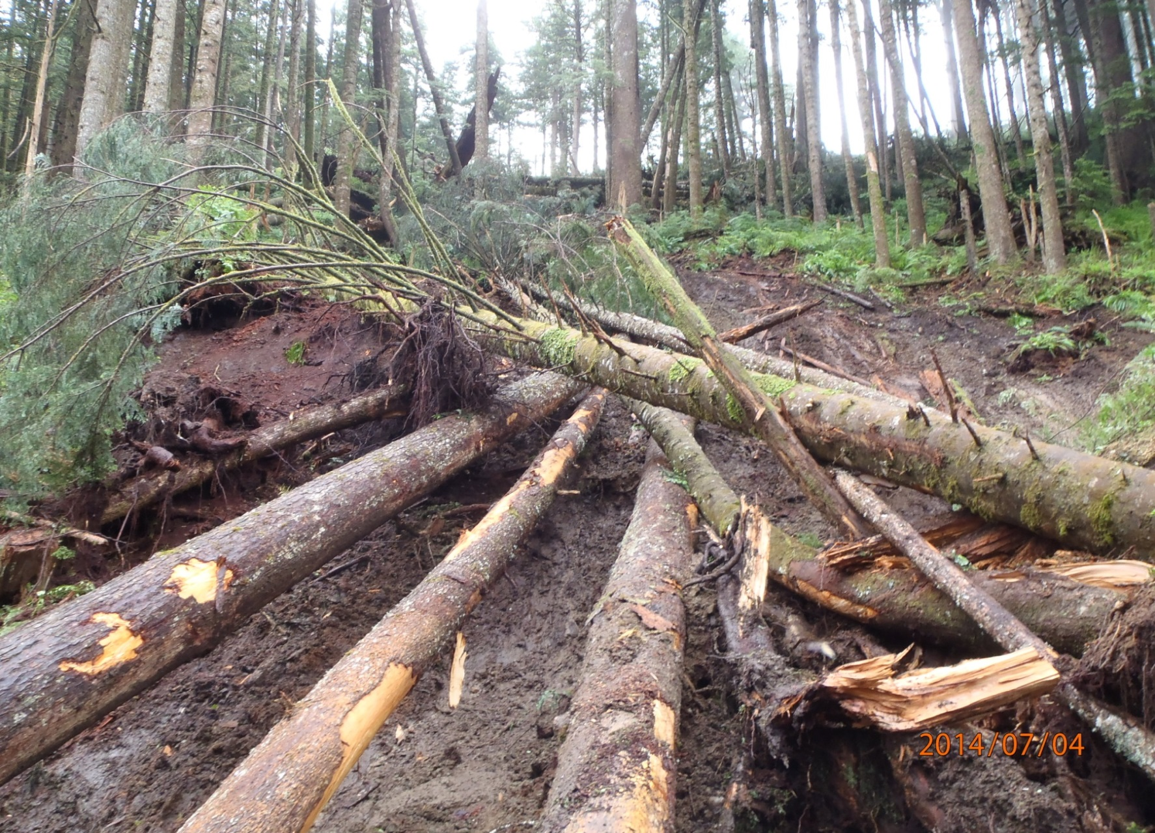
Holberg
Road construction project: Vancouver Island during July (dry conditions).
Notes:
Operator was working in “conventional construction” section, transitioning out of endhaul.
Slopes were 50-55%.
Operator noticed deepening, wet organics in the transition section.
Operator paused and asked for a reassessment of the plan for this section.
On the operator’s advice, the centerline was moved into the bank and additional endhaul was approved, even at increased cost.

Slide 16
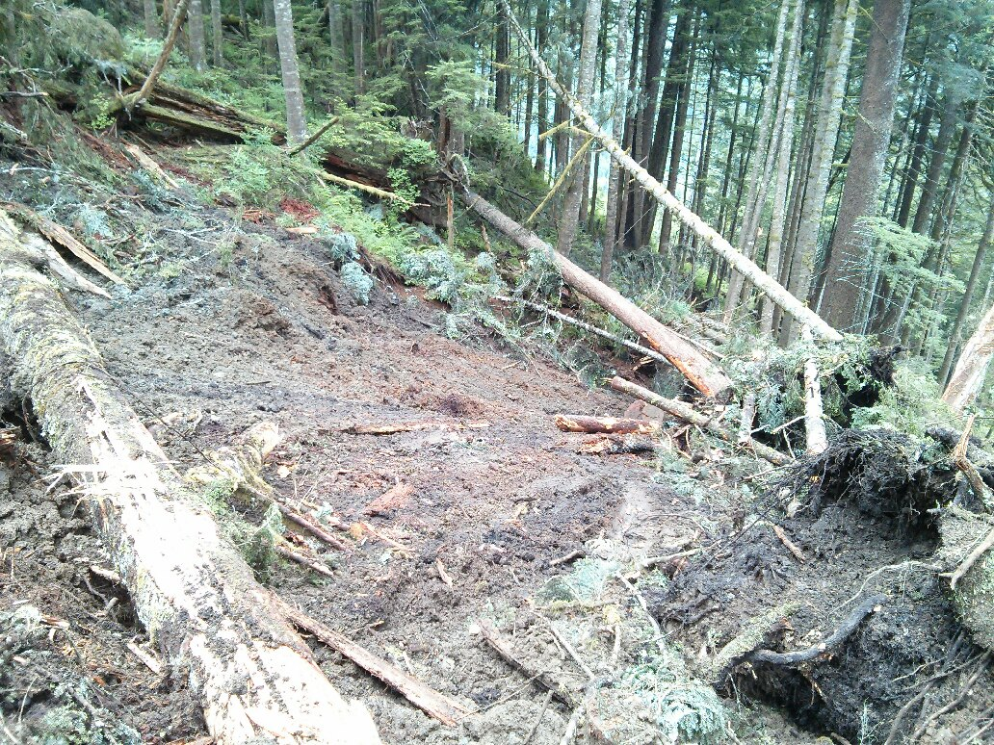
Holberg
Slide still occurred despite dry conditions.
Notes:
It was much less significant than what could have occurred if the centerline was not moved and additional endhaul was not prescribed and approved.
No equipment or personnel were involved in the slide, likely because of the proactive approach taken by the operator.
Environmental damage and loss of timber was minimized, as the slide was medium in size (estimated .25 hectares in size).
Cleanup and reassessment was minimal due to the medium size of the slide.
The contractor was able to return to work quickly, reducing lost $$.
NO ONE WAS INJURED!

Slide 17
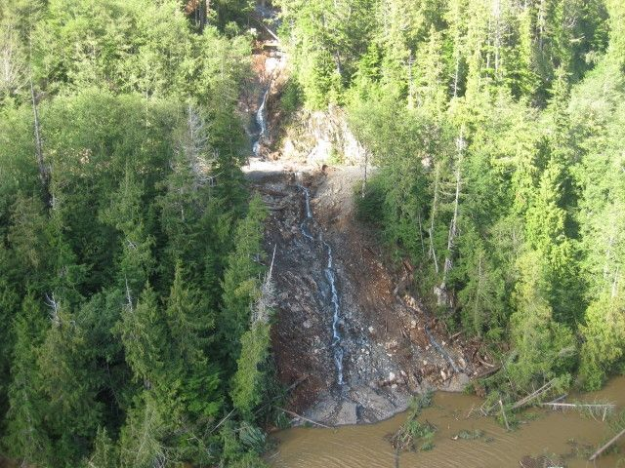
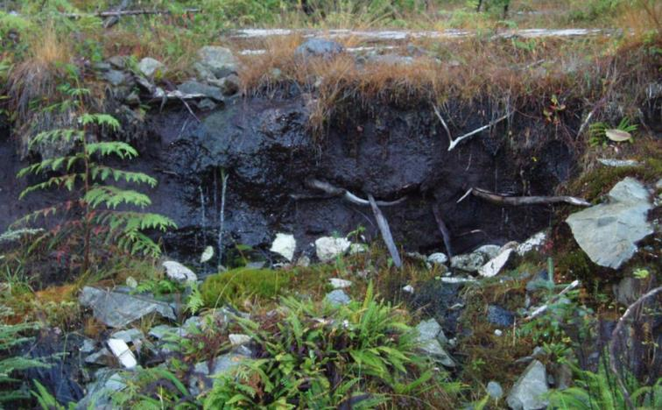
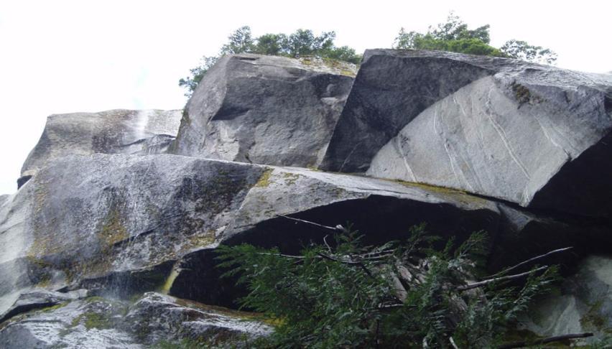
CIS Contributing Factors
Water
Soils
Bedrock
Planning
Production
Weather
Operator competence
Changed conditions
Notes:
Slides are occurring on Vancouver Island, South Coast, Haida Gwaii and central coast with a regularity that is unacceptable.
Factors that effect the risk of initiated slide event can range from environmental to operational.
There are many different factors to consider.
The goal is to try and understand them, recognize indicators and eliminate the events from occurring to prevent fatalities, injuries and promote effective business.
Operator competence plays a factor, young operators typically lack knowledge and seasoned operators can become complacent.
Unknowns/changed conditions of rock, soils, drainage are one of the largest factors until excavation begins.

Slide 18
If a Potential Danger or Hazard exists, or you are unsure about any situation:
Personal Safety
stop work
move to a safe area
consult a supervisor
Notes:
Safety of all personnel involved with planning and construction is paramount.
Interruption to construction activities is always a difficult call, but if conditions look questionable for any reason it is imperative that appropriate action is taken.
This may include reassigning of personnel/equipment/activities or work stoppage.
The cost of not making the right call can be substantial and potentially catastrophic.
There is no road that is worth having workers seriously injured or worse.

Slide 19
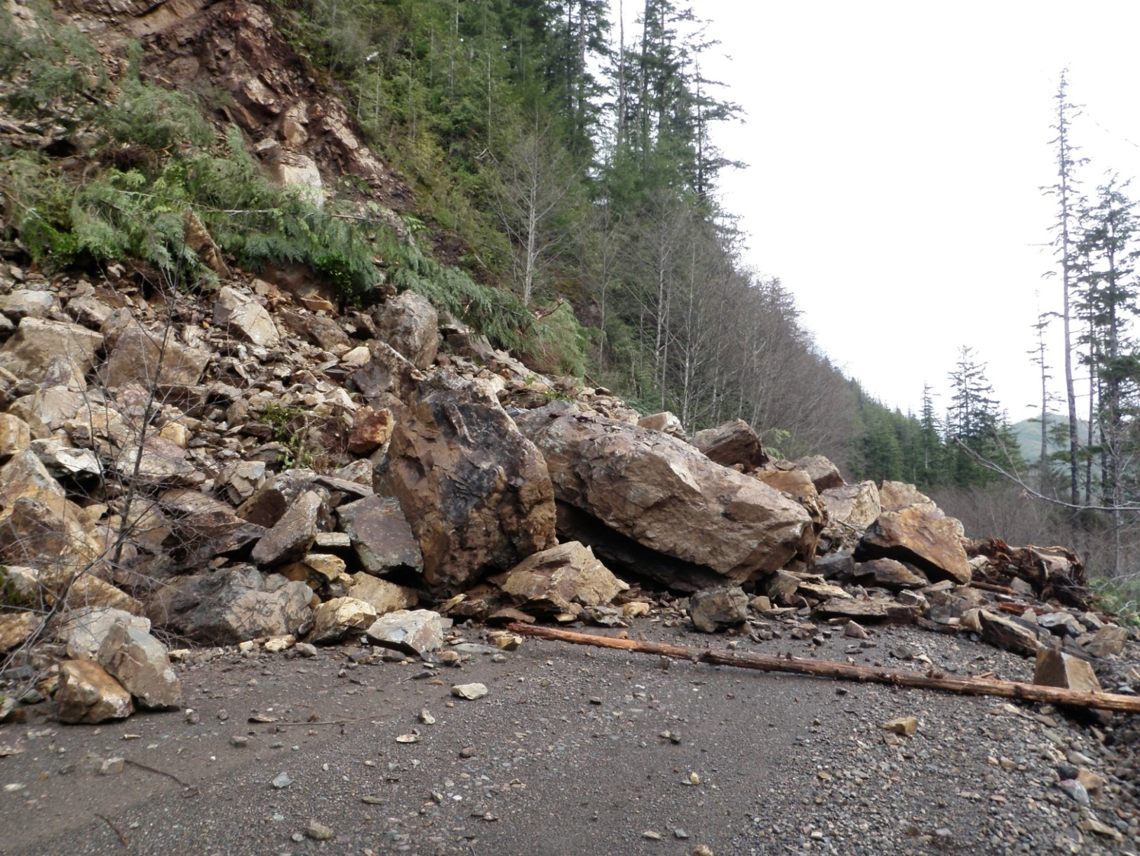
Personal Safety
Rock Slide onto Mainline
Always be aware of your surrounding and associated site conditions
Notes:
Communication is critical.
Report hazards
Pass all information and knowledge on to other members of the crew, particularly between shifts and phases.

Slide 20
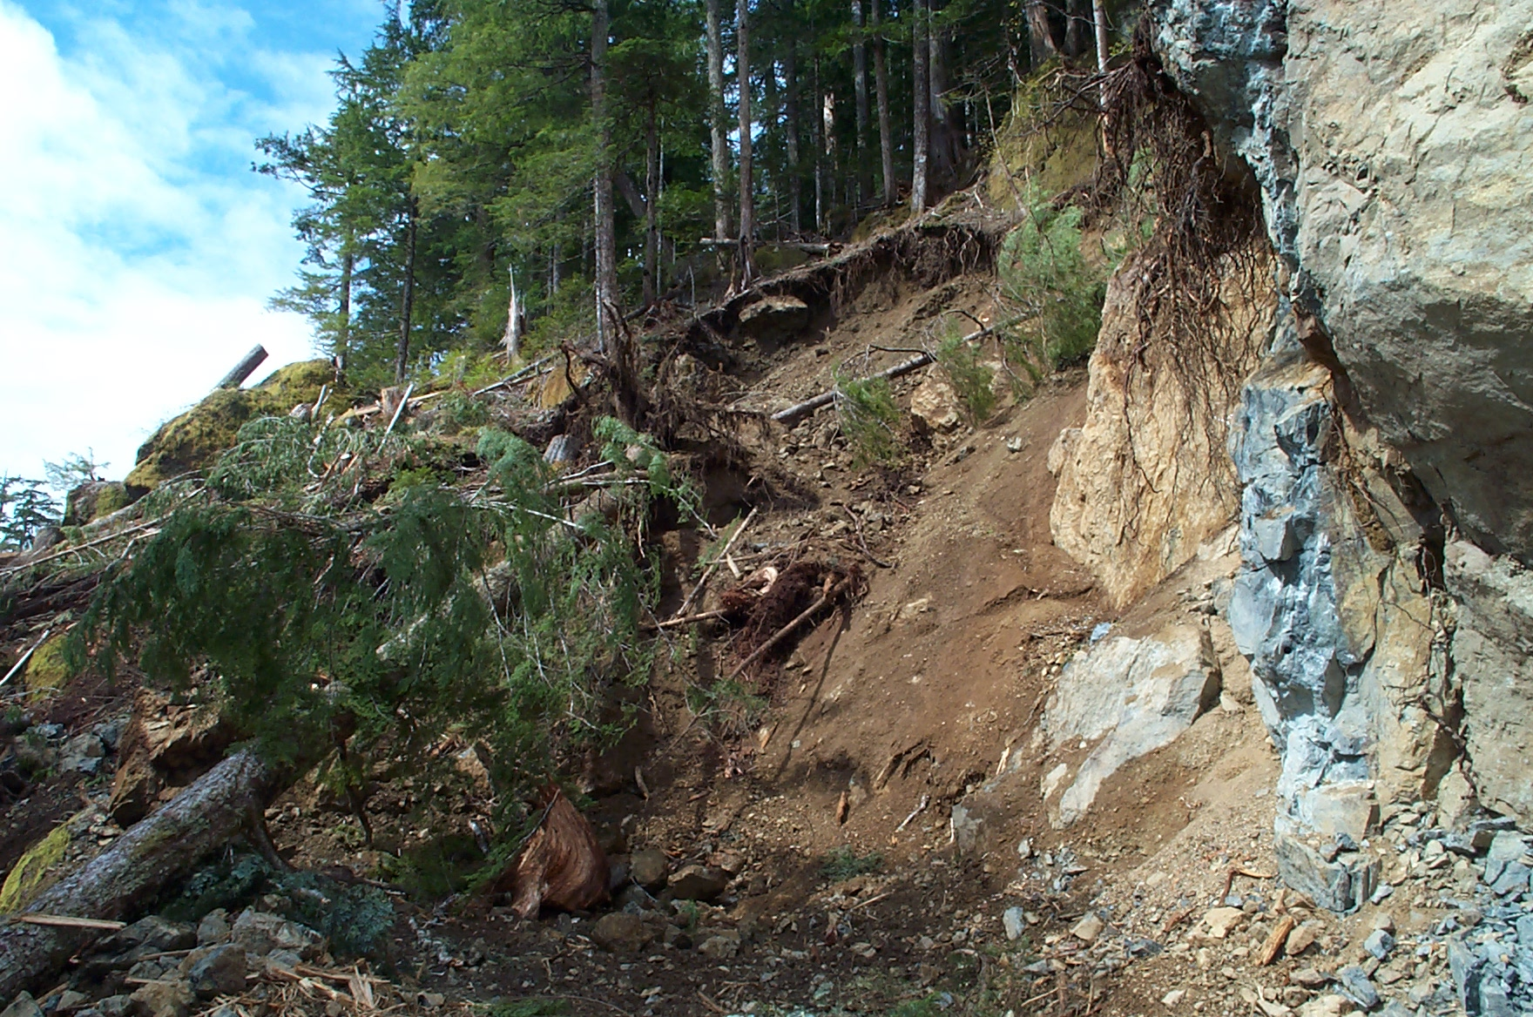
Personal Safety
Cutslope Failure
Are there steep slopes above or below?
Notes:
Potential for terrain instability below or above road prism.
Rock instability – appropriate assessment/scaling
Can occur during and after construction.

Slide 21
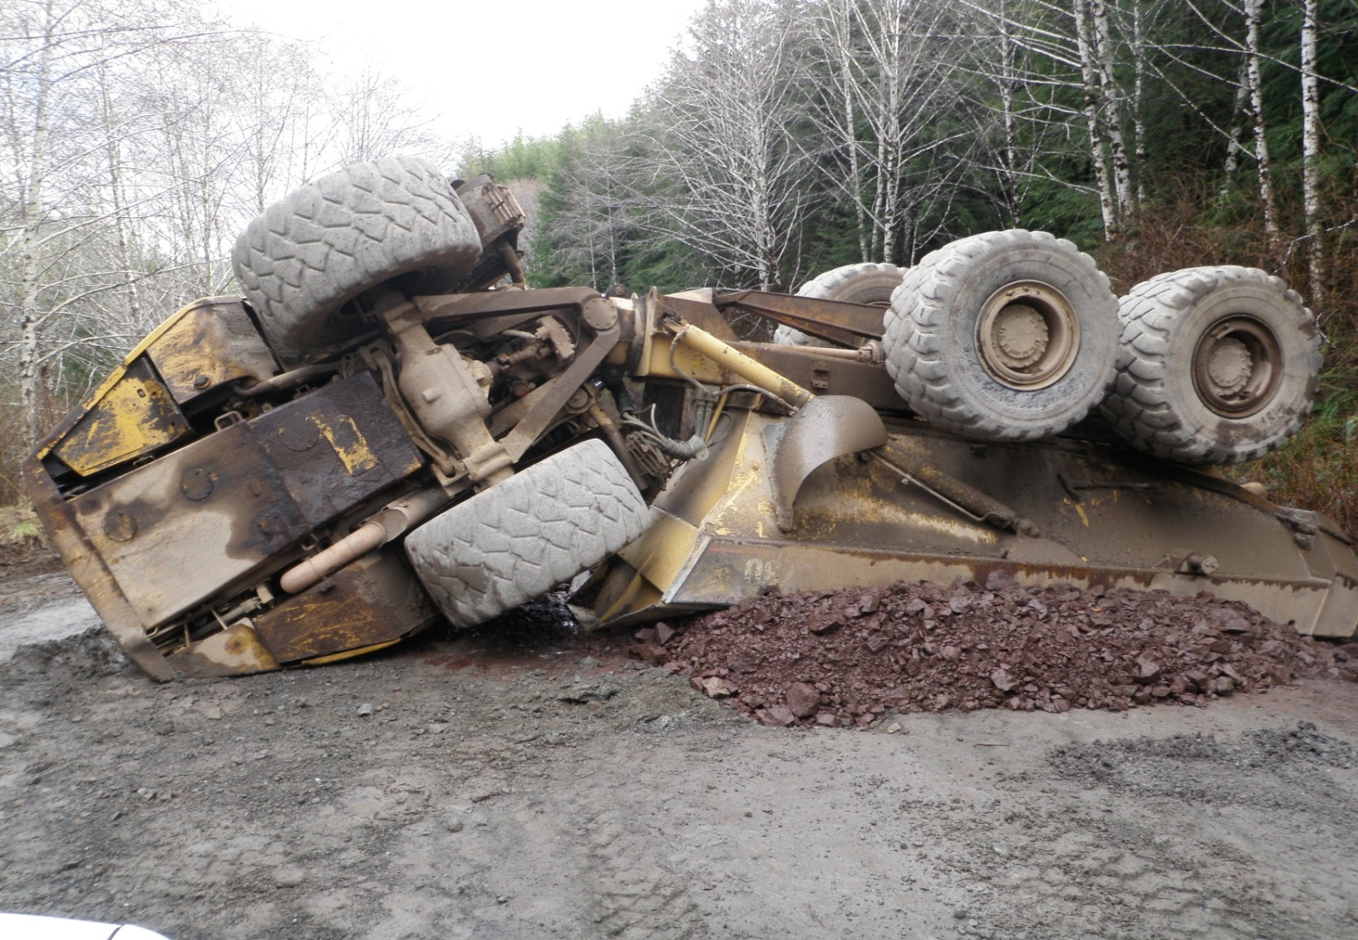
Personal Safety
Play it Safe

Slide 22
The Plan!
Typical Process
Road Planning
Field Review; Engineering and Geotechnical Surveys
Final Road Plan and Design
Road Construction Prework
Road Construction Phases
Road Construction As Built Review
Notes:
There is typically a very comprehensive process involved with road planning and development.
The objective of this process is to ensure the construction meets the objectives of the overall timber development plan and that road design and safety is maintained throughout the process.
Integral to the planning and development process are key individuals and organizations.
These include the licensee staff, government agencies, contractors, and professionals/specialists (i.e. PGeo, PEng, RPF, RFT etc.).
All these individuals are part of a team who are responsible to ensure the development work goes according to plan and is done in a safe manner.
Contractors/Operators are typically very knowledgeable and have developed skill sets regarding road construction.
This knowledge and skill is critical in terms of both team participation and slide prevention.
Applies to reactivation and deactivation as well.

Slide 23
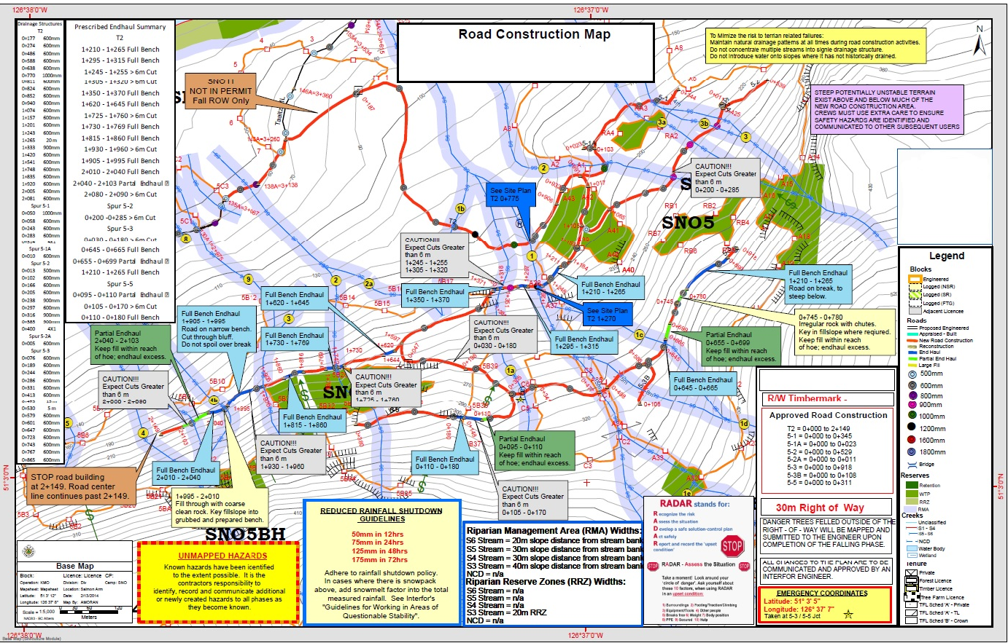
The Plan!
The plan can be complicated
Notes:
Construction on steep slope areas can be complicated.
Comprehensive review and subsequent discussion regarding the plan is critical for all those involved with planning, supervision and construction.
This process will ensure knowledge transfer and provide an opportunity to raise awareness and spur discussion regarding areas requiring special attention during the construction phase.
If the plan is too complicated to understand, is not well documented, or does not make sense, stop, and ask for clarification.
Having a clear understanding and any subsequent input is critical.

Slide 24
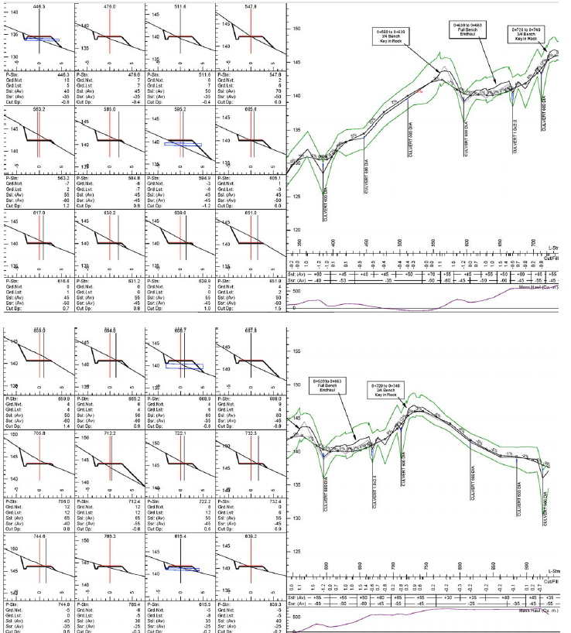
The Plan!
Typical road design plans and profiles
Notes:
Need to understand and follow the plan.
The plan map, profiles and cross-sections are the guts of the plan.
Important to understand them.

Slide 25
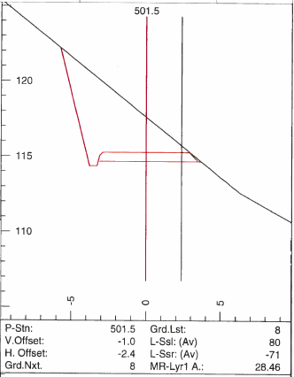
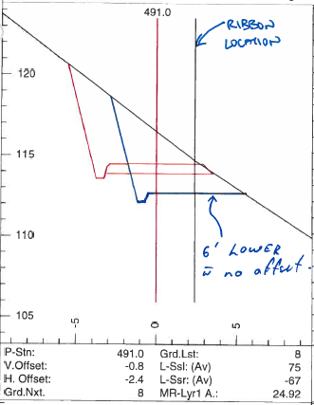
Understanding the Plan!
Full bench road design cross section
Notes:
Minor changes to road location in the field may result due to slight offsets in ribbon locations when compared to the road centerline on the plan.
This is typically not an issue, but if consistent should be brought to the attention of the road construction supervisor.
Relocating the centreline can have significant effects at control points, (bridge crossings, switchbacks, landings, etc.).
Again, understanding is critical.
STOP and get clarification when and where required.

Slide 26
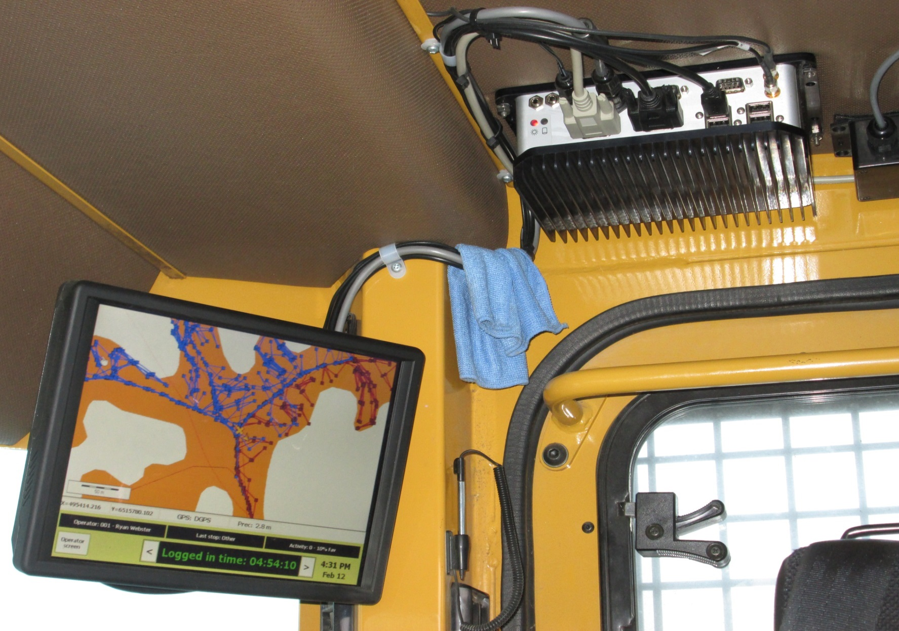
Understanding the Plan!
Digital road design interface
Notes:
Digital display of the plan is an option and can be very beneficial especially when combined with a georeferenced machine location.
This allows the operator to know exactly where he is in relation to the road location/design at any given time.
This not only has the potential to improve productivity, but ensures the operator has real time data relating to the road design/construction requirements.

Slide 27
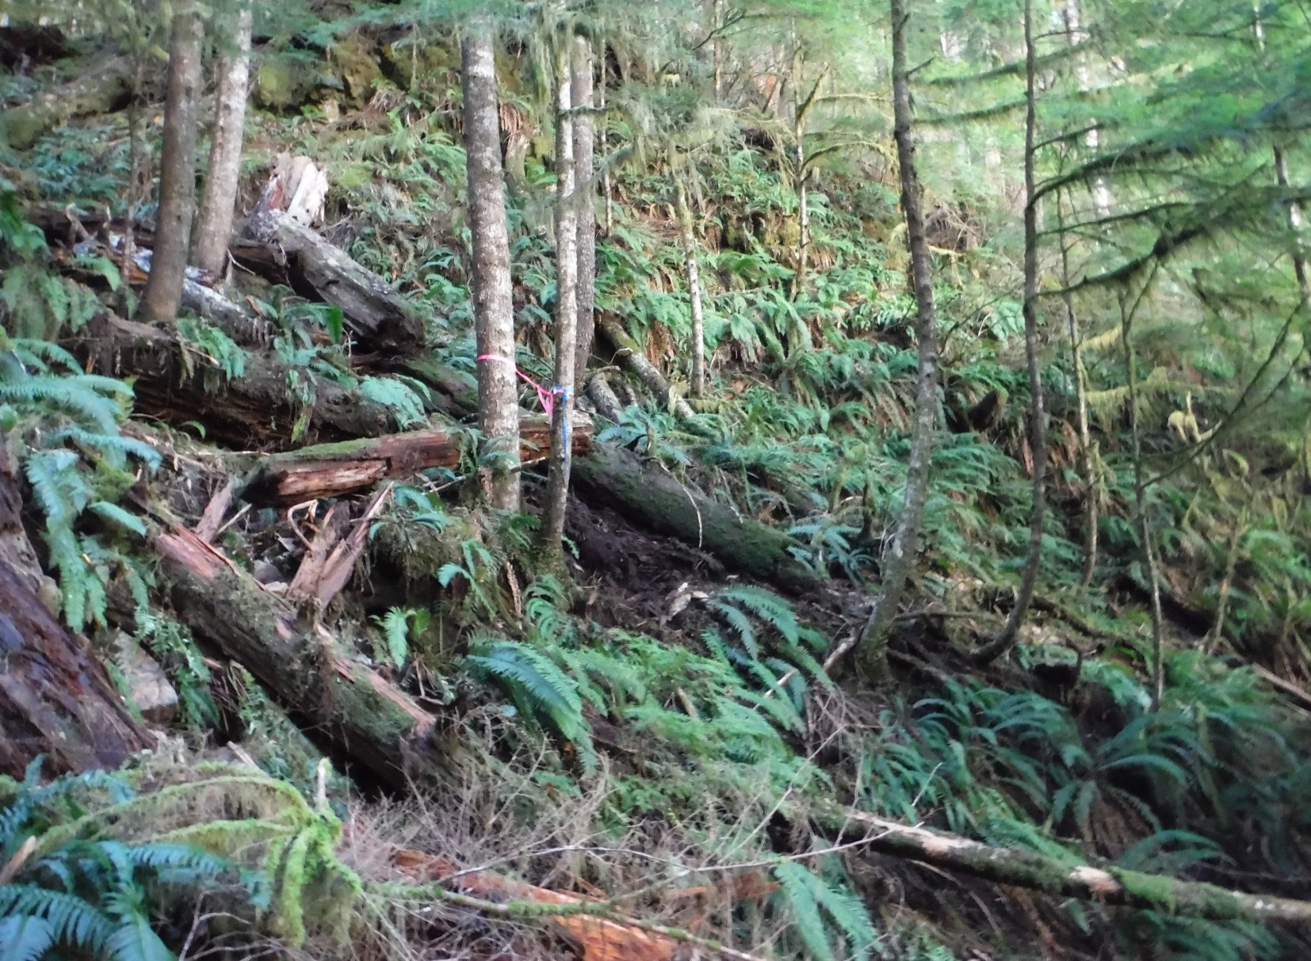
Soils and Terrain
Note pistol-butted trees,
deer fern & soil parting
Be aware of areas that hold moisture !!
Notes:
Areas of subsurface and overland seepage often contain organic soils and excess water, which promote unstable slopes.
This can determine appropriate construction methods and the level of drainage control measures required.
Excessive water, heavy fern cover, devil’s club, salmon berry or swayed, pistol-butted or jack-strawed trees etc.
Sometimes these areas are more visible after R/W felling and the planning team does not always catch them during the field work.
Given this operators are a second set of eyes and are very important in this process.

Slide 28
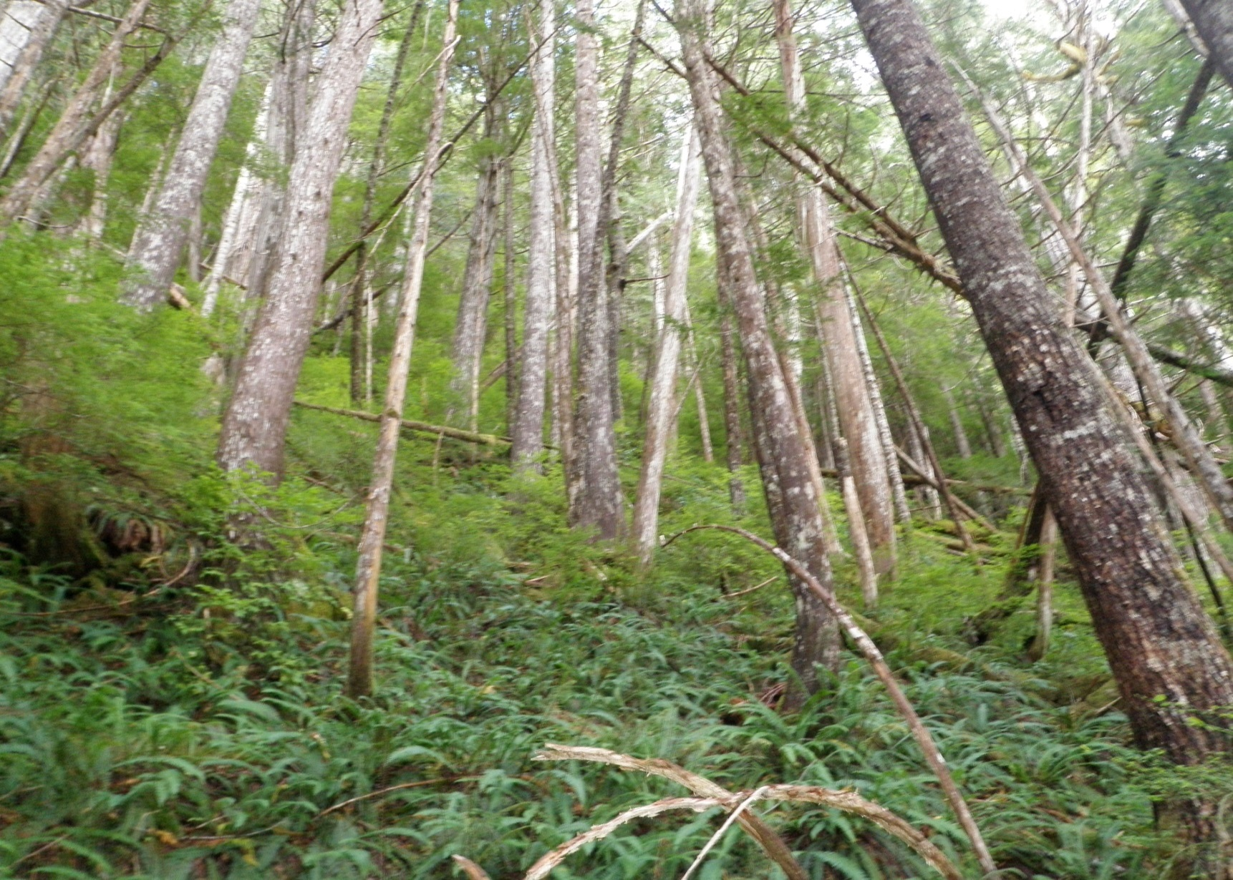
Soils and Terrain
Seepage/wet soils/ deformed trees
Notes:
Leaning, jack-strawed & pistol-butted trees often indicate potential soil instability which can also be associated with subsurface and overland water flow
Especially when in combination with wet site indicators such as:
Heavy fern cover, skunk cabbage, salmon berry, devil’s club, etc.

Slide 29
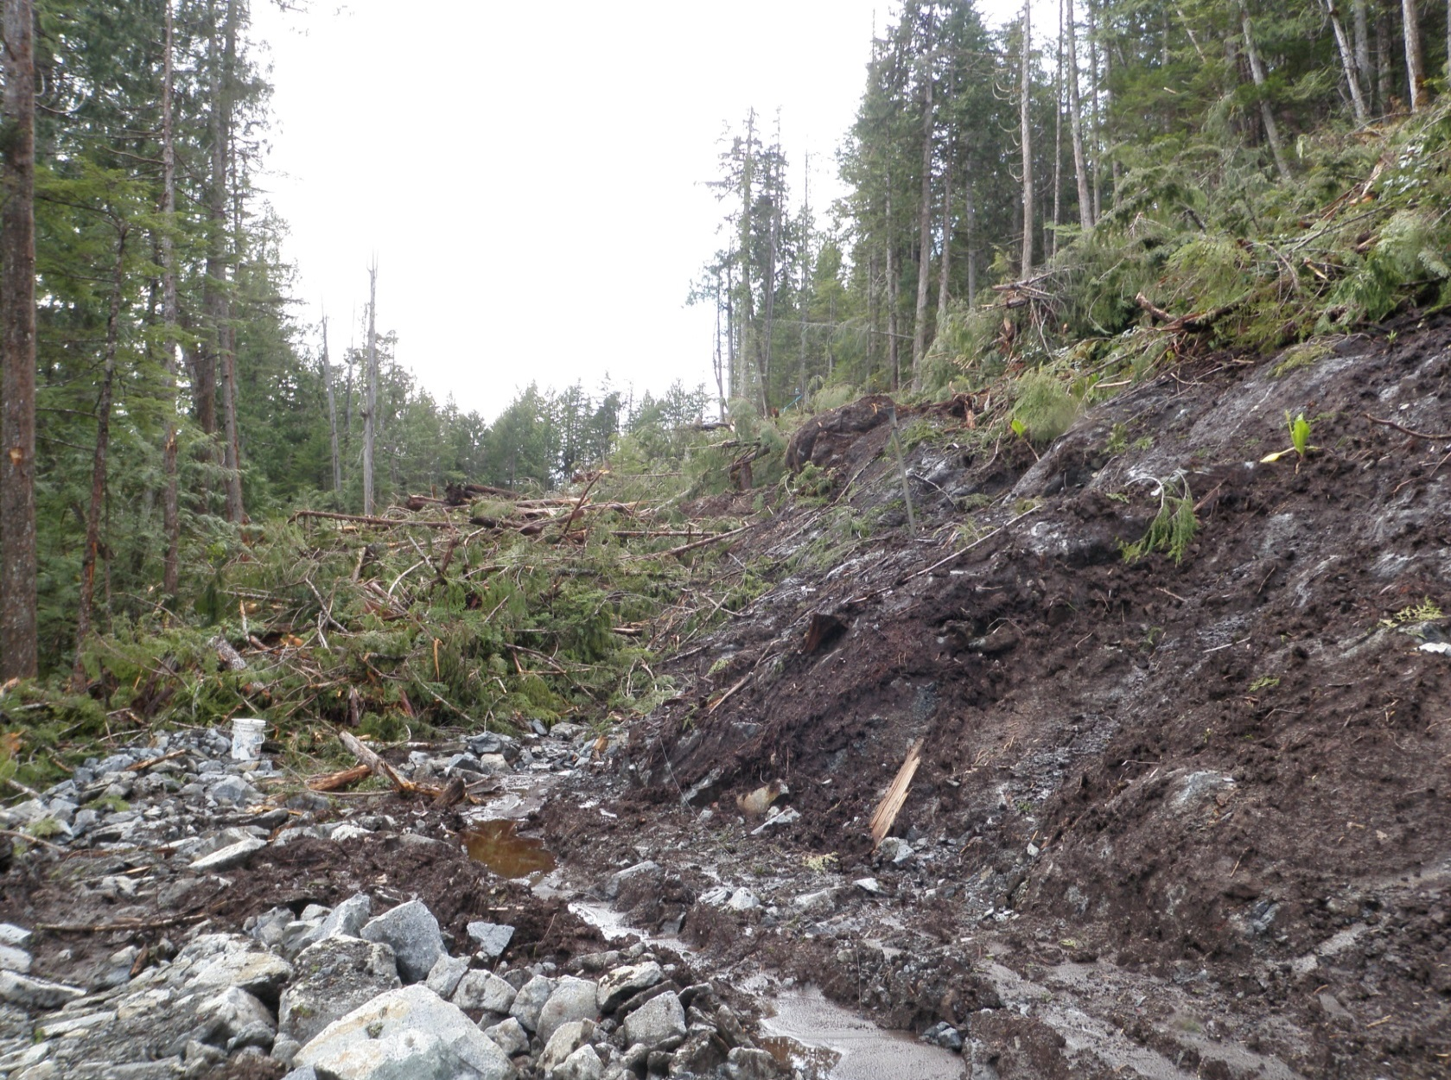
Soils and Terrain
Organics over bedrock; ponded water
Notes:
Combine water with organic soils or compact soils and steep slopes and we have a high hazard.
This a prime location (likely transitioning from steep terrain to a bench) for the potential to sneak ahead which can result in triggering slide events.

Slide 30
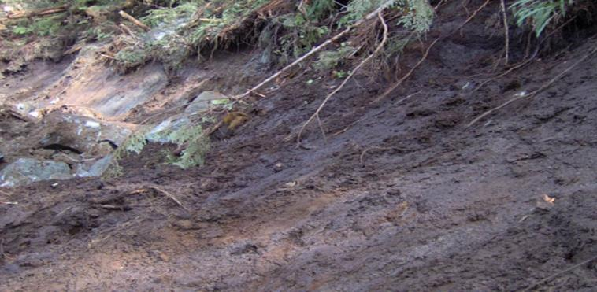
Sediment layers and organic accumulations are commonly greater in draw features and may store significant amounts of water:
Soils and Terrain
Remember:
1 bucket of mud
mixed with 5 buckets
of gravel or sand
= 6 buckets of mud
Notes:
Attention to DRAINAGE and appropriate GRUBBING, STRIPPING and SPOIL PLACEMENT is critical.
Ensure machine is on stable ground.
Plans may have assumed more rock than exists at the site –
Therefore more end haul may be required. Stop and reassess.

Slide 31
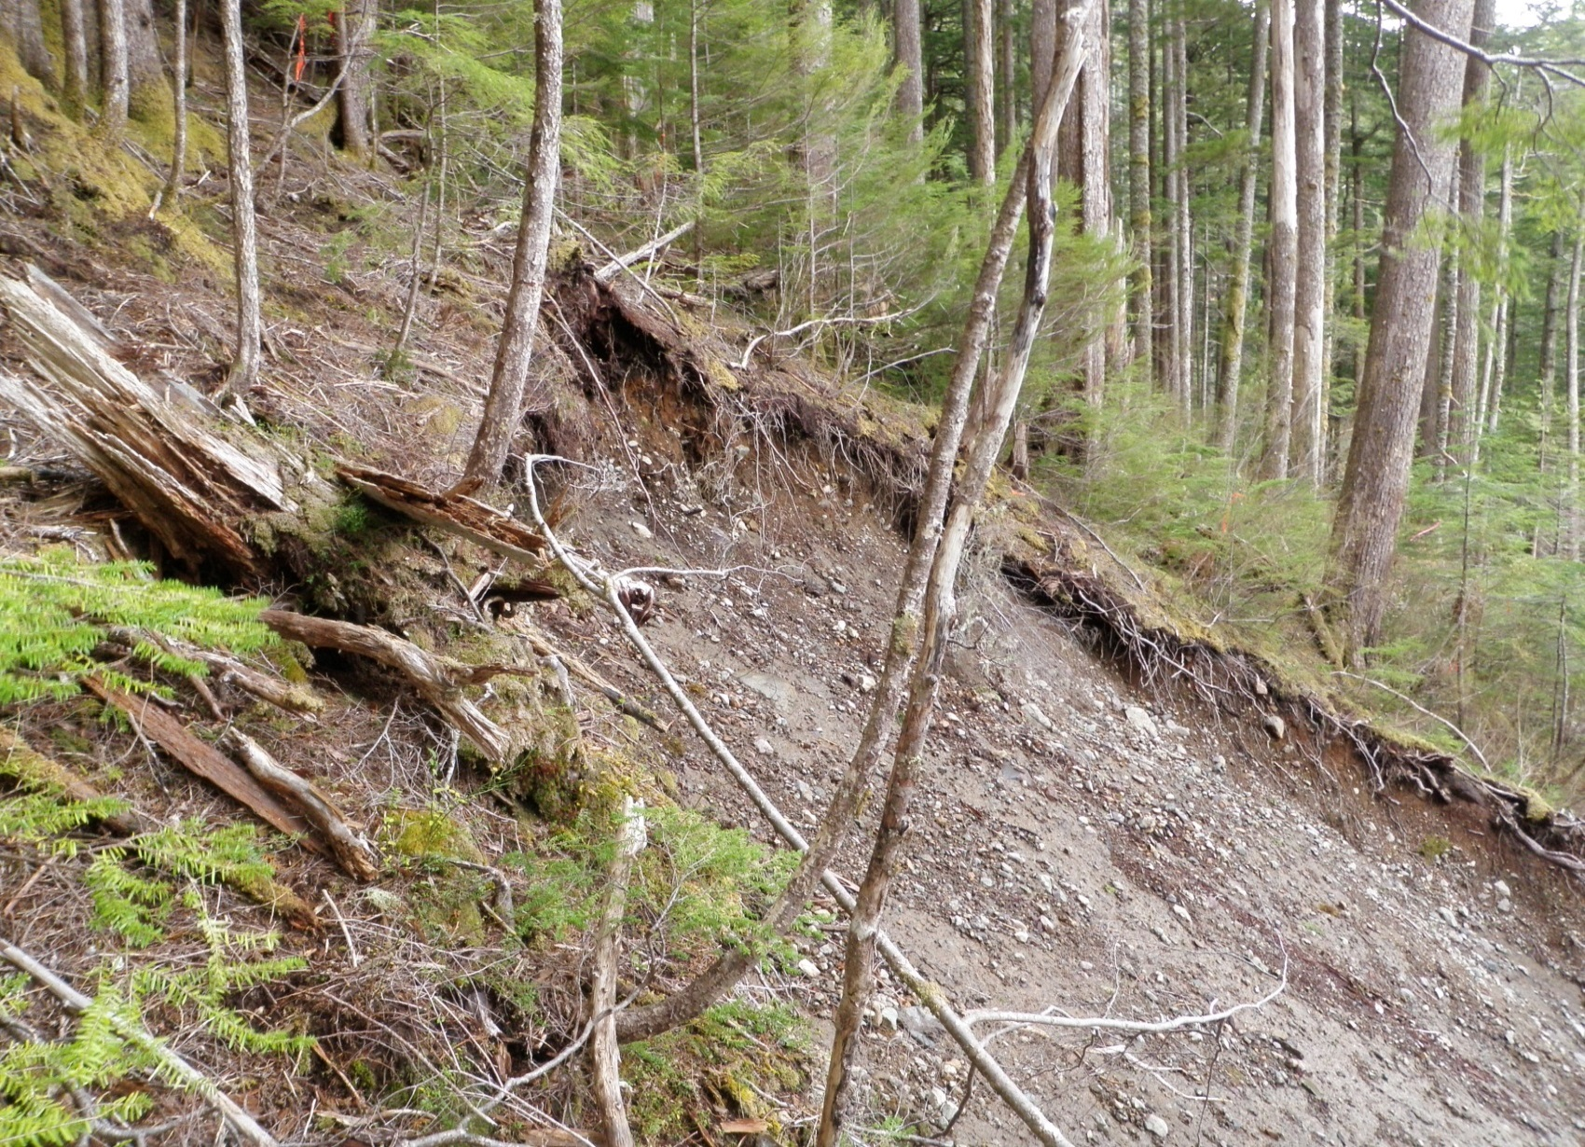
Soils and Terrain
Pistol-Butted trees and soil movement indicating slope instability
Notes:
Areas which show soil movement/creep should be avoided where possible.
These have likely been assessed by a geotech with a construction prescription for the site.
If construction through these areas is required, the plan and construction methods should reflect the potential for and mitigate slope instability.
If the contractor/operator sees signs of instability that are not indicated on the Plan, work should be stopped until clarification is reached.

Slide 32
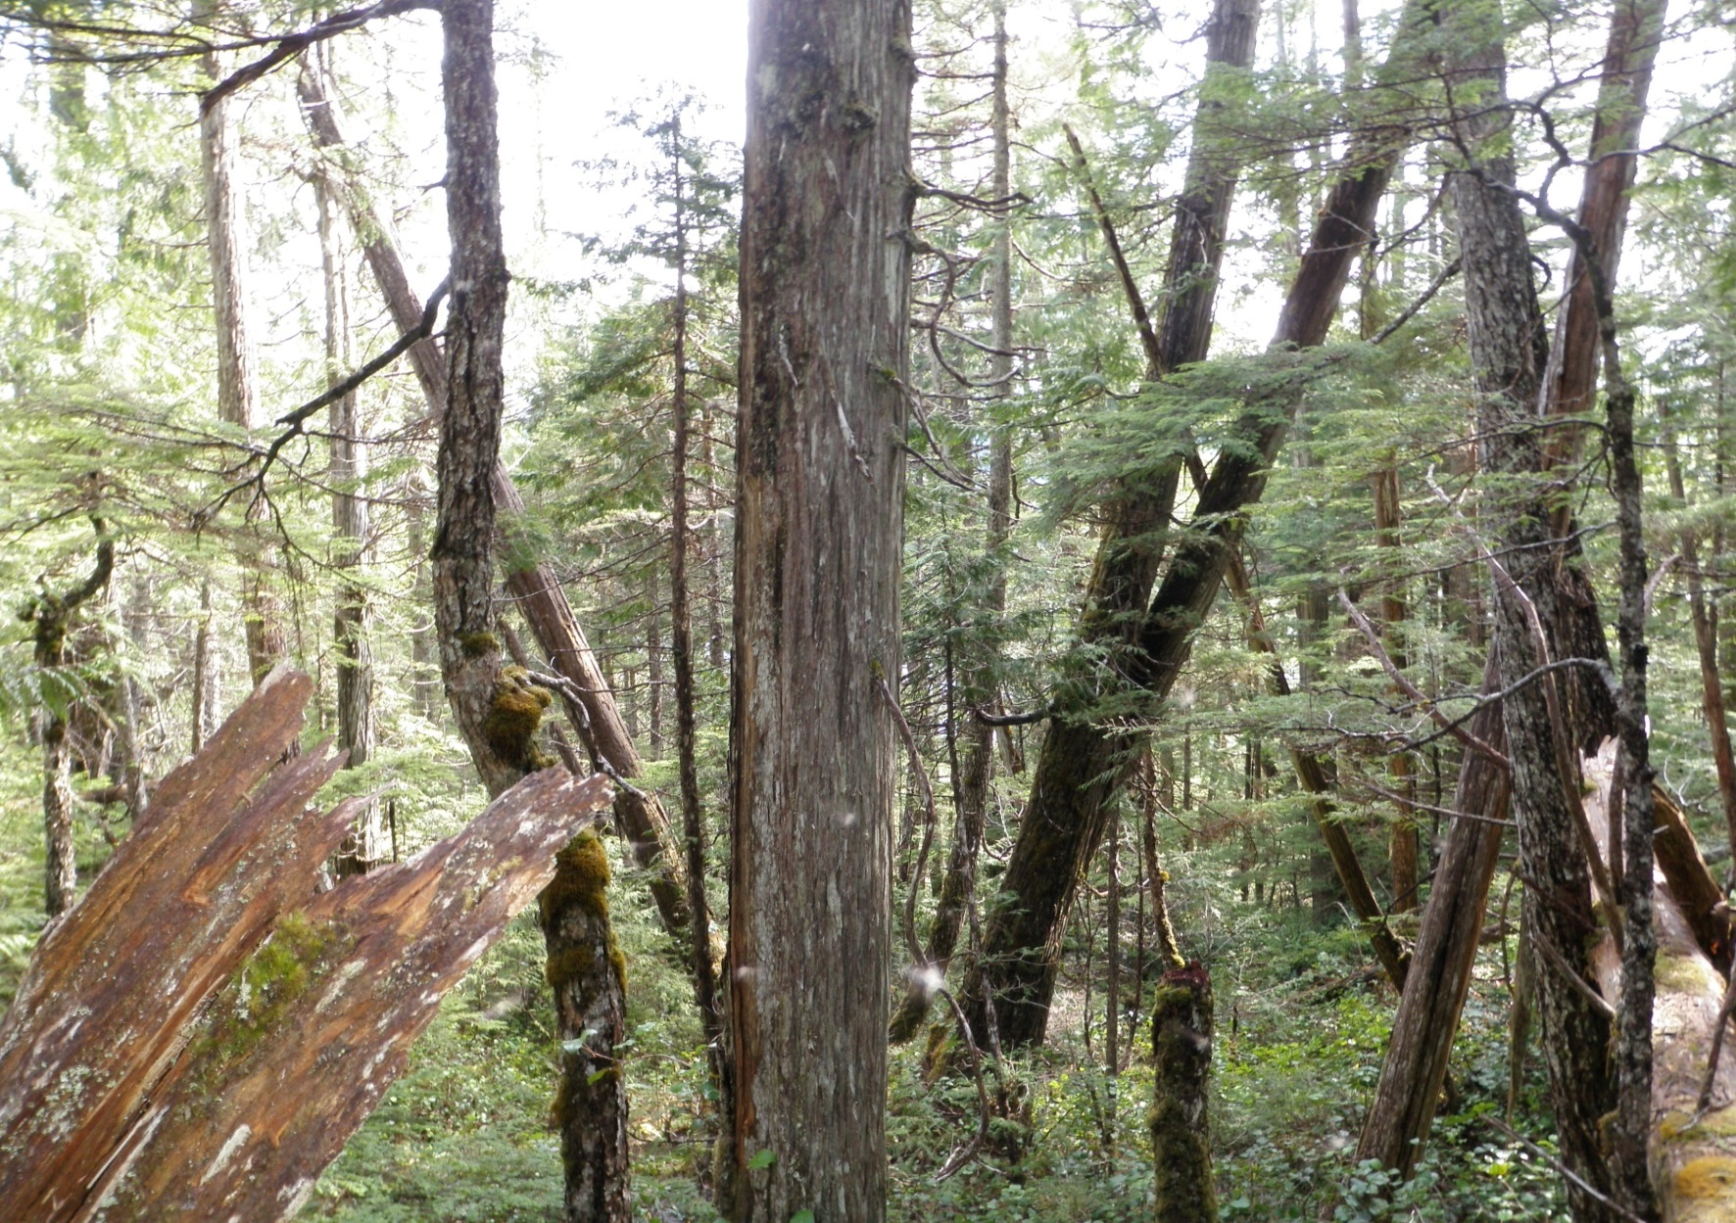
Soils and Terrain
Jack-strawed trees indicating slope instability
Notes:
Jack-strawed trees are a fairly common occurrence on inherently unstable terrain.

Slide 33
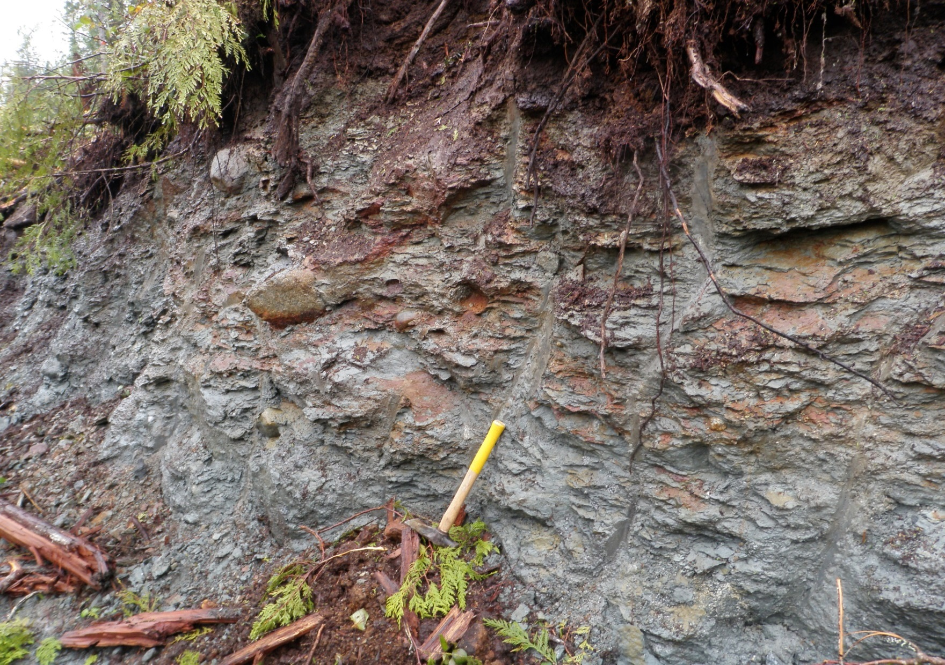
Soils and Terrain
Hardpan soils acting as a water barrier
Notes:
Beware of higher water tables, creating slippery working surface and potential instability.
This was a slide initiation area/cut slope, where a 400 m long slide initiated in fill slope below due to full bench not being carried out.
Jack-strawed trees were numerous in the seepage draw below road, see previous slide.

Slide 34
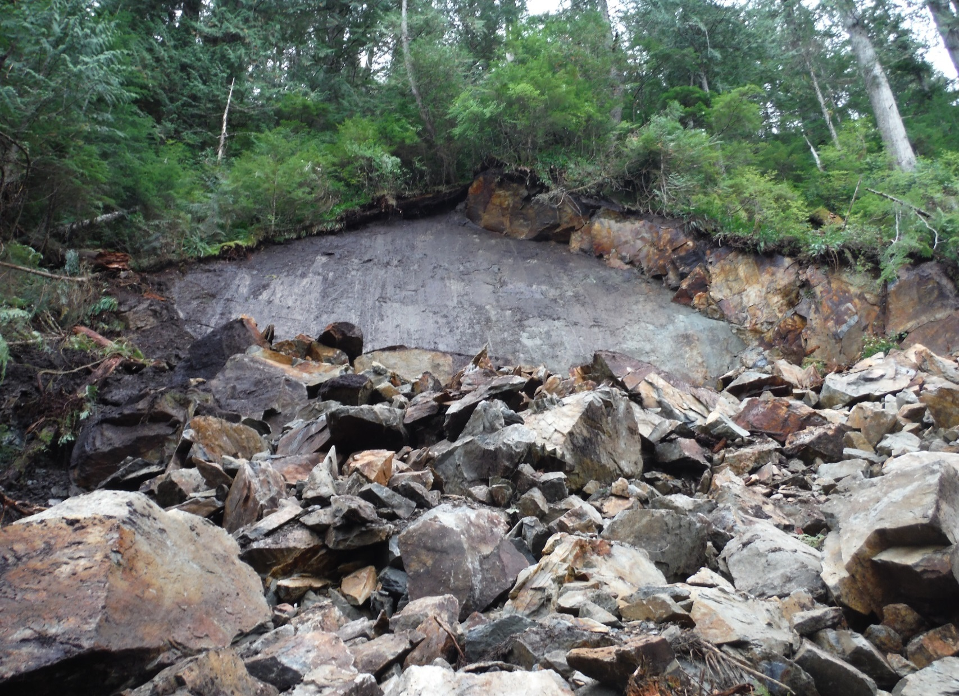
Soils and Terrain
Slip plane with unstable
masses remaining on top
Rock instability
Notes:
High Rock cuts can be High hazard during construction
May also be designated as “No Stopping” zones after construction for hauling and harvesting operations.
Above photo shows steep fracture plane in rock paralleling road, which is a common cause of rock fall.
This road was abandoned due to large volumes of unstable rock along road location.
Not observed in the PLAN…
Resulted in loss of conventional harvest opportunity.
Unforeseen conditions, stop, reassess, ask questions, and make suggestions.

Slide 35
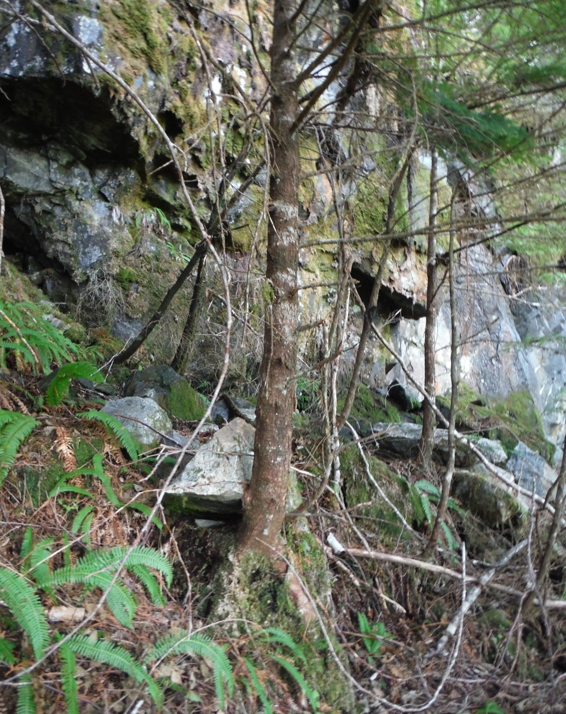
Soils and Terrain
Fractured bedrock with evidence of instability
Notes:
Cutslope failures adjacent to this site shortly after road contruction.
Bluff with overhangs, loose rocks below bluff indicating rock fall.
Also pistol butted trees on slope below bluff immediately above road.
Road heading was stopped after contract supervisor brought in geotech.
The whole slope below the bluff slid a few weeks later.
Road was continued below toe of slide.

Slide 36
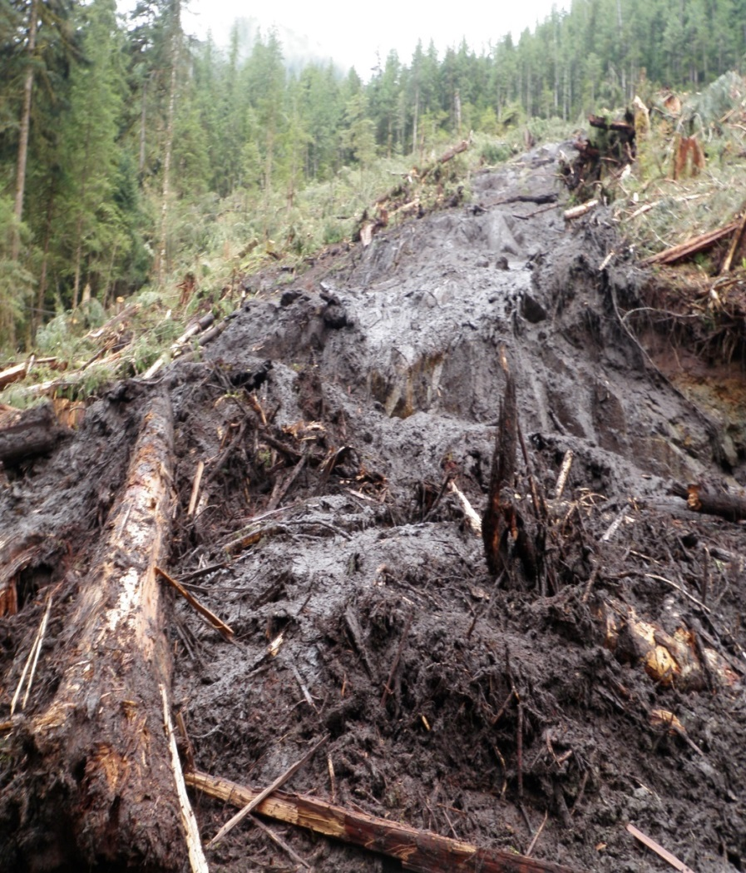
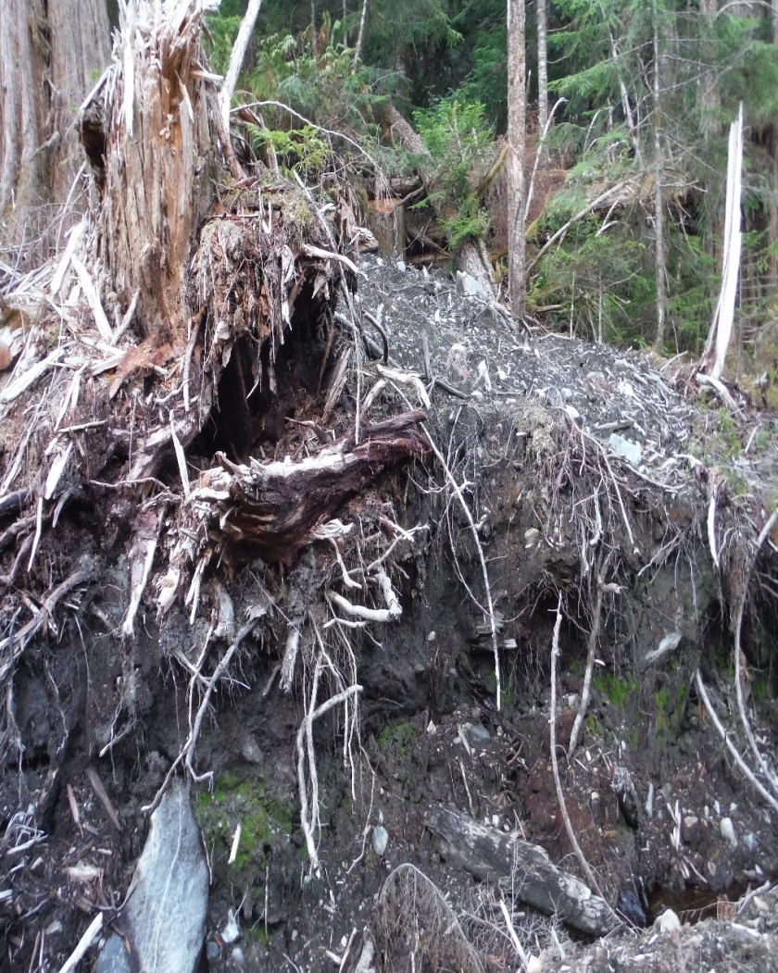
Soils and Terrain
Slides above road depositing organic material within new road prism
Notes:
Slide deposits off upper slopes can result in an unstable mass of organics + mud deposition within the road prism area.
These can be due to disturbance related to new road construction.
On the left, yarding down organic-rich (skunk cabbage pockets) on 40-60% slopes resulted in landslide.
On the right old landslide debris cut by main road.
Important to be aware of your surroundings especially old slide activity and any evidence of inherent slope instability both up and below road prism.

Slide 37
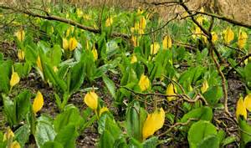
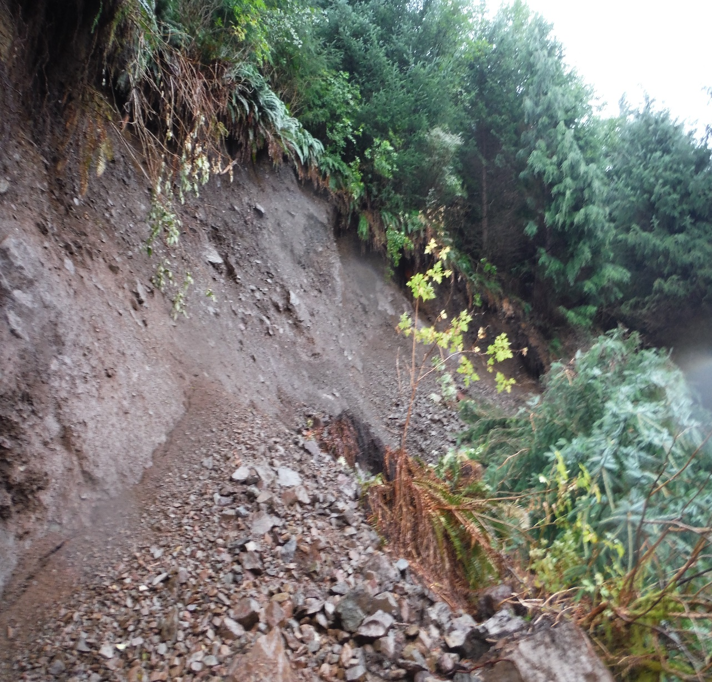
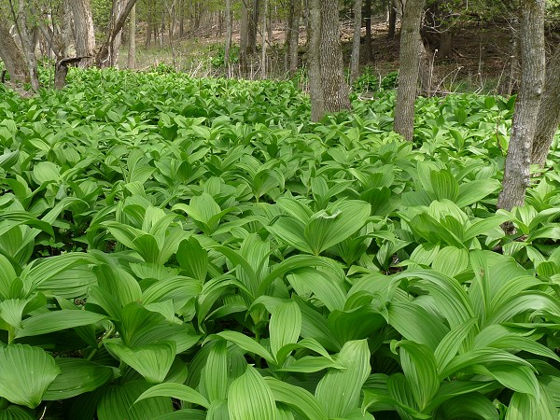
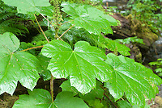
Soils and Terrain
Clockwise from top right: Skunk Cabbage; False Hellebore; Devils Club; cutslope failure with salmon berry & deer fern; All associated with seepage or imperfect drainage
Notes:
Common indicators of subsurface and overland water flow.
Typically associated with organic soils. Fern in open draws indicate water retention/accumulation areas.
These areas contain significant water/seepage and potential for slope instability.
If not noted on the plan, stop, reassess, ask questions and make suggestions.

Slide 38
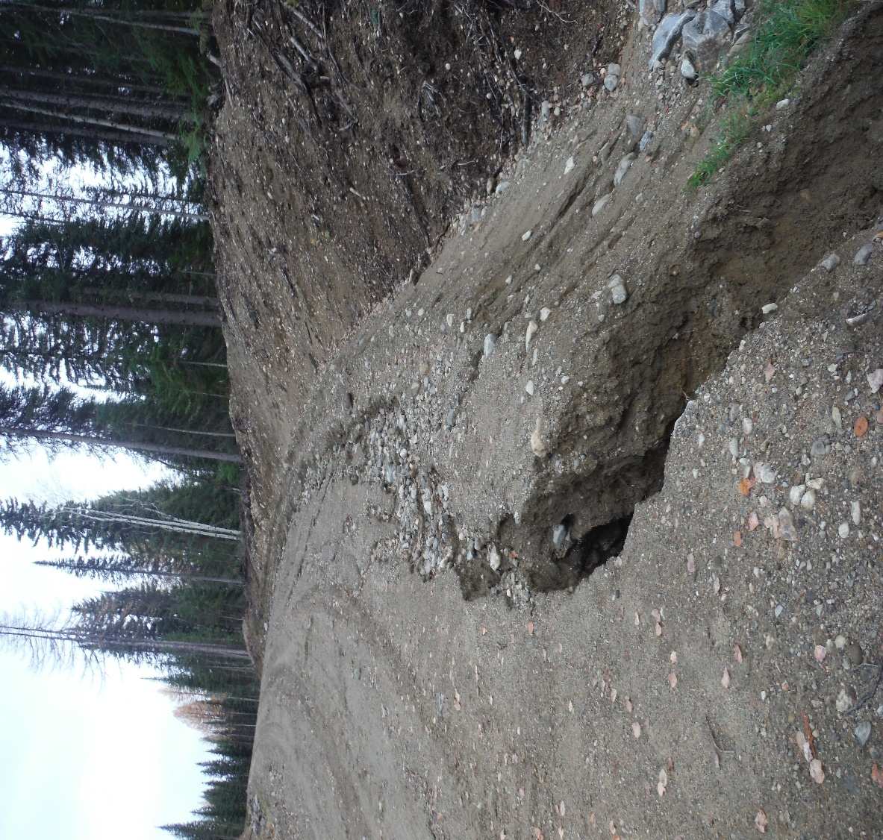
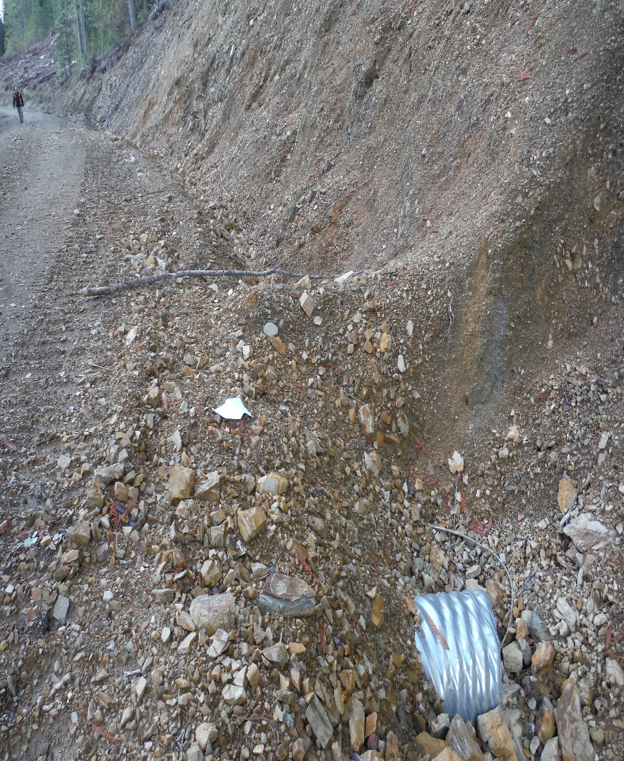
Drainage Control
Ditch Block
Too High??
Road Surface run-off
Resulting in Erosion of Fill
Maintaining natural drainage is critical.
Notes:
Maintaining proper drainage is critical in ensuring the road prism does not become saturated which can result in failure and construction initiated slide events.
This is particularly important on roads with adverse grades draining water to active excavation sites without proper cross-ditching.
Water running into active worksite due to adverse grades requires appropriate control measures, cross-ditching etc..
Use your experience and knowledge and skills in concert with the PLAN to ensure drainage patterns are maintained and drainage control is appropriate for the circumstances.

Slide 39
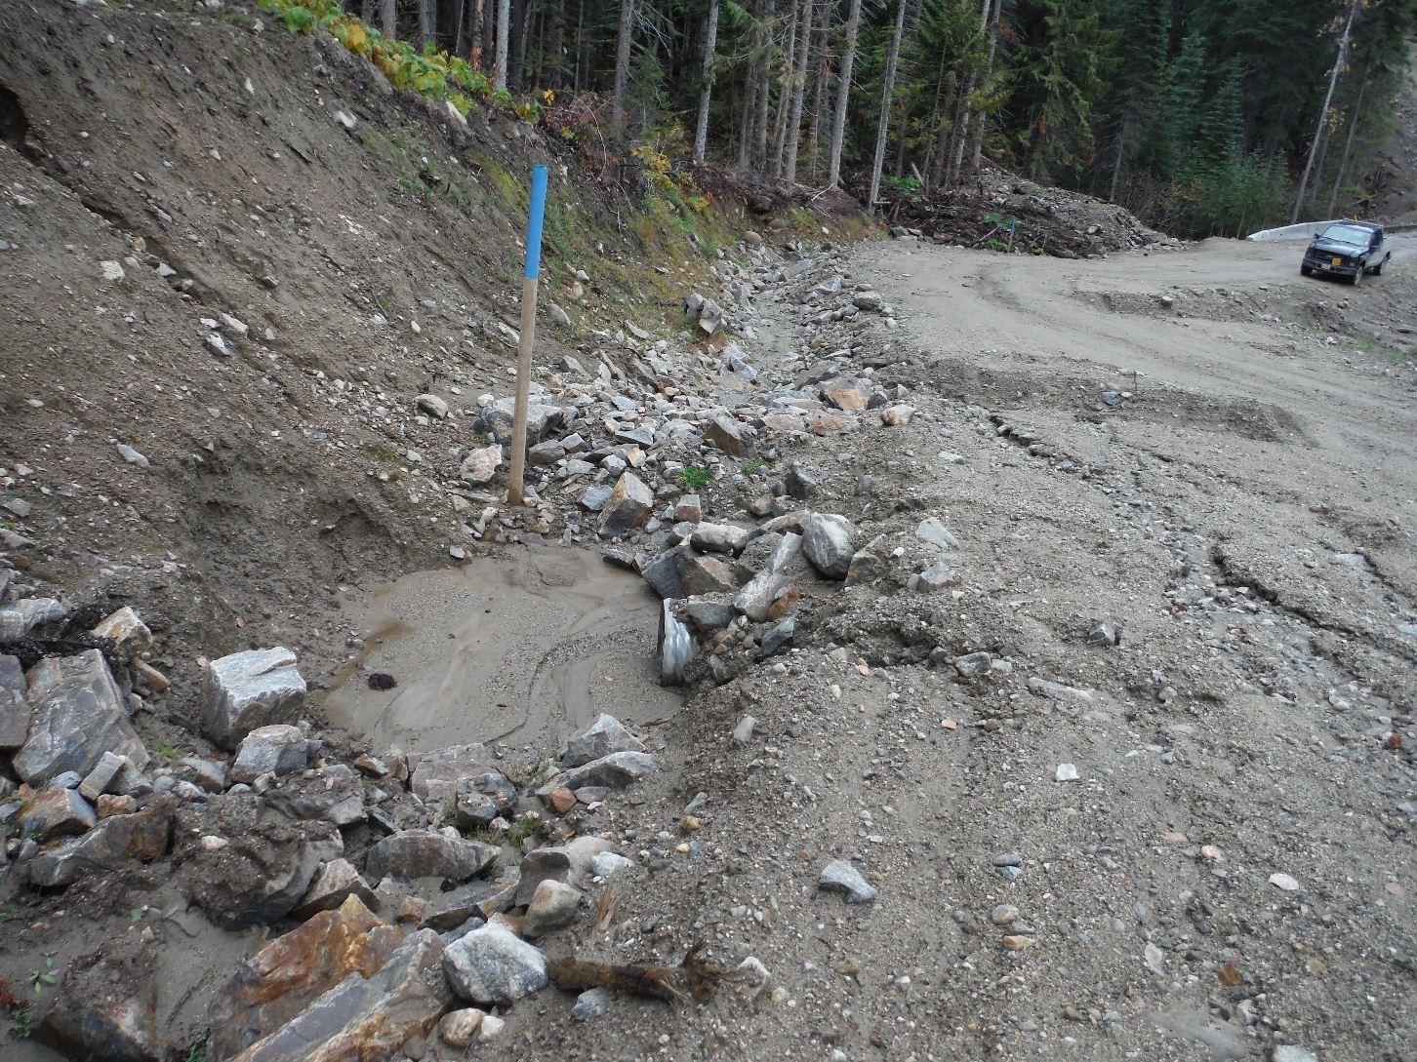
Drainage Control
Notes:
Road surface runoff eroding highly erodible sandy soils used as surfacing
Culvert intake sump could use more rock armouring

Slide 40
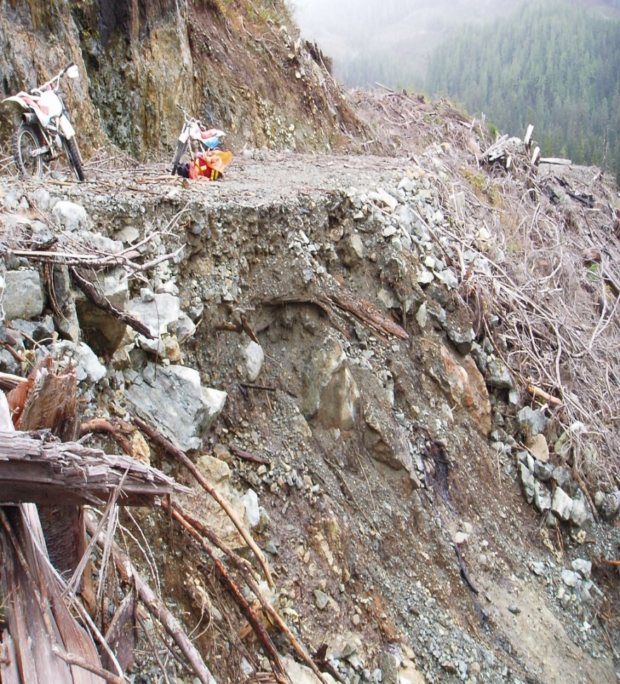
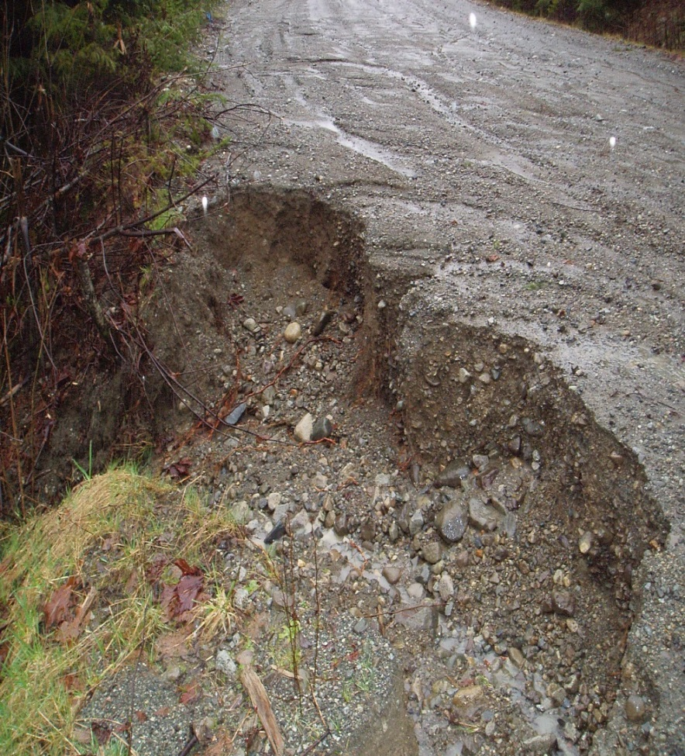
Drainage Control
Drainage Control
Fillslope failure on left; Fillslope erosion on right
Notes:
Is that woody debris in the subgrade…in steep terrain in the left photo?
This is a no-no in steep terrain.

Slide 41
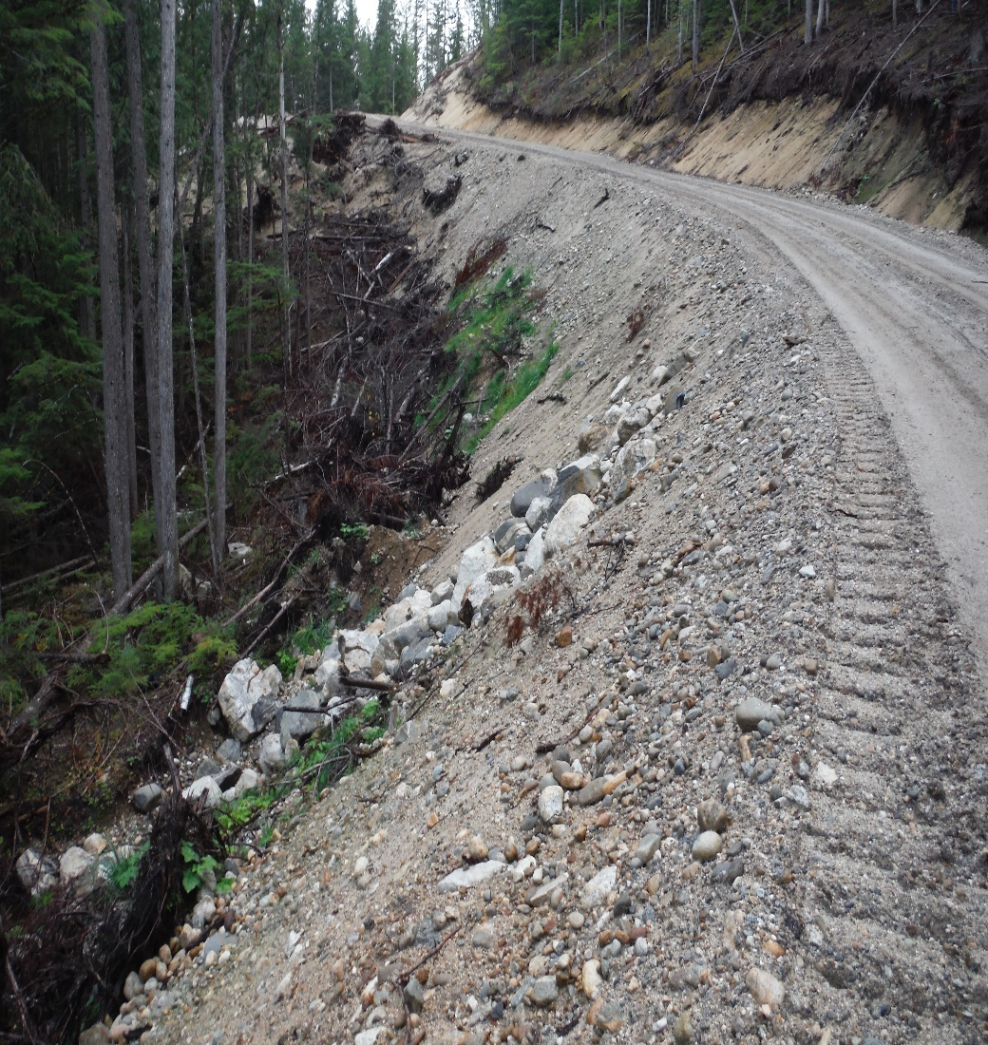
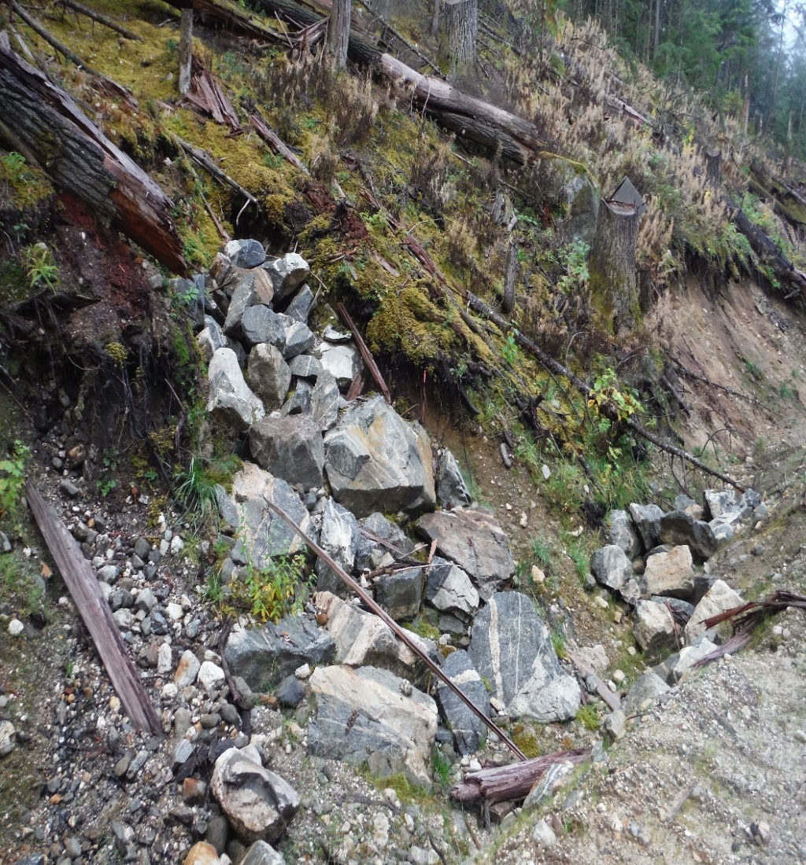
Drainage Control
Blocky material can be used for drainage as well as bank stability
Notes:
Maintaining proper drainage is critical in ensuring the road prism does not become saturated which can result in failure and construction initiated slide events.
Left photo shows effective armouring of culvert outlet.
Right photo shows rock blanketing of unstable cut slopes and ditchline armouring.
Both photos in highly erosive sandy sediments.

Slide 42
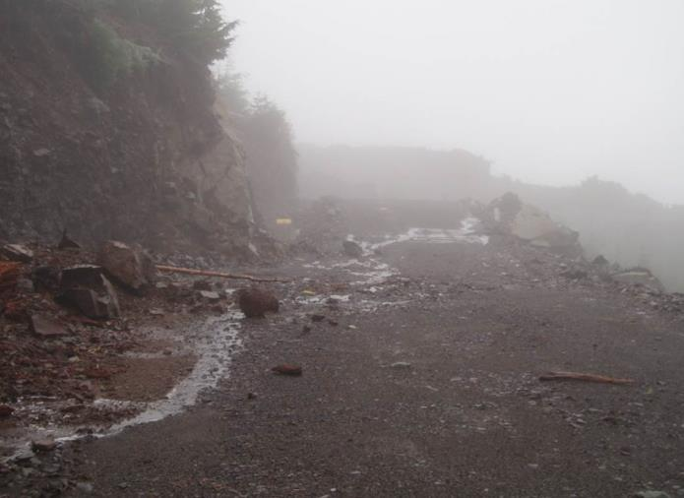
Drainage Control
Ensure that drainage works. Ditches, culverts, cross-ditches and waterbars must be fully functional at all times.
Notes:
Includes grade control on road surface
Methods such as in sloping road surface, crowning, rolling grades, proper culvert or cross-ditch placement, ditch blocks, intake sumps, armouring.
Lack of drainage control can lead to landslide events during and after construction activities.
Particularly during periods of high rainfall or rain-on-snow events.

Slide 43
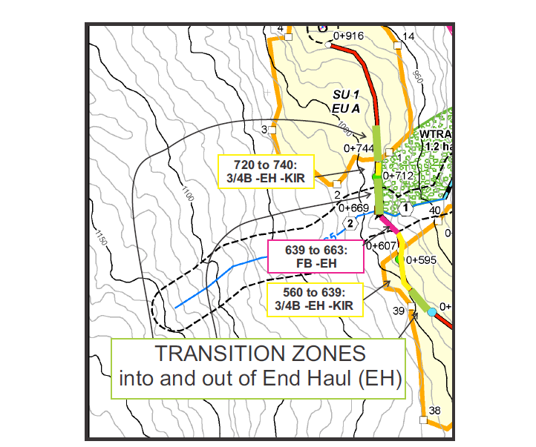
Construction
Road Design Map Indicating Transition Zone Locations
Notes:
Transition zones are a common area of slide initiation,
Particularly at the start and end of the end haul sections.
Start your transition so that you are on full bench by the start of the transition.
start early / end late.

Slide 44
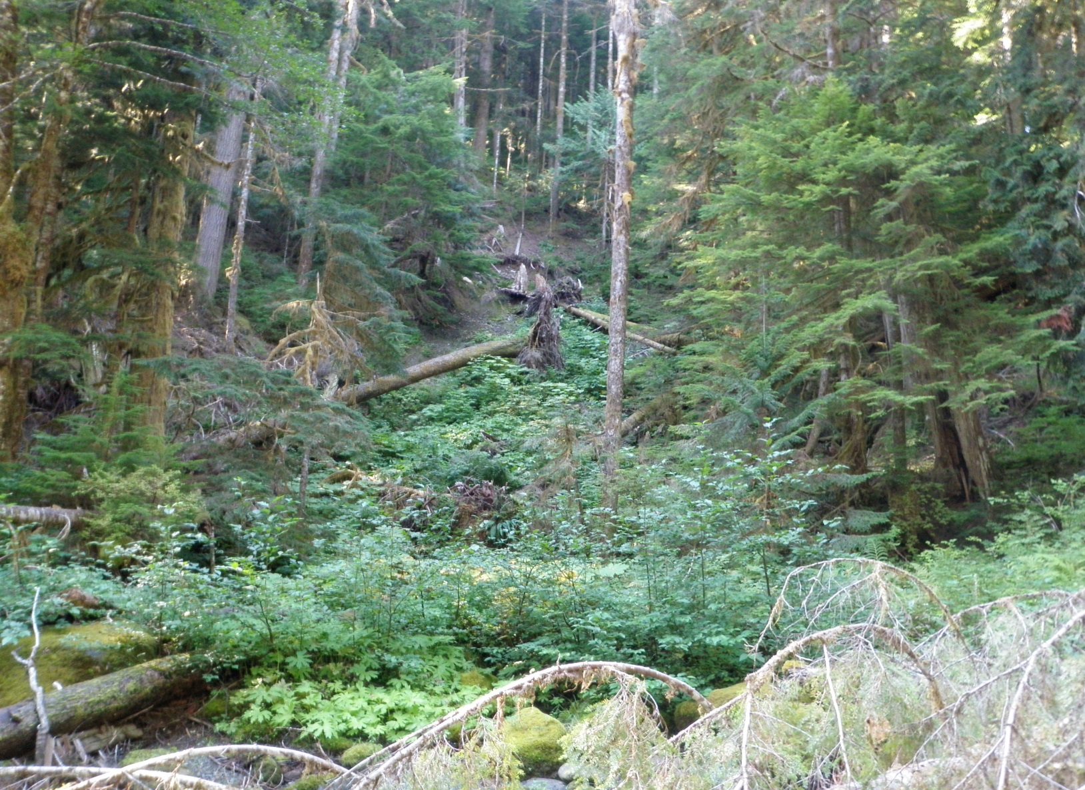
Water tends to concentrate in draw features between steeper bedrock sections (Transition Zones)
Construction
Failure Scarp
Notes:
Area of unstable soils within a gentle draw.
Indicators of overland and /or subsurface seepage is evident; plants (devil’s club in this case), organic soils, open stand, exposed mineral soils.
Raveling within excavation or below excavation can indicate slope instability.
Be aware of active ravelling.

Slide 45
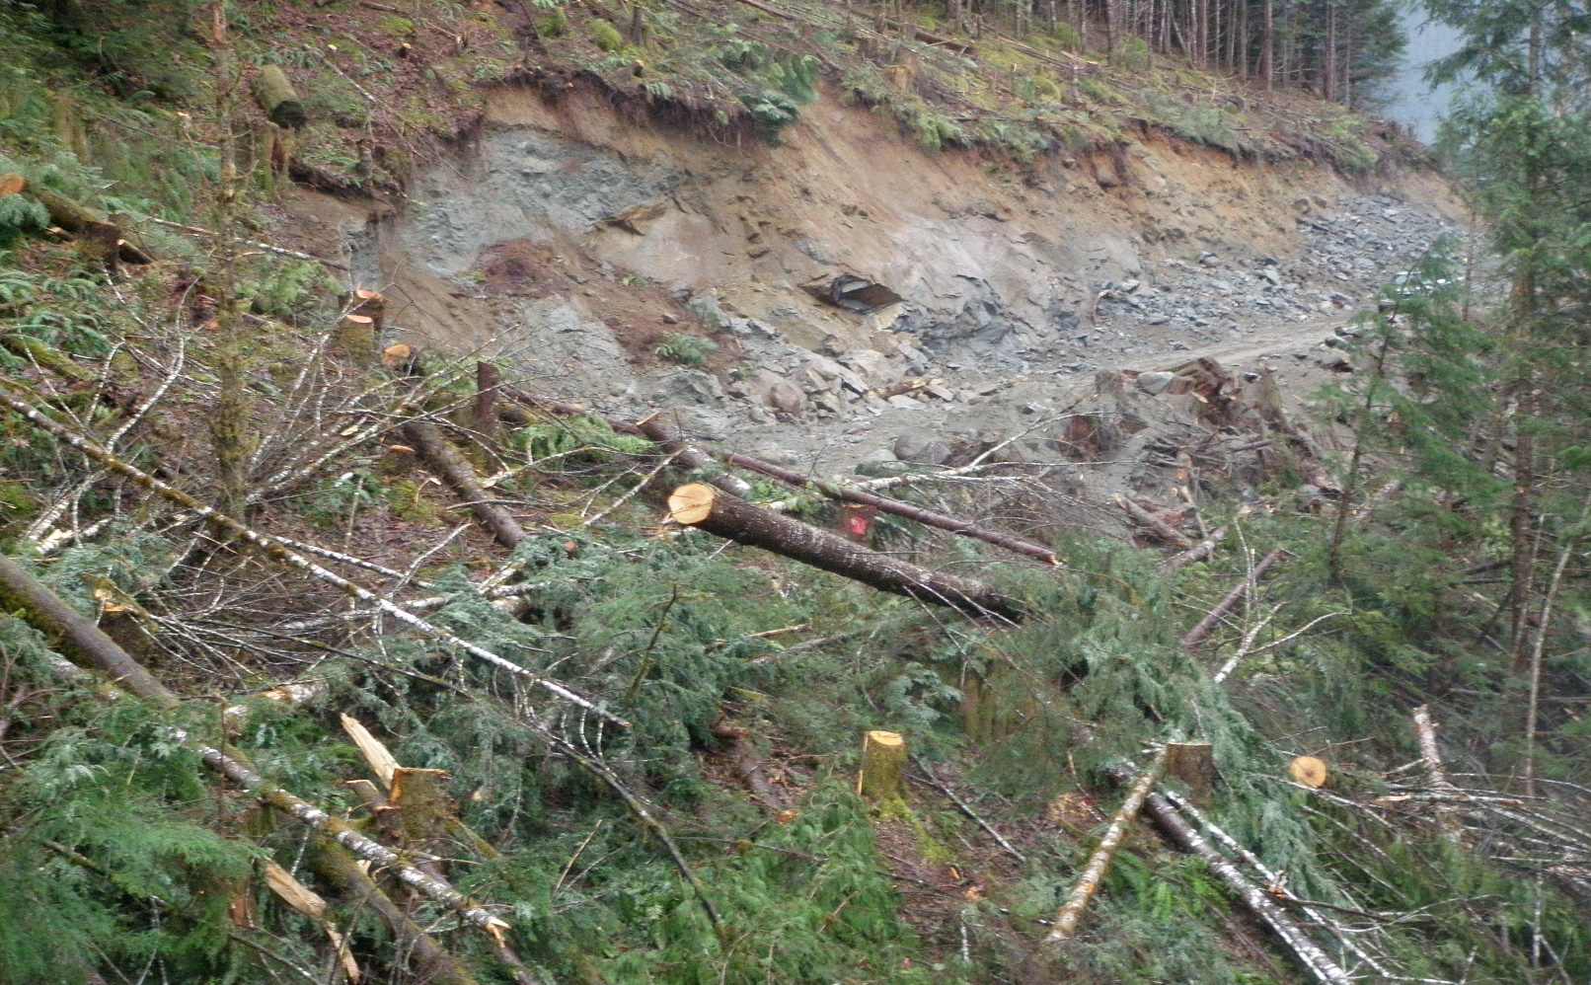
Construction
Failure Scarp
Many of the road construction-related slides on the coast have been in areas where the road stripping and subgrade construction is coming out of a full bench and end haul section with lots of rock

Slide 46

Construction
The operator becomes more relaxed and sees that better time can be made as the terrain begins to flatten out to what may look like “easy going”
Notes:
This is the transition zone which often can be the critical zone with regards to slide ignition.
Too late getting in to full bench and too early getting out.

Slide 47

Construction
Before
Notes:
Stopping construction slide through steep unstable gully sidewalls.
Cutslope seepage and ravelling over weathered bedrock; Temporary logs used to stabilize.
Fillslope failed.
All operations (construction, harvesting and hauling suspended).
Production pressure should not drive appropriate decisions.
Geotech brought in to develop plan.
In this case key in rock; Inslope road
Key-in only effective for ½ of section; Rock blanket remaining
Sufficient enough to allow safe passage for equipment and hauling.

Slide 48

Construction
After
Notes:
All operations (construction, harvesting and hauling suspended).
Production pressure should not drive appropriate decisions.
Geotech brought in to develop plan.
In this case key in rock; Inslope road
Key-in only effective for ½ of section; Rock blanket remaining
Sufficient enough to allow safe passage for equipment and hauling.

Slide 49

Construction
Danger can increase in these locations
Notes:
Transition zones can more hazardous as full bench areas.
Thicker soils and wetter ground.
Generally still above steep slopes, even though on bench.

Slide 50

Construction
Always be AWARE of your surroundings
Notes:
Watching for areas of seepage , organics, unstable material is critical.
Once noted appropriate action should be taken to ensure potential instability is mitigated.
Slow down, evaluate, stop, ask if required and if appropriate make suggestions.
Pioneering ahead in these circumstances is not an option.
Transition zones will vary in length depending on site conditions.

Slide 51

Construction
Transition Zone Slide
Notes:
Wet unstable material within transition zone.
Machine was transitioning out from area of bedrock.
These areas can be/appear dry on top and be wet underneath.

Slide 52

Construction
Clear road of stumps and debris and organics
Notes:
Trees above cut slope show signs of slope instability.
Machine needs to be sitting on stable material at all times.
Grubbing, stripping, and clearing of unsuitable material is critical.
Puncheon should not be used in transition zones even if on bench.
Puncheon should not be used in steep terrain.

Slide 53

Construction
Make sure that your Machine is on stable footing
Notes:
Remember, if the ground slopes away from the edge of the excavation at an angle >33%: You need to be on a stable footing.
If you create a slide, costs can be substantial and results potentially catastrophic.

Slide 54

Construction
Drilling & Blasting operations should be focused towards “controlling the blast”, particularly when road works are above steep slopes. Drill holes should be directional and stemming should be with adequate materials to control the blast.
Notes:
Drill and blast control is critical to minimize over blast and fly rocks.
Utilize powder suppliers as a resource for determining best approach/options for challenging ground.
For example: Seamy holes need to be loaded differently.

Slide 55

Construction
Notes:
Note steep fracture set in cutslope on left.
If excavation is >6m (20ft.) high and has no written instructions; STOP work and reassess site prior to continuing
Excavations are subject to vibrations, both drilling and blasting
Could add to build-up in hydrostatic pressures resulting in ground movement
Hazardous to workers

Slide 56

Construction
Notes:
Slope failure below steep >6m high bedrock cut
If excavation is >6m (20ft.) high and has no written instructions; STOP work and reassess site prior to continuing
Hazardous to workers

Slide 57


Construction
Overloading Outside Edges of Road
Notes:
Avoid decking right-of-way logs on outside edge of road above steep slopes.
Avoid piling blast rock or on outside edge of road above steep slopes.

Slide 58
Road Construction – Interaction
Road crews need to know where they are
Stations identifiable
Reference to plan
Changing conditions
Weather/rain
Terrain/ground
drainage
Notes:
If field identification is difficult or conditions change significantly, consult with road supervisor and resolve.

Slide 59

Construction
Always be AWARE of the RAINFALL situation. Rainfall Shutdown Guidelines must be followed.
Notes:
Rainfall monitoring is critical.
This must be done according to the rainfall monitoring guidelines, no exceptions.
Be conservative regarding rainfall.
Do not wait for the numbers to be met if things do not look or feel right.
Remember the 24, 48 and 72 hr limits (not just the 12).

Slide 60
Other things to consider:
Construction
Poor centerline alignment
Inadequate right-of-way falling
Smooth bedrock
Working in poor light conditions
Decking of Right-of-Way logs
Carry knowledge to Re-Construction of Old Roads
Carry knowledge to Road Deactivation
Notes:
Smooth bedrock should be blasted to create an irregular surface/platform to work on.
Visibility may be impaired during times of poor light conditions.
This can affect the ability to recognize indicators of potential slope instability.
Decking of right of way logs in areas of steep slopes and/or poor drainage increase the risk of slope failure.
Reconstruction of old roads can have increased risk given old cat construction and fill slope instability.
Geotechs have a key role in developing prescriptions that address specific site conditions.

Slide 61


Changing the Plan
Unidentified Conditions:
All changes to be discussed with the road construction team
Notes:
Plans and planning is often not perfect.
Unforeseen circumstances and/or conditions inevitably occur, which is why communication with the team is critical.
If changing conditions stop work and reassess.

Slide 62




Changing the Plan
All those involved with road planning, engineering and construction
play a critical role in ensuring safe and successful operations. It is the
expertise and experience of the team and how they interact which
determines the outcome.
Notes:
All those involved in the planning and construction process have expertise in their areas of responsibility.
It is this combined expertise and good communication that can make the difference between having a problematic or successful project.
Contractors/operators have unique skills and knowledge that are critical in ensuring the job gets done efficiently and safely.

Slide 63


The Cost
Not taking the appropriate action can have
substantial costs to the operation, the
environment and people on the ground.
Based on past events, it is estimated that
a single significant slide event can cost
from $180,000 to $500,000. Add in lost
harvesting opportunity and the costs can
easily double.
This is assuming that there no one is
seriously injured during the event.
If this is the case the cost will be much
higher.
Notes:
CIS type events continue to plague the industry.
Unless appropriate action is taken it will continue.
This will take a unified and comprehensive approach by all parties i.e. licensees, planners, professionals and contractors/operators.
However, based on your expertise and exposure, those most able to make immediate changes in this trend is “you” the construction contractor.

Slide 64

Let’s avoid situations . . .

Slide 65

Which none of us want to witness

Slide 66
Conclusion
CIS type events continue to plague the industry.
Unless appropriate action is taken it will continue.
This will take a unified and comprehensive approach by all parties i.e. licensees, planners, professionals and contractors.
However, based on your expertise and exposure, those most able to make immediate changes in this trend is “you” and your team.

